Slide 1
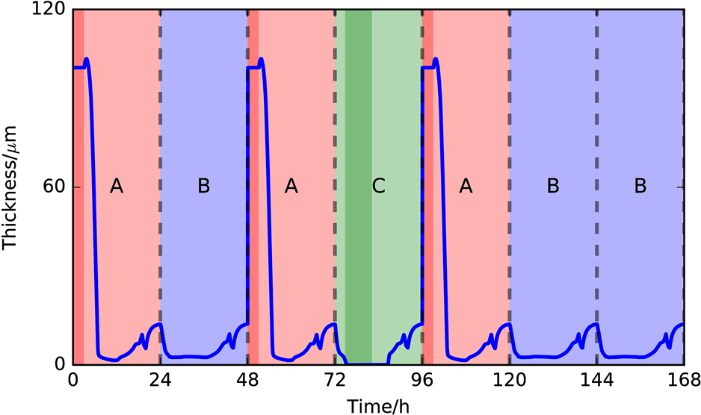
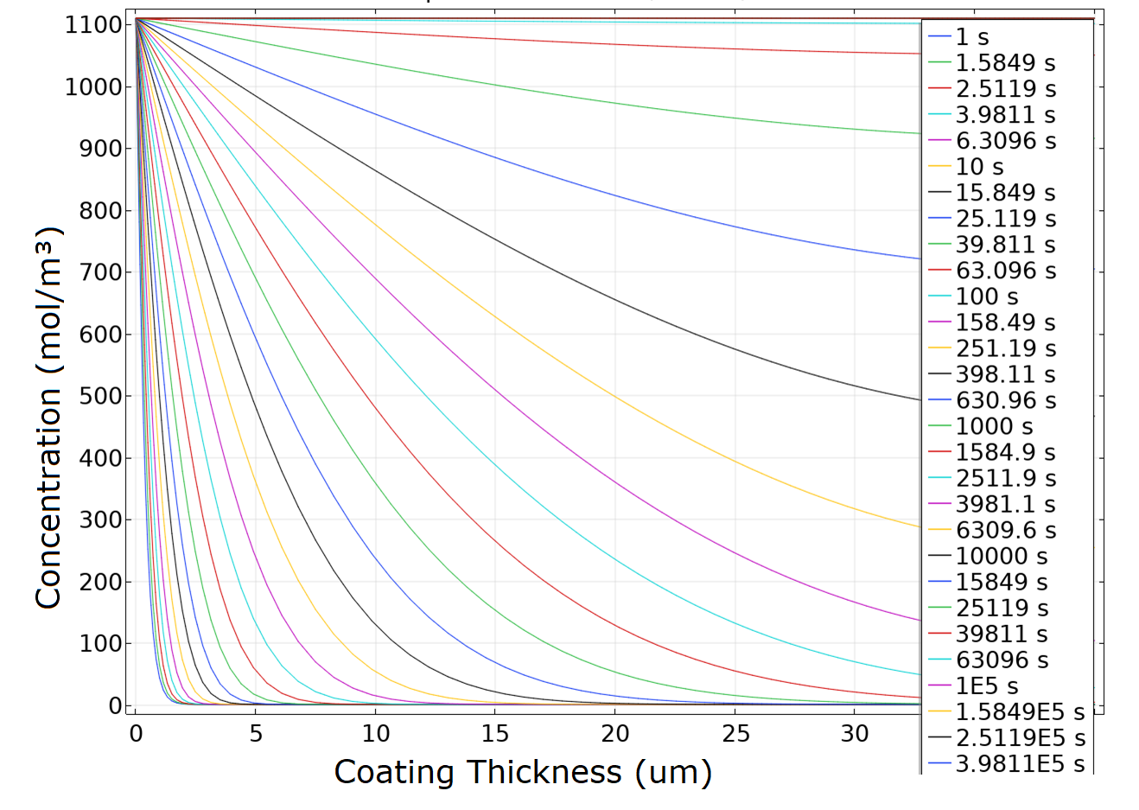
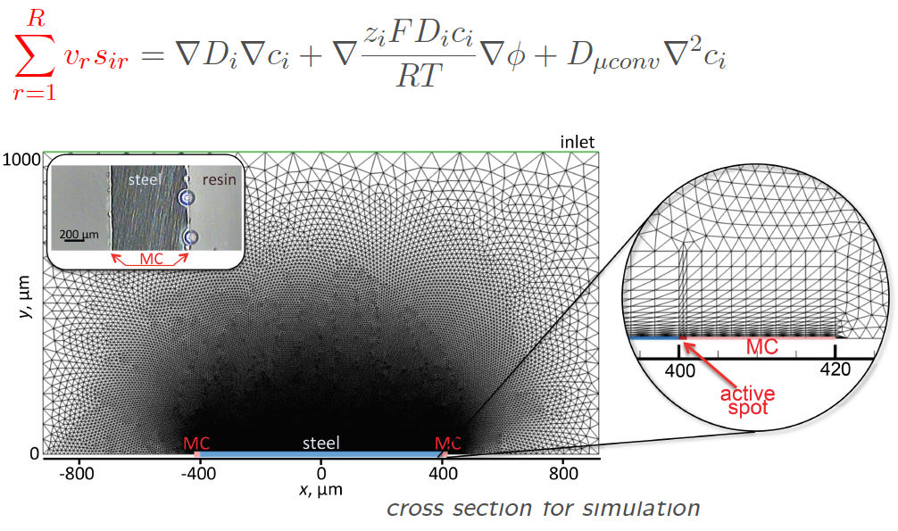
Simulation of ORGANIC COATED METALS UNDER LONG-TERM ENVIRONMENTAL CORROSION
AIR
δ ELECTROLYTE FILM
δ COATING
OXIDE
METAL

