Slide 1





Slide 2

Introduction
Marc-Henry Cornély
Ophaco

Slide 3
Program Overview
Introduction
10:00 | Reception
10:30 | Introduction by Marc-Henry Corneéy, Secretary-General of OPHACO
Migraine – Reducing a negative aura
10:35 | Karen Vanderwaeren, Senior Research Expert at GfK: “Revelation of research results: “Migraine in Belgium – Reducing the negative aura”.
10:55 11:15 | Dr. Jan Versijpt, Department of Neurology at UZ Jette. The symptoms and triggers of migraine Isolde Lasoen, testimonial - living with migraine
11:20 | Pharmacist Alain Chaspierre, Vice President of APB: ‘‘Week of migraine”
11:35 | Q&A
Interviews & migraine simulator
11:45 | Interview possibilities & migraine experience
 | Light lunch
13:30 | End

Slide 4

Karen Vanderwaeren
Senior Research Expert
GfK
Migraine in Belgium – a status
Research results

Slide 5



17%
of respondents have suffered from migraine
in the past 12 months
Notes:
Incidence

Slide 6

6 in 10
migraine sufferers
are embarrassed
to have migraine
1 in 4
think migraine is
not a
serious disease
Almost 4 in 10
migraine sufferers
are not aware
they suffered from migraine
in the past 12 months
1 in 3
hide their migraine
from colleagues
and their employer
Notes:
Problem

Slide 7

When suffering from migraine,
1 in 2 go home and
isolate themselves
37% do not stop their activity, but adapt their schedule
More than 6 in 10 indicate migraine has a negative impact on their family/social life
13% change nothing
Notes:
Impact on family/social life

Slide 8
6 in 10 indicate migraine has a negative impact on their professional life
1 in 4 have indicated their employers know about their migraine
1 in 3 have indicated their colleagues know about their migraine
1 in 3 hide their migraine from colleagues and their employer
Notes:
Impact on professional life

Slide 9
6 in 10 indicate migraine has a negative impact on their professional life
1 in 3 migraine sufferers find that there is misunderstanding at work
50% of migraine sufferers believe that the disease is negatively regarded by others
Notes:
Impact on professional life

Slide 10
45% of migraine patients look for information about symptoms. 58% of the triggers
SYMPTOMS
Sensitivity
to Light 84%
Sensitivity
to Sound 73%
Tiredness 71%
Pain on one side
of the head 62%
Nausea or Vomiting 59%
TRIGGERS
Emotional Causes
44%
Tiredness
35%
Hormonal Causes
25%
Lack of Sleep
23%
Certain Nutrition
11%
Notes:
Information

Slide 11
Dr. Jan Versijpt
Department of Neurology
UZ Brussels
Migraine
Symptoms and triggers

Slide 12
Definition
DEFINITION MIGRAINE
> criteria IHS:
At least 5 attacks fulfilling criteria B-D
Headache attacks lasting 4-72 hours (untreated or unsuccessfully treated)
Headache has at least two of the following characteristics:
      Unilateral location
      Pulsating quality
      Moderate or severe pain intensity
      Aggravation by or causing avoidance of routine physical activity
      (e.g. walking or climbing stairs)
D. During headache at least one of the following characteristics:
    Nausea and/or vomiting
    Photophobia and phonophobia
E. Not attributed to another disorder

Slide 13
Progress
20-60%
15-20%
I
III
I
II
II
III
Normal
Prodromal phase
fatigue (72%), concentration difficulties (51%),
neck pain (50%), mood changes,
food craving, yawning,
intolerance to light and sound, fluid retention
Aura
visual
unilateral tingling (> hand)
speech problems
2-48h
10-60’
<1h between III&IV

Slide 14


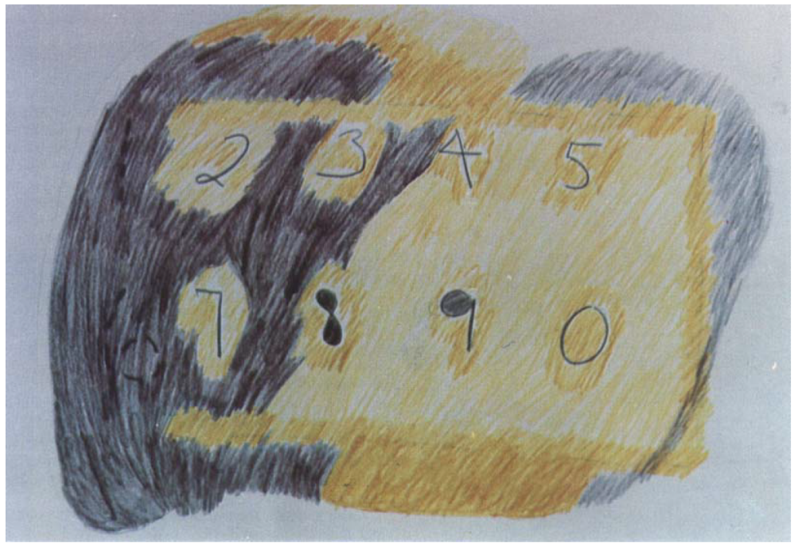


Slide 16
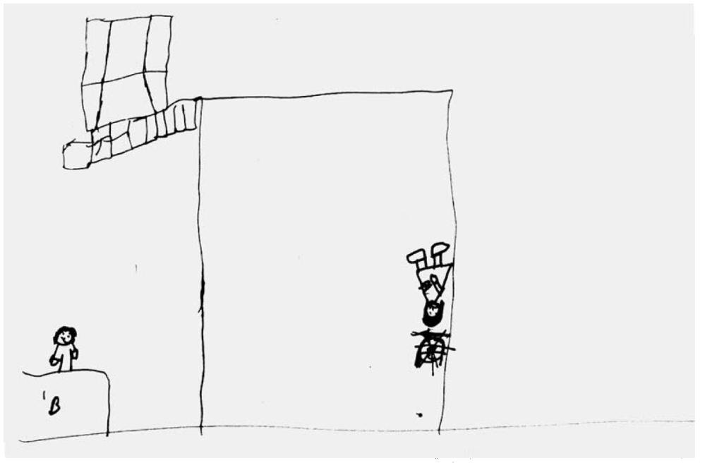

Slide 17
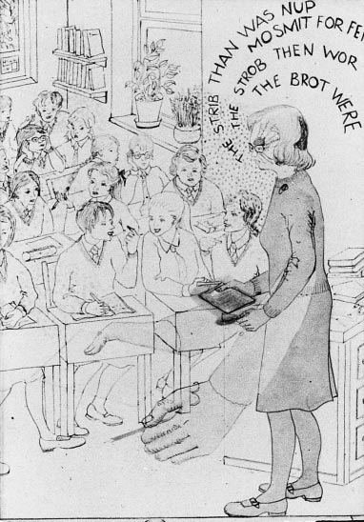

Slide 18

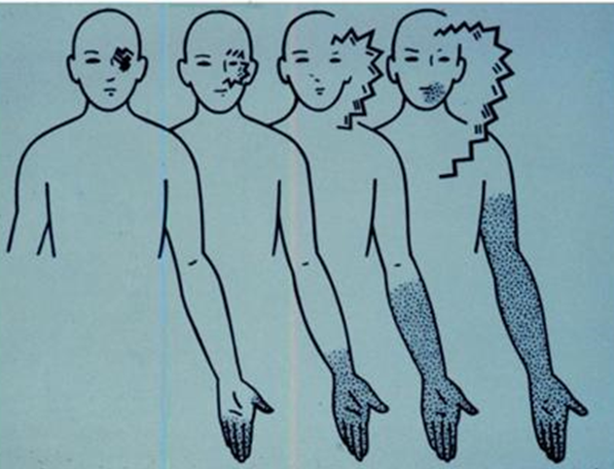

Slide 19
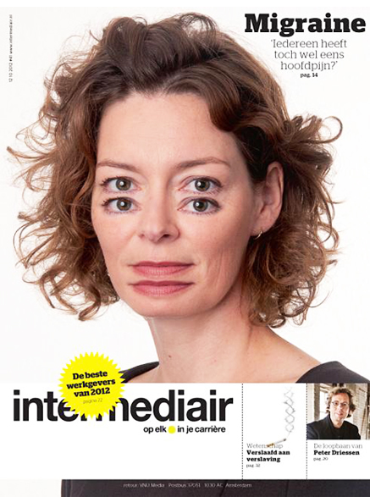

Slide 20
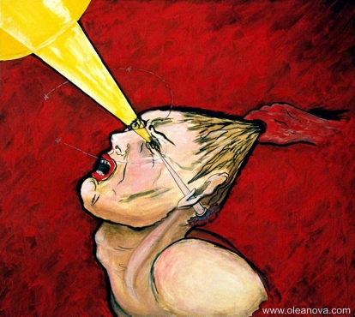
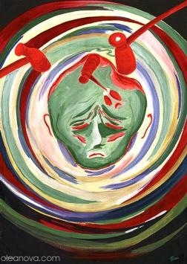
20-60%
15-20%
I
II
III
IV
V
VI
V
VI
Recovery phase
vomiting
deep sleep
mood changes
anorexia
↑ urine production
Normal
10-60’
<1h between III&IV
1-48h
2-48h
4-72h

Slide 21
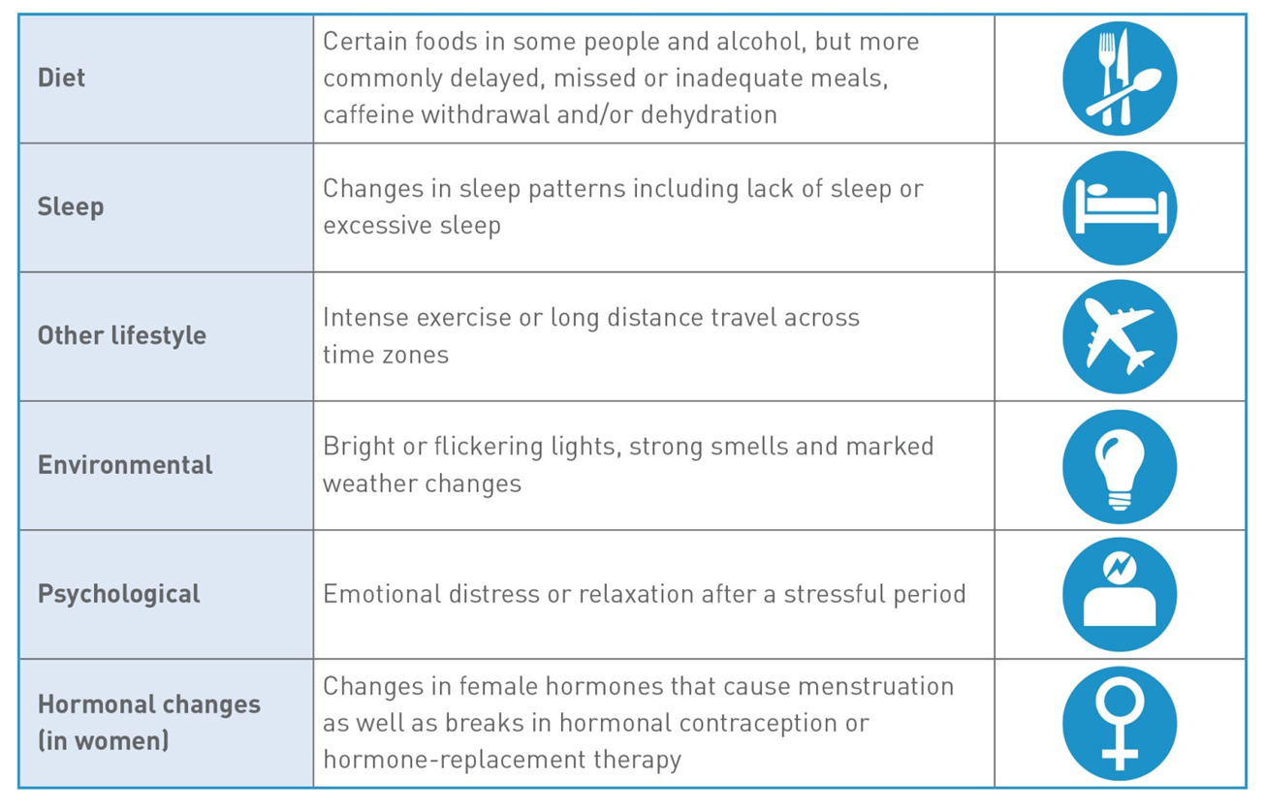

Slide 22
Isolde Lasoen
Testimonial

Slide 23
Alain Chaspierre
Secretary-General of APB
General Pharmacist Association
The Week of Migraine

Slide 24
Community pharmacy
5000 community pharmacies in Belgium
Easily accessible health care provider. 24/24 – 7/7
500.000 patients/day
Some core activities:
  Medicines dispensing (prescription only & prescription free)
  Responsable use of medicines (medication safety)
  Patient counseling (pharmaceutical care)
    Prevention
    Referring
  Collaboration with Medical Doctors

Slide 25
Pharmaceutical care for migraine patients
  Identify & address possible Drug-Related Problems (dosage, contra-indication, side-effects, interactions, overuse - Medication Overuse Headache -, underuse, etc.)
  Provide lifestyle advice (nutrition, prophylaxis)
  Instruct on how to use medication
  Non-specific migraine medication
  Specific migraine medication
  Prophylactic medication
  Physician referral

Slide 26
Facts
Almost 1/5 of all Belgians suffered from migraine during the past 12 months (17%)
Migraine ≠ Headache
Migraine is surrounded by a negative aura
Pharmacists can play a key role
Specific health campaign for pharmacists, migraine sufferers and the general public:
“Semaine de la MIGRAINE” / “Week van de MIGRAINE”

Slide 27
Objectives
Reduce the negative aura around migraine by
  Stimulating patients, pharmacists and the general public to talk about migraine with their family, friends and colleagues
  AND
  Informing them in an easy and accesible way about the symptoms and triggers of migraine
  By
  Providing tools and information around migraine in the pharmacies
  Supporting the role of the pharmacist as a primary point of contact

Slide 28
CAMPAIGN MATERIALS

Slide 29
Campaign Materials
Informative leaflet for pharmacists with migraine test
Notes:
Liste des caractéristiques des différents types de céphalée primaire
Test de migraine : le pharmacien peut effectuer le test avec le patient et lui donner une premère indication s’il souffre de migraine ou d’un autre type de céphalée.

Slide 30
Campaign Materials
Brochure
Notes:
Brochure destinée au patient

Slide 31
Campaign Materials
Migraine diary
Notes:
Le pharmacien peut remettre au patient un journal de la migraine où consigner, pendant plusieurs mois successifs, le déroulement des crises de migraine et de céphalée.
Le journal de la migraine donne au patient un aperçu plus clair de la fréquence et de la sévérité des crises. Des schémas peuvent alors être établis.
Le patient peut présenter son journal lors de sa prochaine visite chez le pharmacien, le médecin ou le spécialiste.
Les professionnels de la santé disposent ainsi d’un document clair qui peut les aider à poser un diagnostic, à identifier les déclencheurs et à choisir un traitement.

Slide 32
Campaign Materials
Poster

Slide 33
Take home message
When a patient turns to his pharmacist with headache-related questions, the pharmacist can and should counsel the patient and/or refer to a medical doctor.
On the occasion of the Migraine Week, pharmacists are offered all the appropriate tools in support of this counselling role.

Slide 34
Q&A

