Slide 1
Facts and figures about cancer in Belgium
Brussels, Federal Parliament, 2nd of July 2015
Dr. Liesbet Van Eycken

Slide 2
Résumé
Introduction
Flux de données et sources
Incidence/Mortalité/Survie/Prévalence
Conclusion

Slide 3

Data flow
Registre du Cancer: flux de données et sources
Programmes de soins de base
et d’oncologie
Lab. pathologie
Fichier + protocoles
COM + données suppl (e.g. rectum, oropharynx, prostate, endomètre,… )
Organismes Assureurs
IMA-AIM
+ procédures diagnostiques et thérapeutiques + médicaments (5 ans)
Cert. Décès
Registre du Cancer
RegistreNational
Statut vital/ décès/

Slide 4
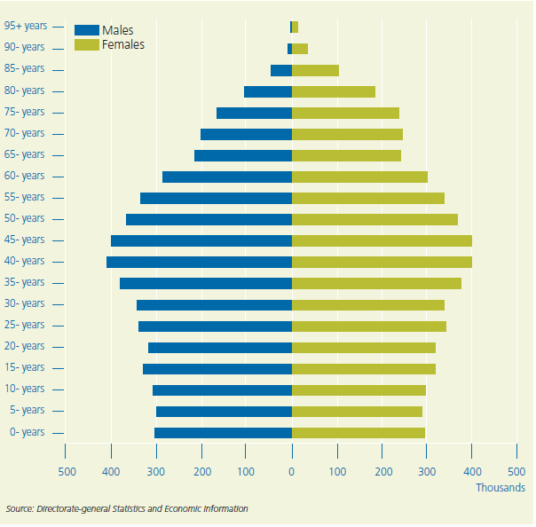
Cancer Burden
Cancer Incidence:
first diagnosis /treatment
Belgian population (11Mio)

Slide 5
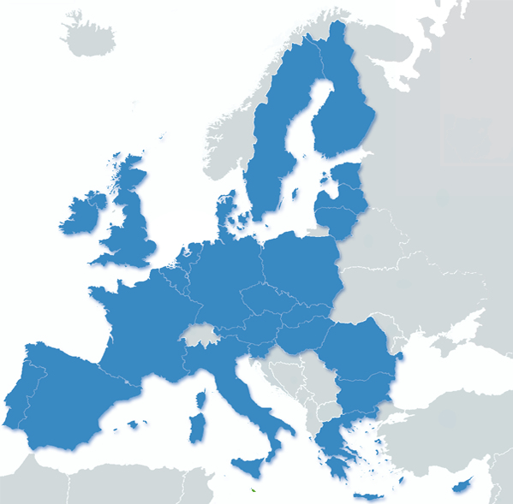




Incidence de cancer en Belgique
65,269 nouveaux diagnostics en 2012 (excl. non melanoma skin cancer)
  34.774
  30.495

Slide 6
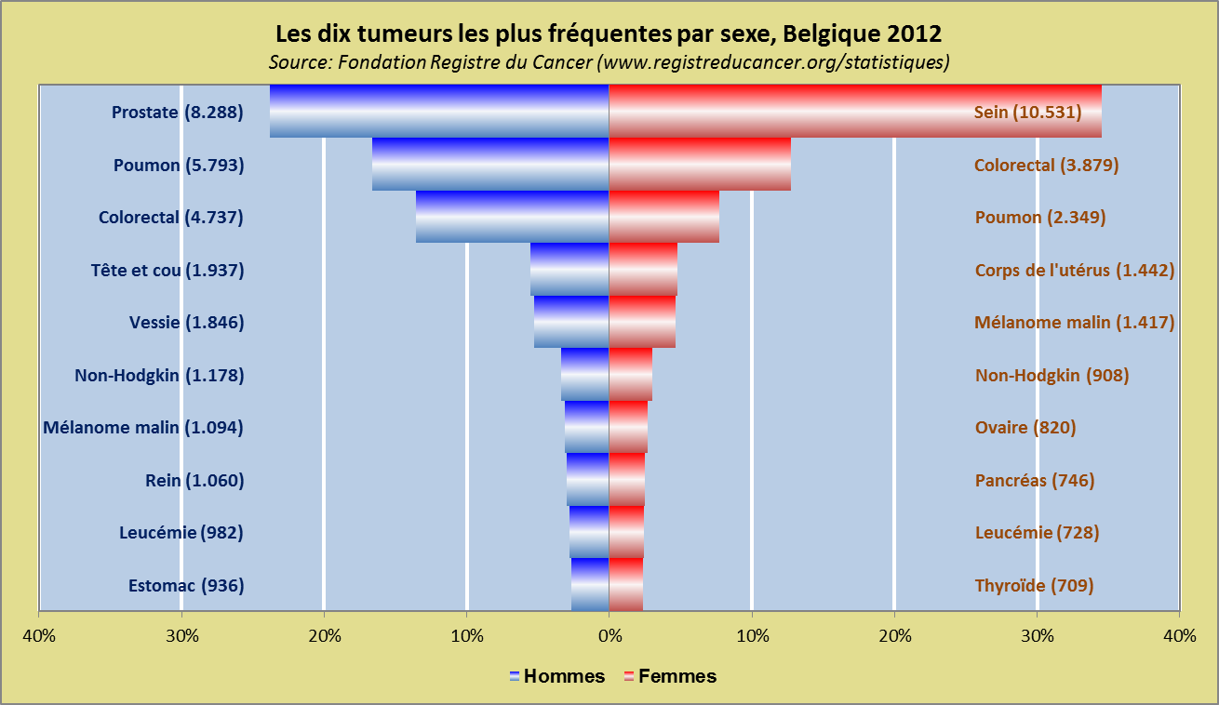

Slide 7
Cancer Burden
Cancer Incidence: first D/ R/
Belgian population (11Mio)
Population growth and ageing
Early diagnosis
Screening activities
Changing risk factors
?

Slide 8
Trends 2004-2012: Incidence is increasing…

Slide 9
Trends 2004-2012

Slide 10
Trends 2004-2012: lung cancer

Slide 11
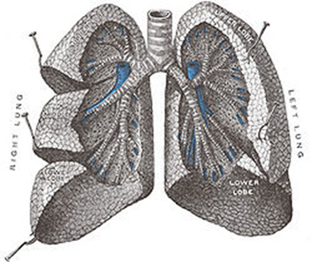
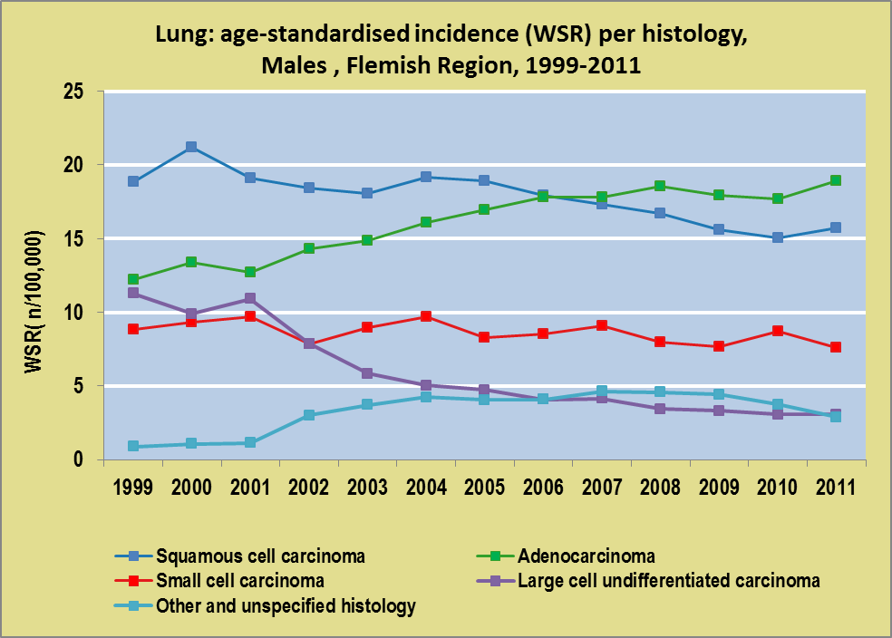
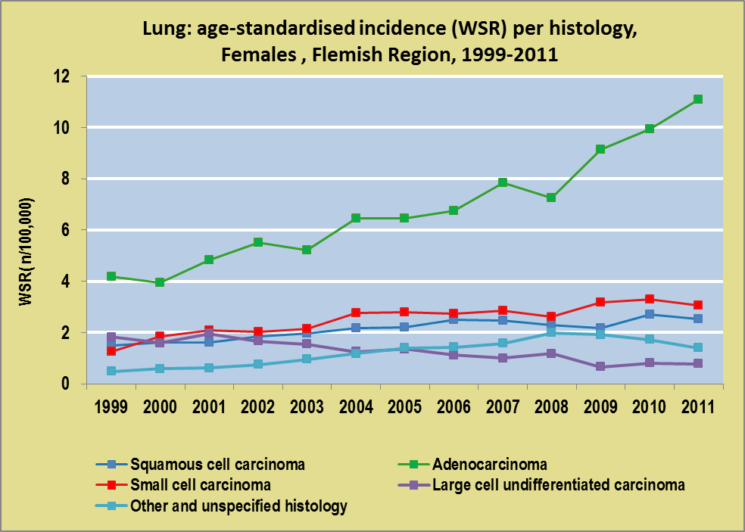
Lung cancer by histology

Slide 12
Mapping tumours related to alcohol and smoking
Oral Cavity
Pharynx
Liver
Orofarynx
Hypofarynx

Slide 13
Mapping tumours related to alcohol and smoking
Oral cavity
Pharynx
Liver
Cholangio CA
Mortaliteit CLD
Hepatocellulair CA

Slide 14
Cancer in the elderly
=> 2025 increase of new diagnoses 65+ => 48,000 (due to ageing)
=> 2040 more than 60,000 65+ new diagnoses

Slide 15
Burden of cancer
Incidence
Mortality
Population
Survival

Slide 16
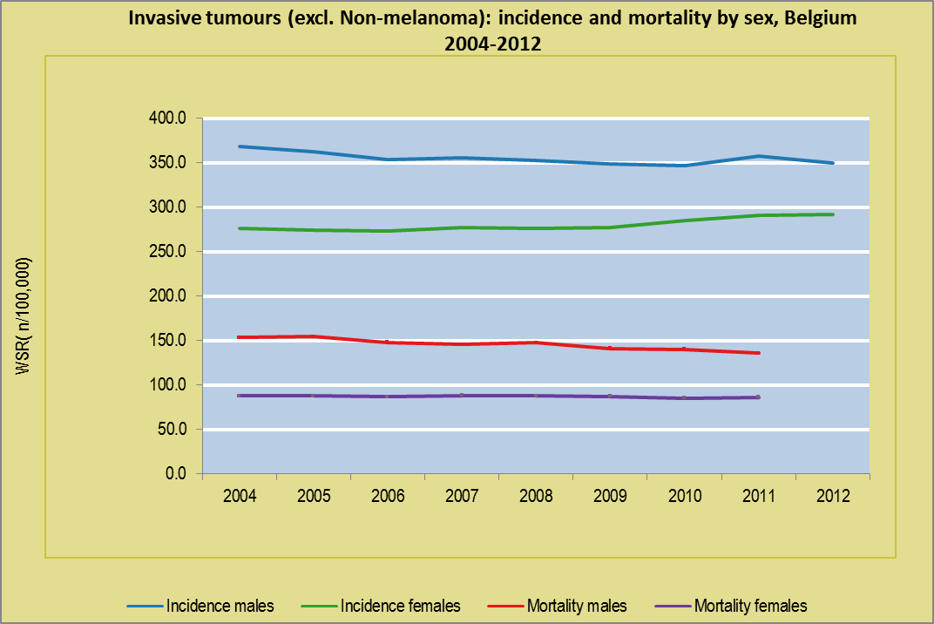

Slide 17
Survival
    Decreases in females
    Stable in males
    ➔ prostate cancer
Survival decreases in young adults
  Males >> Females
Children & adolescents
  Very low incidence
  Very good prognosis
Increasing incidence Males >> Females
Incidence young adults
  Females >> Males
65+:
Highest incidence
  Worst prognosis

Slide 18
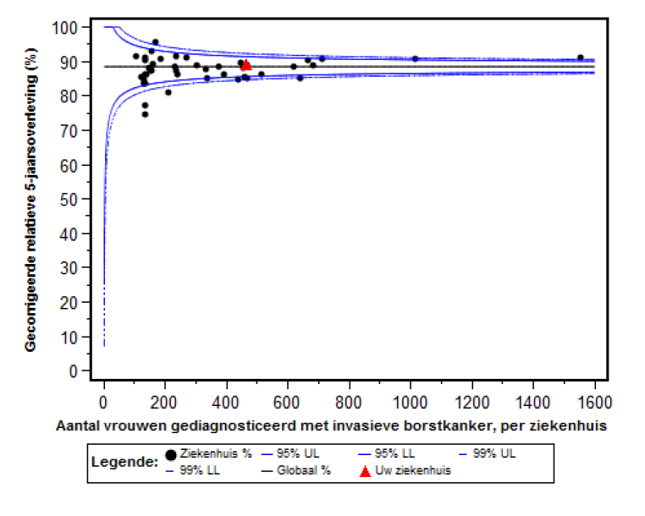

Breast cancer: 5-year relative survival, adjusted for age and stage, Flemish hospitals, 2009-2011
Min. 100 pts

Slide 19
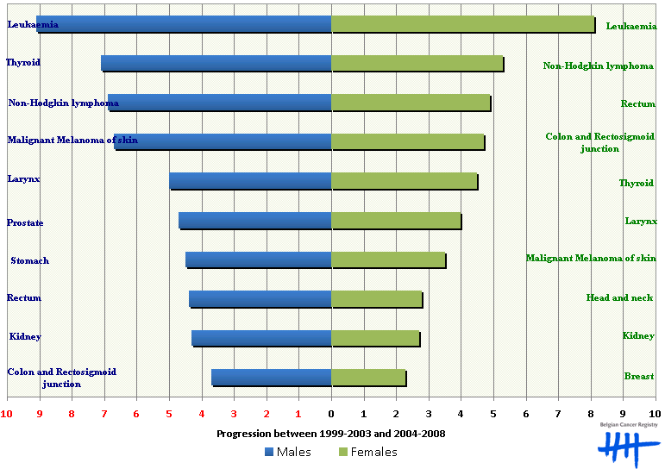
Survival improvement between
1999-2003 and 2004-2008, Flanders

Slide 20
Burden of cancer
Incidence
Mortality
Population
Survival
20-y Prevalence: Follow-up/Chronic care
4% (Be)

Slide 21
Conclusion
Chaque année: >65.000 nouveaux diagnostics
  Nombres
  Cancers: > 50%
    Sein
    Prostate
    Colorectal
Mortalité: Risque nombres
Survie

Slide 22




Thank you for your attention!
www.kankerregister.org/Statistieken_publicaties

Slide 23








Finances BCR
Protocolakkoord - Protocole d’accord, as from 2014
Project funding

Slide 24
Cancer registration: data set
Date of incidence and basis of diagnosis
Topography ICD-O3
"Morphology and behaviour ICD-O3 “Annexe 55”
Differentiation grade
clinical TNM and (y)pathological TNM
Overview treatment (given and planned)
WHO performance score
Pathology: All cancers + All specimens of breast, colorectal, cervix
Mortality: causes of death
Nomenclature: diagnostic and therapeutic procedures, drugs
No specific data on recurrence/progression
Under construction: comorbidity, geocode, SES
+ clinically relevant data sets for selected subjects

