Slide 1
STADA Group Health Report “The Future of Health”
Belgium
Prepared for STADA: Jörg Elfes, Melanie Aulmich
By: Kantar Health Division: Sandy Popko, Manuela Sievers, Ilka Oswald, Franziska Bozic
April 2020
316401193

Slide 2
Contents
Study Design 03
Summary 04
Study results - Belgium
Opening Questions/Future of Health 08
1 Digitalised Medicine 12
2 Immunities 17
3 Dying 23
4 Innovation 28
5 Everyday Illnesses 33
6 Sexuality & Health 39
Local Question 45
Demographics 49
BEL

Slide 3
Study Design
Methodology: Online Interviews
Interview length:
Approx. 20 min
Country: Belgium
Field: March 2020
Target group / sample size
n=2.010 Interviews Population aged 18+ years, representative according to the criteria of age (in groups: 18-34, 35-49, 50-99), gender and region
Content of questionnaire:
Under the core topic “The future of health", the questionnaire was divided into six subjects:
1: Digitalised Medicine
2: Immunities
3: Dying
4: Innovation
5: Everyday Illnesses
6: Sexuality & Health
BEL

Slide 4
Summary (1 of 4)
The Future of Health
The vast majority of the general population is satisfied with the healthcare system in Belgium.
People generally trust in conventional medicine while significantly more men trust wholeheartedly.
Being treated by webcam or internet is an option for the respondents, for 40% it depends on the condition.
Digitalised Medicine
About one third knows that in Belgium online pharmacies may only offer over the counter medicines.
Due to safety reasons people feel confident if the stationary pharmacy carries out medicine.
People are interested in using apps to save time and to keep an eye of their health levels and and being able to send relevant health data to their doc anytime.
Most frequent data the respondents would like to be digitalised are appointment reminders, doctor’s letter, the certificate of vaccination and sick notes.
BEL

Slide 5
Summary (2 of 4)
Immunities
38% of the respondents are aware that antibiotics are used to combat bacteria only. The fear of antibiotic-resistant germs seems to be an important topic for a majority.
Rather high awareness about the possibility to vaccinate against measles and hepatitis A/B, while awareness about chickenpox and HPV is only moderately high.
Belgium population approve compulsory vaccinations but only half of respondents know when they checked their Certificate of Vaccination the last time.
Dying
One third only knows the correct definition of ‘Assisted Suicide’
Nearly half of the respondents is aware of heart attack being responsible for the majority of casualties in Europe.
It is common to talk about death with their families in Belgium. This applies especially to women.
About three quarters could imagine availing themselves of Assisted Suicide, mostly to avoid constant agony.
BEL

Slide 6
Summary (3 of 4)
Innovation
In general, there is a low level of awareness of the genetic predisposition of diseases. About half are aware of the genetic predisposition of breast cancer and cardiovascular diseases.
Eternal life is being regarded as hocus pocus by 41%, another 35% would not want to live eternally even if it was possible.
Taking a polypill every day to prevent possible age-related conditions is for half of the respondents imaginable.
Half of the respondents would consider changing their genes, though among those, half of them would feel uneasy messing with their genes.
Everyday Illnesses
When asked about possible causes for insomnia, stress, depression and jet lag/shift are most frequently mentioned. Alcohol is only mentioned by half of the respondents.
Effect of beer on antibiotics is well known. But almost nobody knows that all three substances - beer, citric juices and milk - can impair the effect of antibiotics.
Generally, there is a low willingness to consider sleeping pills with about one third being afraid of becoming addicted to it.
People go to work even when they are suffering a cold.
Package leaflet and asking the doctor are the most frequently used sources of information on medication intake.
BEL

Slide 7
Summary (4 of 4)
Sexuality & Health
The majority knows that sex can promote healthier sleep, less know about the prevention of heart disease and obesity.
Only about one quarter is aware that kissing can cause sexually transmitted diseases.
Frequency of sexual intercourse is the most frequently discussed topic, followed by contraception and lack of sexual desire. 40% do not talk about sex topics.
A cold does not keep away the majority from being intimate with each other.
Slightly more than half of the respondents have never been tested for sexual transmitted diseases. Most of them do not think it is necessary.
Local Questions
Most people are worried about the long-term affordability of healthcare.
Half of the respondents (50%) are aware that antibiotics kill bad and good bacteria. 43% are aware that antibiotics weaken the immune system.
Also half of the respondents states the correct answer that most people having vitamin D deficiency after the winter period.
BEL

Slide 8
Opening Questions/
Future of Health

Slide 9
In general high level of satisfaction with the Belgian healthcare system with 91% being either satisfied or very satisfied.
Opening
Questions
Q1. How satisfied are you with the healthcare system in your country? – (single answer)
Base: n=2.010
69%
66%|71%
26%|18%
1%
9%
-
22%
22%|18%|24%b
Very Unsatisfied
Unsatisfied
Satisfied
Very Satisfied
m
f
18-34 (a)
35-49 (b)
50-99 (c)
BEL

Slide 10
37% wholeheartedly trust conventional medicine. Another 40% trust it by large, but also educate themselves about some topics on the internet.
Opening
Questions
Q2. How much do you trust conventional medicine at the doctor’s office and in hospitals? – (single answer)
Base: n=2.010
44%|30%
37%
34%|31%|42%ab
40%
38%|43%
12%|19%
43%c|44%c|37%
-
16%
5%
3%
I wholeheartedly trust conventional medicine. | By and large, I trust conventional medicine, but I also educate myself independently about some topics on the internet. | While I trust conventional medicine, I like to stay up to date on alternative treatments (e.g. homeopathy and acupuncture). | I am gradually losing trust in conventional medicine. | I distrust conventional medicine because our system is more concerned with money than health.
m
f
18-34 (a)
35-49 (b)
50-99 (c)
BEL

Slide 11
More than half could imagine being treated by webcam or internet.
Opening
Questions
Q3. Could you imagine being treated by your doctor via webcam or the internet for a minor illness or secondary disease? – (single answer)
Base: n=2.010
21%|14%
40%
23%|33%
-
18%
-
28%
-
15%
11%|16%a|18%a
Yes, I could well imagine doing that. It would save me travelling and waiting time. | Depending on the condition I could imagine giving it a try. | Not really, it would feel weird. | No, personal interaction with my doctor is very important to me.
m
f
18-34 (a)
35-49 (b)
50-99 (c)
BEL

Slide 12
1
Digitalised Medicine

Slide 13
36% are aware of the correct answer that online pharmacies may only offer over-the-counter medicines.
Digitalised Medicine
Q4. Is it possible to obtain prescription drugs through online or mail order pharmacies in your country? – (single answer)
Base: n=2.010
Knowing
33%|39%
-
-
16%|10%
36%
30%|35%a|40%ab
37%
31%|36%|41%a
14%
21%c|17%c|9%
13%
18%bc|13%|10%
Yes, if the prescription is submitted by mail in advance. | Yes, it is, if a scan or photograph of the prescription is uploaded previously. | No, online pharmacies may only offer over-the-counter medicines. | I don’t know.
m
f
18-34 (a)
35-49 (b)
50-99 (c)
BEL

Slide 14
The majority would have more confidence if the medicine was carried out by a stationary pharmacy to ensure they don’t receive counterfeit drugs and have their local contact.
Digitalised Medicine
Q5. Would you have more confidence in the shipping of medicine if it were carried out by a stationary pharmacy instead of a mail order pharmacy or a mail order company? – (multiple choice)
Base: n=2.010
Talking/ Thinking
-
35%|30%
37%
32%
-
33%|32%|41%ab
-
33%bc|22%|23%
15%|20%
26%
18%
19%c|23%c|15%
Yes, because I could be sure that I don’t receive counterfeit drugs. | Yes, since I would have my usual contact person from my local pharmacy, even for online orders. | Yes, compared to a large parcel delivery service, shipping through a pharmacy courier service seems safer to me. | No, I trust mail order pharmacies and mail order companies completely.
m
f
18-34 (a)
35-49 (b)
50-99 (c)
BL
BEL

Slide 15
Respondents are generally in favour of using an app prescribed by their doctor, mostly to keep an eye on health levels and being able to send relevant health data to their doc anytime.
Digitalised Medicine
Q6. Could you imagine using an app prescribed by your doctor to keep track of your treatment progress and sharing it with your
doctor regularly? – (multiple choice)
Base: n=2.010
Talking/ Thinking
-
34%
33%
-
-
38%c|34%|31%
22%
29%bc|23%c|16%
21%
14%|18%|26%ab
14%
Yes, it would enable me to keep an eye on my health levels and react as soon as they change for the worse. | Yes, it would allow me to send relevant health data to my doctor at any time and save myself the trip to the check-up. | Yes, such an app would be an additional motivation to live a more healthy lifestyle. | No, I don’t think such an app could add any value to my life. | No, I would be worried about the safety of my data.
m
f
18-34 (a)
35-49 (b)
50-99 (c)
BEL

Slide 16
Most frequent data the respondents would like to be digitalised are appointment reminders, doctor’s letter, the certificate of vaccination and sick notes.
Digitalised Medicine
Q7. Which analogue health data would you like to digitise, e.g. in the form of an app? – (multiple choice)
Base: n=2.010
Doing
-
46%|50%
44%|51%
52%
48%
47%
52%|58%ac|50%
-
53%c|52%c|42%
41%|47%
13%|9%
-
44%
55%c|55%c|32%
11%
7%|8%|15%ab
10%
4%|7%c|14%ab
An appointment reminder, so that I don’t accidentally skip important visits with my doctor. | The doctor’s letter, so that it can be easily forwarded to another doctor or my health insurance company. | The Certificate of Vaccination, in order to be reminded of my immunisations’ expiration. | The sick note, in order to share it with my employer and health insurance company more easily. | None, I have no need for it and am well-organised as it is. | None, I don’t like the idea of digitising all of my health data.
m
f
18-34 (a)
35-49 (b)
50-99 (c)
BEL

Slide 17
2
Immunities

Slide 18
38% of the respondents are aware that antibiotics are used to combat bacteria only.
Immunities
Q8. Antibiotics are used to combat which of the following? – (multiple choice)
Base: n=2.010
Knowing
69%
67%|71%
30%|25%
-
-
64%|73%a|70%a
31%c|31%c|23%
23%|29%a|24%
13%b|9%|13%b
27%
25%
6%
4%
12%
Bacteria | Viruses | Fungi | Tumours | All of the above | I don’t know
Proportions of correct answers
38%
36%
40%
m
f
18-34 (a)
35-49 (b)
50-99 (c)
(n=2.010)
(n=.985)
(n=1.025)
BEL

Slide 19
Rather high awareness about measles and hepatitis A/B vaccination, while awareness about chickenpox and HPV is only about medium/moderately high.
Immunities
Q9. Against which of the following can you be vaccinated? – (multiple choice)
Base: n=2.010
Knowing
-
78%
61%|82%a|87%ab
65%|75%
66%|58%
45%|72%
21%|16%
70%
-
62%
46%|66%a|70%a
59%
-
19%
15%|20%a|20%a
7%
7%
Measles | Hepatitis A/B | Chickenpox | Cervical Cancer/HPV | Norovirus | AIDS | I don‘t know
Proportions of correct answers
21%
16%
26%
m
f
18-34 (a)
35-49 (b)
50-99 (c)
(n=2.010)
(n=.985)
(n=1.025)
BEL

Slide 20
About two thirds state to be afraid of antibiotic-resistant germs.
Immunities
Q10. Are you afraid of antibiotic-resistant germs? – (single answer)
Base: n=2.010
Talking/ Thinking
67% Yes
21% No
47%
45%|50%
22%|17%
-
37%|47%a|54%ab
-
14%
4%
3%
12%
16%bc|11%|10%
20%
Yes, I think that antibiotics are prescribed too frequently and prematurely. | Yes, absolutely. I believe that currently, not enough money is being invested in research. | No, I have great faith in our healthcare system and scientific research. | No, the media are playing up the topic. | No, if antibiotics fail to take effect, there is other medication available. | I have not thought about the topic yet.
m
f
18-34 (a)
35-49 (b)
50-99 (c)
BEL

Slide 21
86% of respondents express to be in favour of compulsory vaccinations.
Immunities
Q11. What do you think about compulsory vaccinations? – (single answer)
Base: n=2.010
Talking/ Thinking
50%
-
42%|52%a|53%a
36%
7%
5%
3%
I approve of compulsory vaccinations because it is important to protect our society. | I think compulsory vaccinations are important. They allow for preventive protection against dangerous diseases. | I don’t think compulsory vaccinations are a good idea. I am too worried about possible side effects of immunisations. | I disagree with compulsory vaccinations because I don’t believe vaccinations actually work. | I feel patronised by compulsory vaccinations.
m
f
18-34 (a)
35-49 (b)
50-99 (c)
BEL

Slide 22
Few respondents regularly check their Certificate of Vaccination.
Immunities
Q12. When did you last look at your Certificate of Vaccination? – (single answer)
Base: n=2.010
Doing
34%
-
-
13%|10%
-
-
10%
12%c|12%c|7%
16%
22%c|17%c|13%
11%
16%bc|11%|8%
10%
25%|33%a|41%ab
15%|15%|22%ab
19%
Fairly recently, I check it at least once per quarter. | Perhaps a few months ago. | Before my last long-distance trip to see which vaccinations I needed. | I usually check it every three to four years. | I can’t remember – it must have been a long time ago. | I don’t know where my Certificate of Vaccination is.
m
f
18-34 (a)
35-49 (b)
50-99 (c)
BEL

Slide 23
3
Dying

Slide 24
33% are aware of the correct understanding of the term ‘Assisted Suicide’.
Dying
Q13. What is generally understood by the term “Assisted Suicide“? – (single answer)
Base: n=2.010
Knowing
-
38%
37%|34%|41%b
33%
-
14%
10%
12%c|11%|8%
5%
The refrainment from or cessation of life-prolonging measures, such as the switching off of machines, due to a living will. A living will is a document in which patients specify what should happen to them when they are no longer able to communicate their wishes themselves, for example after a serious accident. | When a third party, e.g. a doctor, causes the death of a patient who expressly wishes to die. | The administration of medication, such as pain relief, which can also cause premature death. | Causing the death of a patient as intended by the doctor | Euthanizing an animal which is terminally ill.
m
f
18-34 (a)
35-49 (b)
50-99 (c)
BEL

Slide 25
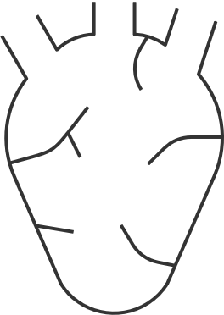
About half of the respondents is aware of heart attack being responsible for the majority of casualties in Europe.
Dying
Q14. Which condition is responsible for the majority of casualties in Europe? – (single answer)
Base: n=2.010
Knowing
48%
-
-
-
39%|49%a|54%a
20%|26%a|29%a
26%bc|17%|13%
26%
18%
6%
3%
Heart attack | Lung cancer | Diabetes | HIV | Brain Tumour
m
f
18-34 (a)
35-49 (b)
50-99 (c)
BEL

Slide 26
71% discussed the topic of death either with their closest relatives or their partner. 9% even have spoken to their doctor about death.
Dying
Q15. Have you ever spoken to someone about death? – (multiple choice)
Base: n=2.010
Talking/ Thinking
39%
33%|45%
25%|20%
50%bc|40%c|31%
17%
16%|22%a|27%a
32%
9%
22%
Yes, I have discussed the topic with my closest relatives (parents, children, siblings). | Yes, my partner and I have talked about death. | Yes, I have spoken to my doctor about death. | No, I have not talked about death yet because I have not had a reason to. | No, I generally do not talk about death.
m
f
18-34 (a)
35-49 (b)
50-99 (c)
BEL

Slide 27
About three quarters could imagine availing themselves of Assisted Suicide, mostly to avoid constant agony.
Dying
Q16. Could you imagine availing yourself of Assisted Suicide? – (single answer)
Base: n=2.010
Talking/ Thinking
73% Yes
27% No
45%
-
-
14%|9%
40%|47%a|47%a
18%b|12%|19%b
10%|15%ac|10%
17%
11%
10%
9%
8%
Yes, if I were fatally ill and in constant agony. | Yes, so that I could decide when and how I would like to pass away. | Yes, so that I will not become a burden to my family. | No, because one can never entirely rule out spontaneous improvement of a serious condition. | No, I would never consider Assisted Suicide for religious reasons. | No, I could not do that to those closest to me.
m
f
18-34 (a)
35-49 (b)
50-99 (c)
BEL

Slide 28
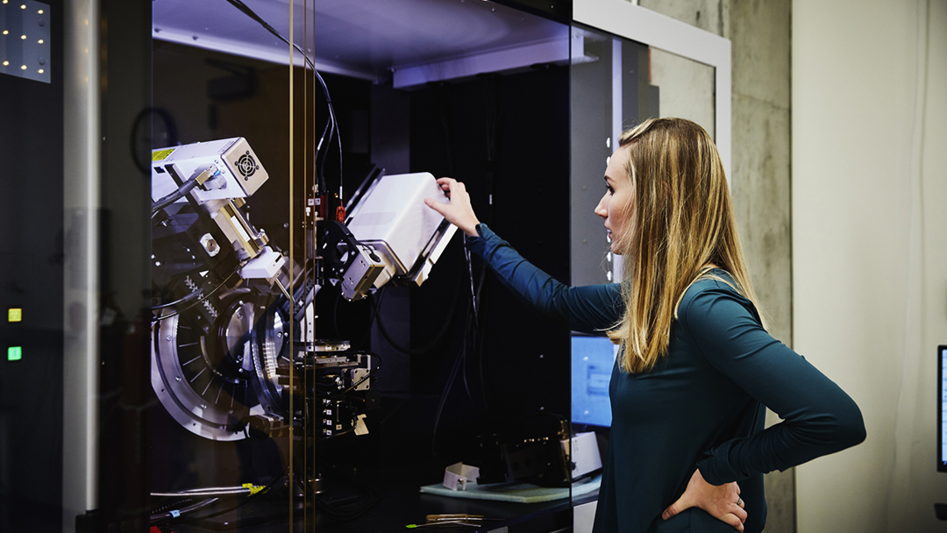
4
Innovation

Slide 29
About half are aware of the genetic predisposition of breast cancer and cardiovascular diseases, rather low levels of awareness regarding other diseases.
Innovation
Q17. Which of the following diseases are typically favoured by predisposition and genetics? – (multiple choice)
Base: n=2.010
Knowing
40%|64%
52%
-
42%|55%
-
22%|37%
23%|29%
20%|25%
28%|17%
48%
42%|50%a|52%a
42%c|40%c|28%
34%c|34%c|24%
-
-
22%|19%|24%b
35%
29%
26%
23%
22%
Breast cancer | Cardiovascular diseases | Parkinson‘s disease | Depression | Arthrosis | Osteoporosis | I don‘t know
Proportions of correct answers
5%
3%
7%
m
f
18-34 (a)
35-49 (b)
50-99 (c)
(n=2.010)
(n=.985)
(n=1.025)
BEL

Slide 30
41% regard eternal life to be hocus pocus, another 35% would not want to live eternally even if it was possible.
Innovation
Q18. What do you think about eternal life? – (single answer)
Base: n=2.010
Talking/ Thinking
41%
-
31%|39%
-
33%|38%a|47%ab
-
20%c|20%c|14%
7%
35%
17%
That sounds like hocus pocus to me, I do not believe we will ever be able to live eternally. | I think that eternal life will eventually become a possibility. | Even if it was possible, I would not want to live eternally. | If I were given the opportunity, I would like to live eternally.
m
f
18-34 (a)
35-49 (b)
50-99 (c)
BEL

Slide 31
Half of the respondents would take the polypill to prevent possible age-related conditions.
Innovation
Q19. Based on your current state of health, could you imagine taking a so-called “polypill” every day to prevent possible (further) age-related conditions, such as cardiovascular disease, in the future? – (single answer)
Base: n=2.010
Talking/ Thinking
50% Yes
51% No
27%
29%|24%
25%|31%c|26%
24%
23%
7%
20%
Yes, I would definitely take such a pill. | Yes, but only if I had already been diagnosed with an increased risk of cardiovascular disease. | No, I would wait until long-term studies on the effects of such a pill become available. | No, I would be afraid of possible side effects. | No, as long as I am in good health I do not take any medication.
m
f
18-34 (a)
35-49 (b)
50-99 (c)
BEL

Slide 32
Half of the respondents would consider changing their genes, though among those, half of them would feel uneasy messing with their genes.
Innovation
Q20. Imagine the following: Your doctor tells you that, based on the results of a gene test, you are very likely to suffer from a serious illness in five years’ time. Would you consider changing your genes to evade falling ill? – (single answer)
Base: n=2.010
Doing
52% Yes
48% No
29%|23%
-
-
14%|18%
26%
26%
26%|30%c|25%
21%c|18%|15%
11%|13%|17%ab
-
18%
14%
16%
Yes, I most certainly would. | Yes, but I would feel uneasy knowing that someone is messing with my “genes”. | No, I would rather risk falling ill than having someone interfere with my genetic material. | No, I would hope that the illness will not break out despite the increased probability detected by the test. | No, I would be too concerned that the manipulation of my genes might cause other unforeseeable changes in my body.
m
f
18-34 (a)
35-49 (b)
50-99 (c)
BEL

Slide 33
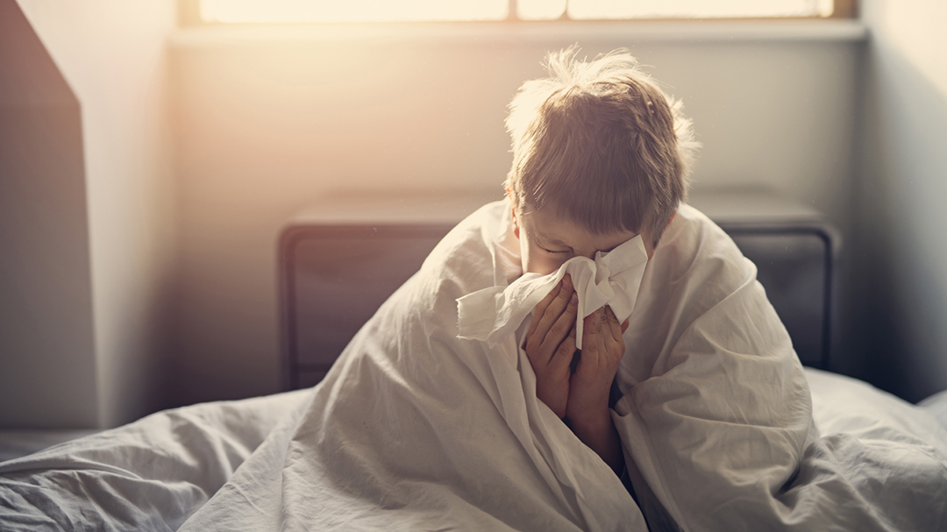
5
Everyday Illnesses

Slide 34
Stress, depression and jet lag/shift work are the most frequently mentioned causes for insomnia, only half mentions alcohol.
Everyday Illnesses
Q21. What are possible causes for insomnia? – (multiple choice)
Base: n=2.010
Knowing
86%
82%|90%
67%|74%
58%|70%
49%|55%
-
81%|85%|90%ab
-
58%|64%a|69%a
-
19%c|19%c|14%
71%
64%
52%
17%
9%
Stress | Depression | Jet lag/shift work | Alcohol consumption | The consumption of certain foods, such as bananas | The medical agent ibuprofen
Proportions of correct answers
20%
18%
23%
m
f
18-34 (a)
35-49 (b)
50-99 (c)
(n=2.010)
(n=.985)
(n=1.025)
BEL

Slide 35
Two thirds (64%) correctly mention beer to be impairing antibiotics, only 27% mention citric juices, 17% milk.
Everyday Illnesses
Q22. Which of the following substances can impair the effect of antibiotics? – (multiple choice)
Base: n=2.010
Knowing
64%
80%|84%
-
23%|30%
-
-
32%c|28%|25%
22%|25%|31%ab
18%|21%c|15%
28%
27%
17%
6%
Beer | Coffee | Citric juices | Milk | Water
Proportions of correct answers
1%
1%
1%
m
f
18-34 (a)
35-49 (b)
50-99 (c)
(n=2.010)
(n=.985)
(n=1.025)
BEL

Slide 36
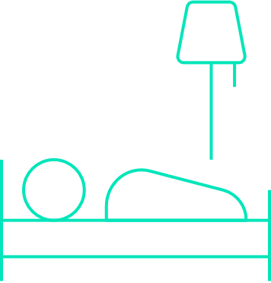
Low willingness to consider sleeping pills (28%), with about one third being afraid of becoming addicted to it.
Everyday Illnesses
Q23. Would you ever consider taking sleeping pills? – (single answer)
Base: n=2.010
Doing
71% No
28% Yes
31%|22%
16%|12%
31%
27%|35%
-
26%
31%bc|23%|25%
16%c|13%|13%
-
19%|26%a|25%a
14%
23%
5%
No, I never suffer from insomnia. | No, I do not believe in the effectiveness of sleeping aids. | No, I am afraid of becoming addicted to sleeping pills. | Yes, I do not see why not. | Yes, sleeping pills are the only thing that really helps.
m
f
18-34 (a)
35-49 (b)
50-99 (c)
BEL

Slide 37
Most respondents consider going to work despite having a cold.
Everyday Illnesses
Q24. Do you go to work even if you have a cold? – (single answer)
Base: n=2.010
Doing
61% Yes
30%
-
-
8%|12%
12%|8%
-
33%c|40%ac|24%
19%c|15%c|11%
13%c|13%c|7%
12%c|12%c|7%
12%|11%|47%ab
14%
10%
4%
3%
10%
28%
Yes, a sniffle does not keep me from work. | Yes, I do not want to let down my colleagues. | Yes, because there is simply too much to do. | Yes, because I am indispensable at work. . | Yes, because I am scared of my boss | No, I stay at home. | I do not currently work
m
f
18-34 (a)
35-49 (b)
50-99 (c)
BEL

Slide 38
Package leaflet and asking the doctor are the most frequently used sources of information, followed by the pharmacy and the internet.
Everyday Illnesses
Q25. Where do you look for information on medication intake, their interplay and side effects? –(multiple choice)
Base. n=2.010
Doing
49%|61%
-
55%
55%
47%|5%2|61%ab
31%|38%
51%|53%|59%ab
41%
35%
42%bc|35%|30%
12%
6%
On the package leaflet | I ask my doctor | At the pharmacy | On the internet | On the manufacturer’s website | I do not look for this kind of information at all
m
f
18-34 (a)
35-49 (b)
50-99 (c)
BEL

Slide 39
6
Sexuality & Health

Slide 40
Very high awareness of sex promoting healthier sleep. However low awareness in preventing heart disease and obesity.
Sexuality & Health
Q26. What effects can sexual intercourse have on a person’s overall health? – (multiple choice)
Base: n=2.005
Knowing
85%
82%|88%
34%|27%
-
76%|82%a|92%ab
31%|35%c|28%
17%c|15%c|9%
30%
13%
6%
5%
4%
Sex can promote healthier sleep. | Sex can prevent heart disease. | Sex prevents obesity. | Sex improves eyesight. | Sex alleviates asthma and bronchitis. | Sex prevents hair loss.
Proportions of correct answers
3%
4%
3%
m
f
18-34 (a)
35-49 (b)
50-99 (c)
(n=2.010)
(n=.985)
(n=1.025)
BEL

Slide 41
Only about one quarter are aware of the fact that kissing can cause sexually transmitted diseases.
Sexuality & Health
Q27. Which of the following activities can cause an infection with sexually transmitted diseases? – (multiple choice)
Base. n=2.010
Knowing
83%|88%
-
26%|22%
85%
81%
83%|88%a|85%
73%|81%a|86%ab
27%b|20%|24%
70%
24%
5%
Vaginal sex | Anal sex | Oral sex | Kissing | Cuddling
Proportions of correct answers
18%
19%
16%
m
f
18-34 (a)
35-49 (b)
50-99 (c)
(n=2.010)
(n=.985)
(n=1.025)
BEL

Slide 42
Frequency of sexual intercourse is the most frequently discussed topic, followed by contraception and lack of sexual desire. 40% do not talk about sex topics.
Sexuality & Health
Q28. What sex topics do you openly talk about with your partner or friends? – (multiple choice)
Base: n=2.010
Talking/ Thinking
-
24%|39%
-
-
-
21%|33%a|54%ab
37%
48%c|44%c|27%
52%bc|38%c|15%
34%c|31%c|22%
31%bc|23%c|15%
40%
31%
28%
22%
17%
Frequency of sexual intercourse | Contraception | Lack of sexual desire | Sexually transmitted diseases | Erectile dysfunction | I do not talk about sex topics
m
f
18-34 (a)
35-49 (b)
50-99 (c)
BEL

Slide 43
About two thirds would get intimate even if the partner had a cold, 28% even would have sex with their partner.
Sexuality & Health
Q29. Imagine your partner has a cold. Would you consider getting intimate with them anyway? – (single answer)
Base: n=2.010
Doing
65% Yes
35% No
37%
35%|40%
31%|26%
-
47%bc|41%c|30%
-
12%|14%|27%ab
28%
15%
20%
Yes, I kiss my partner even if my partner has a cold. | Yes, I have sex with my partner even if my partner has a cold. | No, I try to stay away from my partner for fear of catching whatever he/ she has. | No, I generally prefer not to get intimate when my partner has a cold.
m
f
18-34 (a)
35-49 (b)
50-99 (c)
BEL

Slide 44
One third of respondents had ever been tested for sexual transmitted diseases.
Sexuality & Health
Q30. Have you ever been tested for sexually transmitted diseases? – (single answer)
Base: n=2.010
Doing
33% Yes
51% No
23%|27%
43%
40%|47%
19%|14%
28%c|33%c|19%
33%c|34%|55%ab
13%c|15%|19%a
8%
25%
6%
2%
16%
Yes, and I continue to get tested regularly. | Yes, once or twice. | No, the thought of getting tested makes me uncomfortable. | No, it is too much trouble for me. | No, I do not think it is necessary. | I have never thought about this
m
f
18-34 (a)
35-49 (b)
50-99 (c)
BEL

Slide 45
Local Questions

Slide 46
43% worry about the long-term affordability of healthcare. 37% state that healthcare gets more expensive for older patients and government cannot incease spending in healthcare.
Local Questions
BEL 1. Which of the following statements on the affordability of healthcare corresponds best with your perspective? – (multiple choice)
Base: n=2.010
Belgium
-
-
20%|11%
-
43%
37%|45%a|47%a
27%|34%a|41%ab
14%|11%|18%ab
16%bc|9%|8%
37%
35%
15%
11%
Healthcare will become more and more expensive for patients, as people get older and government cannot increase spending in healthcare. | I worry about the long term affordability of healthcare. | Governments should promote more use of generic medicines to sustain affordable healthcare. | I am confident that when I will be 70+ years old, healthcare will be affordable for me. | I don’t know.
m
f
18-34 (a)
35-49 (b)
50-99 (c)
BEL

Slide 47
Half of the respondents (50%) are aware that antibiotics kill bad and good bacteria. 43% are aware that antibiotics weaken the immune system.
Local Questions
BEL 2. Which of the following statements concerning antibiotics/probiotics are correct? – (multiple choice)
Base: n=2.010
Belgium
50%
45%|55%
-
17%|13%
15%|11%
-
41%|41%a|46%a
18%bc|13%|14%
14%|15%c|11%
43%
15%
13%
Antibiotics kill bad and good bacteria, so during and after an antibiotics treatment, it is important to take probiotics | After an antibiotics treatment, your immunity is weaker than an average person. | After an antibiotics treatment, your immunity is stronger than an average person. | Probiotics can be harmful for your gut.
Proportions of correct answers
13%
11%
16%
m
f
18-34 (a)
35-49 (b)
50-99 (c)
(n=2.010)
(n=.985)
(n=1.025)
BEL

Slide 48
73% are aware of most people having vitamin D deficiency after the winter period.
Local Questions
BEL 3. Which of the following statements concerning vitamin D are correct? – (multiple choice)
Base: n=2.010
Belgium
68%|78%
29%|22%
73%
67%|72%|77%ab
-
26%
20%
7%
Most people have a vitamin D deficiency after the winter period. | With a healthy diet, you will have enough vitamin D from your food. | To solve a vitamin D deficiency, you need a vitamin D treatment of 2 weeks. | Vitamin D is a hype, but it has never been proven that this vitamin is really needed
Proportions of correct answers
52%
48%
56%
m
f
18-34 (a)
35-49 (b)
50-99 (c)
(n=2.010)
(n=.985)
(n=1.025)
BEL

Slide 49
Demographics

Slide 50
Demographics
Age & Gender:
Region:
49%
51%
female
male
age
Brussels
Antwerp
East Flanders
Flemish Brabant
Limburg
West Flanders
Hainaut
Liège
Luxembourg
Namur
Walloon Brabant
BMI:
Education:
Smoking:
Lower secondary education (first three years)
Higher secondary education (last three years)
22%
29%
Primary school
Smoke every day
Do not
currently smoke
3%
12%
38%
Post-secondary education, not higher
Higher education (college or university)
8%
41%
Smoke occasionally
Have never smoked
6%
40%
BEL

Slide 51
Demographics
Employment:
Household:
Status:
2
2
under 18
Ø
people
Ø
Area:
town in a purely rural area
town near
to a city
small city
(up to 30k)
19%
27%
21%
Unemployed but looking for work
Employed full time outside the home
Employed part-time outside the home
Disabled or retired
Pupil / Student
Self-employed or
ind. contractor
Full-time homemaker
Other
medium city
(up to 100k)
large city
(up to 500k)
large city
(500k +)
15%
8%
10%
Chronic disease:
Household income:
n=726
Up to 500 €
Don’t’ know/ no answer
Muscular & Skeletal System
500 – 1.000 €
1.001 – 1.500 €
1.501 – 2.000 €
2.001 – 2.500 €
2.501 – 3.000 €
3.001 -3.500 €
3.501 – 4.000 €
4.001 – 5.000 €
Neurological
disease
Cancer
5.001 € and above
Cardiovascular
Psychological condition
Other chronic disease
Respiratory
Chronic bowel inflammation
Not Specified
Diabetes (I / II)
BEL

Slide 52
Demographics
Health insurance:
Organ and tissue donation:
Consent organs/ tissues are being collected:
n=573
Prefer not to answer
Private health insurance
No health insurance
Public health insurance
Both, public and private
BEL

