Slide 1
Swimming For Psoriasis
Press Conference
28 October 2014

Slide 2
Welcome
Prof. Myrto Trakatelli
Dermatologist
Miss Dufourny Dominique
Alderwomen of Ixelles

Slide 3
Prof Erwin Tschachler
Presentation of the Campaign

Slide 10
Treatment of psoriasis in 2014 EADV 2014
Carle Paul, MD, PhD
Dermatology department
Paul Sabatier University,Larrey Hospital,Toulouse

Slide 11
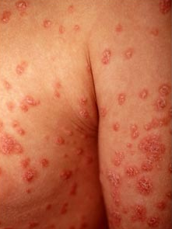
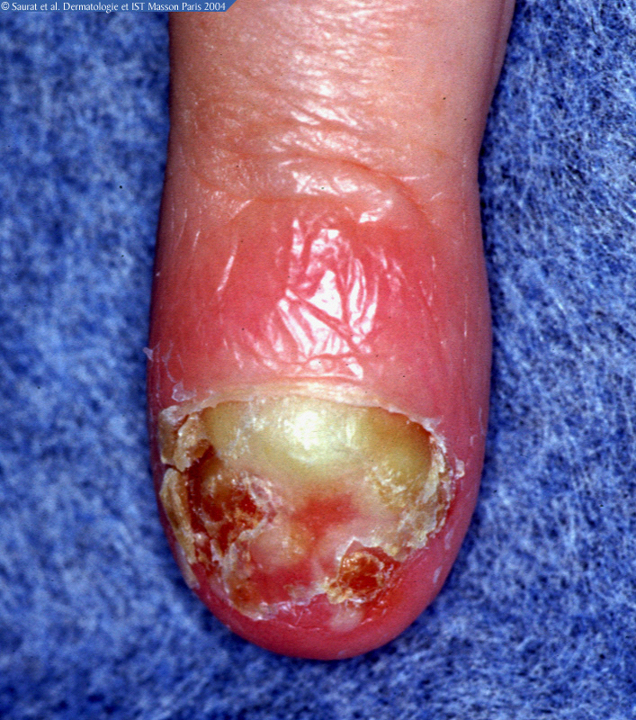
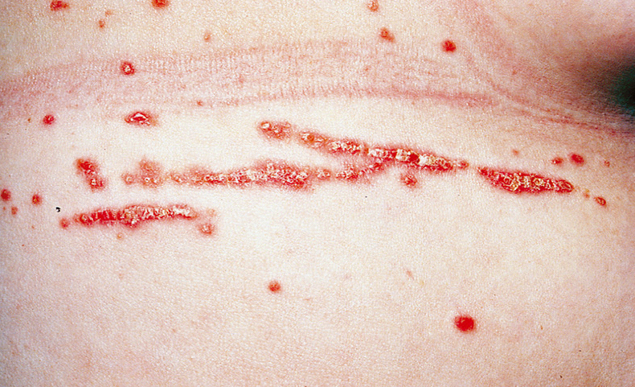
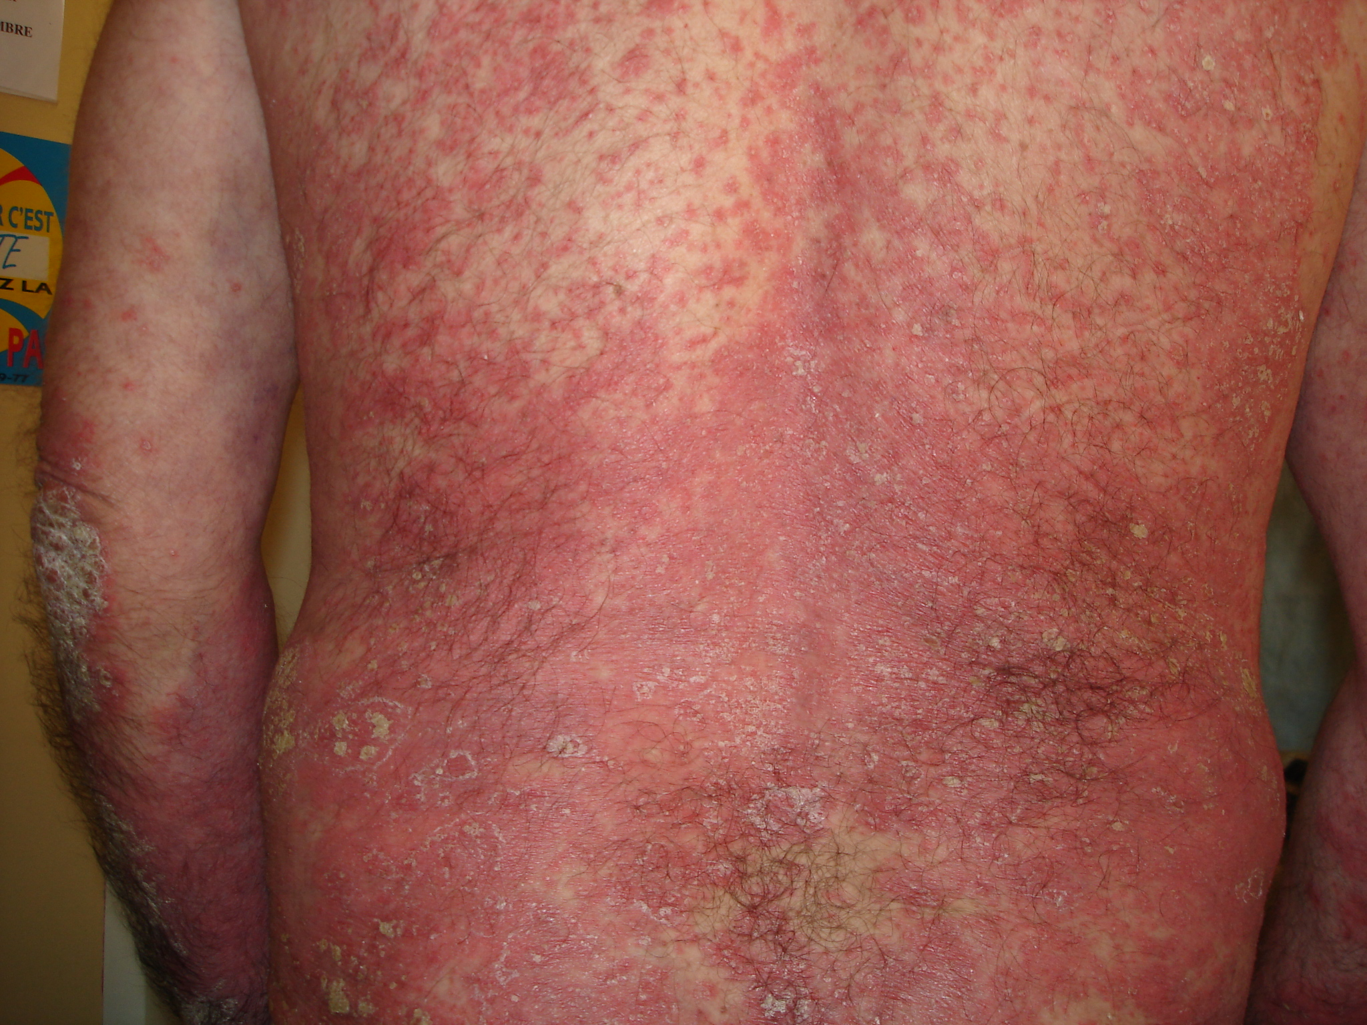
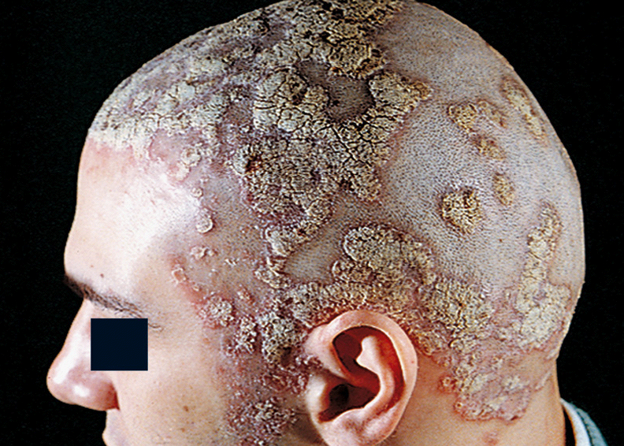
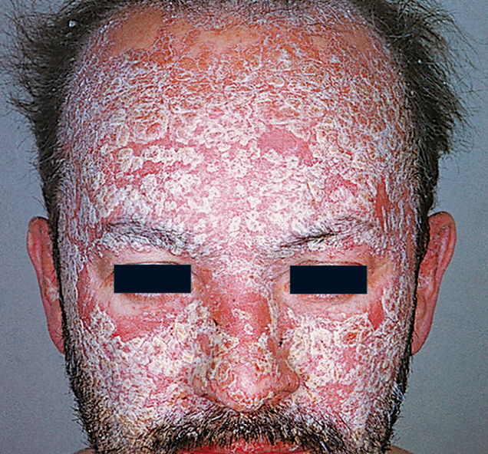
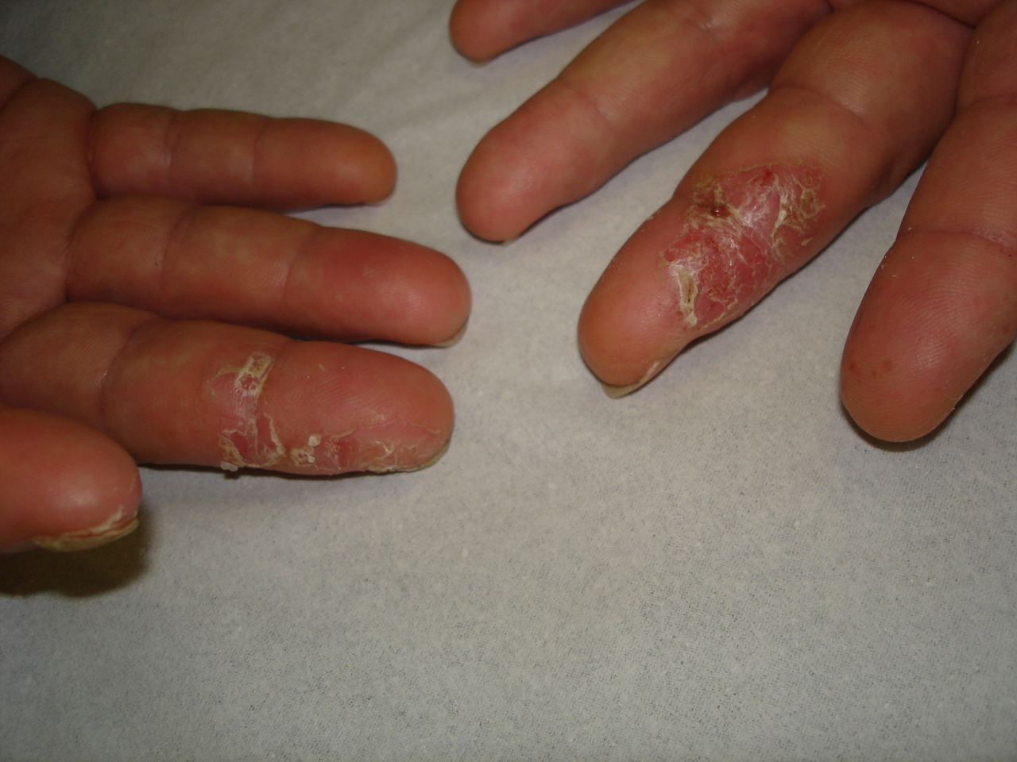
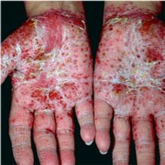
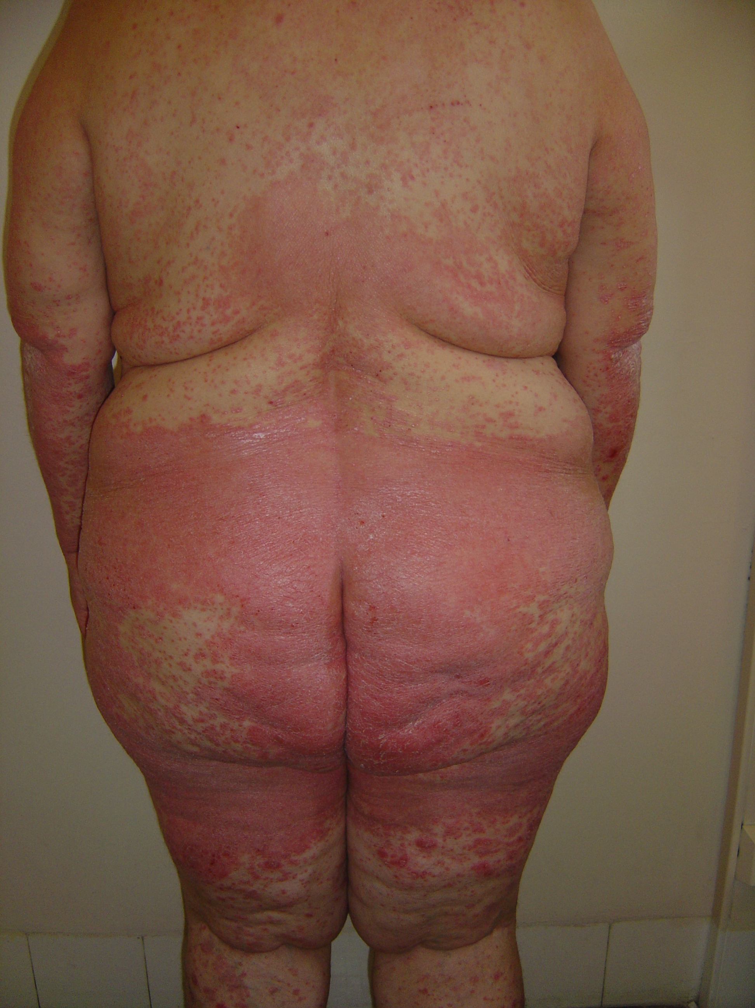
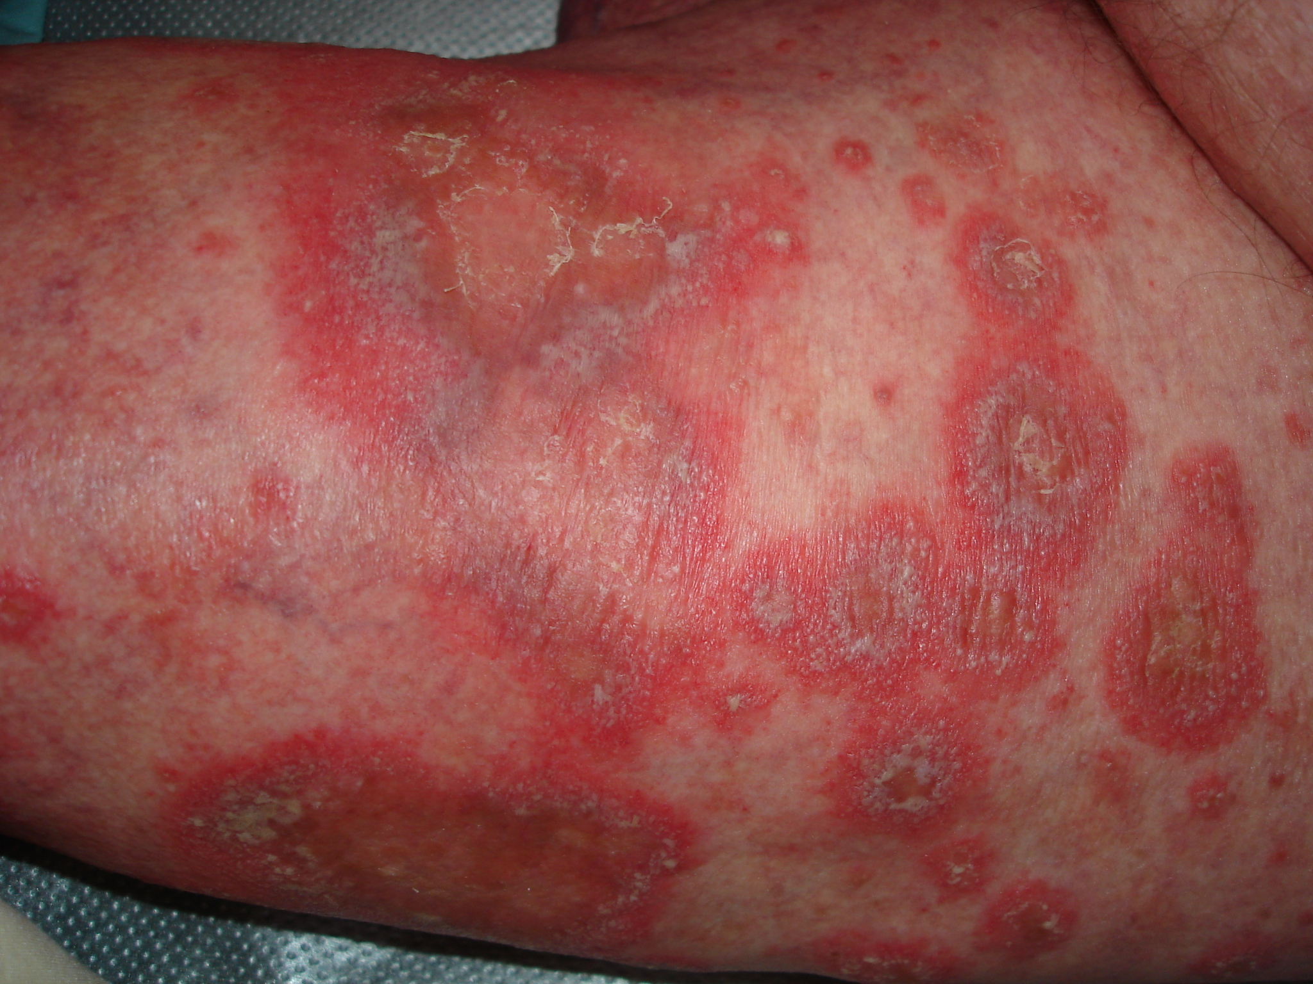
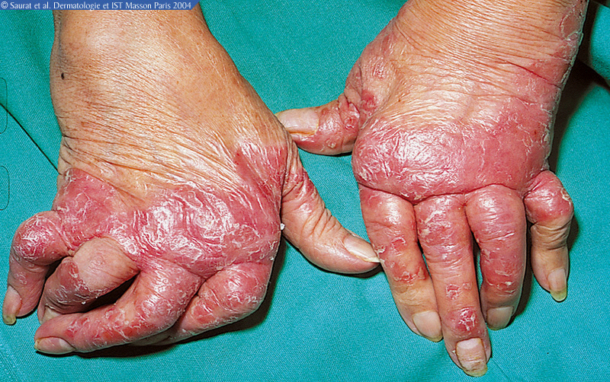
Psoriasis affects 2 to 3 % of the population

Slide 12
Psoriasis
Chronic inflammatory skin disease
Non- infectious, non-transmissible
Genetic factors
Environmental factors : aggressions, bacteria
Skin immune system activation and increased skin proliferation and renewal
Psoriatic arthritis (15 to 30%)

Slide 13
Psoriasis has a significant impact on quality of life
Pruritus, pain, loss of productivity
Anxiety and depression
Reduced self-esteem, loss of confidence
Stigmatisation

Slide 14
Psoriasis does not only affect the skin !
Increased risk of:
High blood lipids
Diabetes
Hypertension
Cardiovascular diseases
1. Prey S et al. JEADV 2010;24(Suppl. 2):23–30.
2. Armstrong AW et al. Br J Dermatol 2013
Notes:
14

Slide 15
Treatments of psoriasis
Treatment paradigm is driven by disease severity and burden to patients
The different disease severities can be successfully treated
Treatment selection is a shared decision by patient and physician
Injectable
Biologicals
Anti-TNF
Anti-IL-12/23
Oral drugs
Methotrexate Ciclosporin
Acitretin
Phototherapy
Topicals : creams
Ointments, gels
s
Increased disease severity

Slide 16
Conclusion – Q&A Start relay

Slide 17
Somes testimonials
Politician, Vip’s, Patient Associations

Slide 18
Politician - Miss De Cloedt
"De toutes les maladies, l'ignorance est la plus contagieuse. C'est donc elle qu'il faut combattre."

Slide 19
VIP - Thomas Gunzig
"Quand j'étais ado, j'avais des boutons partout. Des gros, des rouges, des blancs. Je crois que si quelqu'un avait pris la peine de nager pour me soutenir, ça m'aurait peut être aidé"

Slide 20
VIP - Ben Heine
‘’Vaak wordt gedacht dat psoriasis besmettelijk is maar dat is niet waar. Ik denk dat dit evenement zal het grote publiek tonen dat we kunnen zonder probleem zwemmen met mensen die psoriasis hebben.
Het is een heel belangrijk doel en ik ben gelukkig om deel te nemen aan deze nationale sensibiliseringactie.’’

Slide 21
VIP - Vandecaveye Gella
“Psoriasis mag geen belemmering zijn om te sporten ondanks de ongemakken en het nakijken. Ik wil heel graag meehelpen om het taboe rond deze huidziekte te doorbreken door samen met “psoriasis patiënten” te zwemmen.”

Slide 22
VIP - Virginie Claes
‘’1) never judge a book by its cover
2) Beauty starts in your head. Not in your Mirror
3) La vie, ce n’est pas d’attendre que les orages passent, c’est d’apprendre comment danser sous la pluie - sénèque’’

Slide 23
VIP - Sophie Nollevaux
‘’Les personnes atteintes de psoriasis doivent savoir qu’elles ne sont pas seules. La solidarité est une valeur très importante pour moi ! Si participer à cette action peut, un tant soit peu, faire changer le fameux « regard des autres », j’aurai bien fait de mouiller le maillot ! ☺’’

Slide 24
Patients associations – France Psoriasis
Today patients wish to be well-informed about treatments options, especially with a condition such as psoriasis.
An informed patient is an empowered patient and clearly we still need help and must continue to focus on information and develop even further in our future strategic work.
The WHO psoriasis resolution , points out the need for multilateral efforts to promote and improve human health, providing access to treatment and health care education, so this should be definitely a priority.
It is a quite common disease which also carries with it an extensive physical, psychological and socioeconomic burden, there are still many gaps in the understanding of the disease itself and its management.
Patient’s organisations need support for :
Educating the patient about treatment options
Educating and supporting patient to better manage their psoriasis in daily life
Educating patients about psoriasis as a serious , inflammatory, noncommunicable disease
Educating policy makers about psoriasis and its socioeconomic and psychosocial impact
Educating the General Public (non communicable disease, non psychological disease)

