Slide 1
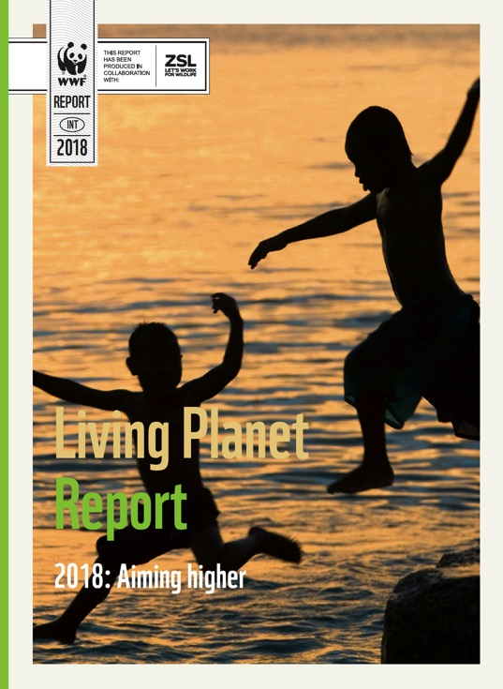
Living Planet Report
2018: Aiming higher
All the figures and legends included in the report

Slide 2
© Global Warming Images / WWF
© Global Warming Images / WWF
Notes:
Cover image
Living Planet Report
2018: Aiming higher
Cover photograph
© Global Warming Images / WWF
Children dive into the sea at sunset, Funafuti, Tuvalu

Slide 3
Notes:
A new global deal for nature and people urgently needed
Credit: Marco Lambertini / Director General / WWF International

Slide 4
Notes:
A mangrove crab on the root of a red mangrove tree
A mangrove crab on the root of a red mangrove tree (Rhizophora mangle), just below the water line on Kostrae Island, Federated States of Micronesia.
© naturepl.com - Tim Laman - WWF

Slide 5
Notes:
Chapter 1: Why biodiversity matters
A butterfly rests on a branch in Kaya Kauma forest. Kilifi, Kenya.
© Greg Armfield - WWF-UK

Slide 6
Notes:
Chapter 2: The threats and pressures wiping out our world
© naturepl.com - Tim Laman - WWF

Slide 7
Notes:
Land degradation
© Staffan Widstrand - WWF
Text next to the photo: Land degradation
Land degradation is a problem in virtually every terrestrial ecosystem, reducing the welfare of more than 3 billion people. A recent assessment found that only a quarter of land on Earth is substantively free of the impacts of human activities and this is projected to decline to just one-tenth by 2050. This ongoing degradation has many impacts on species, the quality of habitats and the functioning of ecosystems. Two recent studies have focused on the dramatic reductions in bee and other pollinator numbers and on the risks to soil biodiversity, critical to sustain food production and other ecosystem services.

Slide 8
Notes:
The impacts of land degradation
Land degradation is a pervasive, systemic phenomenon: it occurs in all parts of the terrestrial world and can take many forms. Combating land degradation and restoring degraded land is an urgent priority to protect the biodiversity and ecosystem services vital to all life on Earth and to ensure human well-being.
© Natthawee Suwannatthacho - Shutterstock

Slide 9
Notes:
Pollinators: What’s all the buzz about?
The red-tailed bumblebee (Bombus lapidarius) is a widespread and generalist species of bumblebee and so it is a really important pollinator of many different crops across Europe.
© Ola Jennersten - WWF-Sweden

Slide 10
Notes:
Building up a picture: Artisanal fishermen return to the port after fishing for hake off the coast of Valparaiso, Chile.
© Meridith Kohut - WWF-US

Slide 11
Notes:
Plastics in the ocean
Green sea turtle (Chelonia mydas) with a plastic bag, Moore Reef, Great Barrier Reef, Australia. The bag was removed by the photographer before the turtle had a chance to eat it.
© Troy Mayne - WWF

Slide 12
Notes:
Threats and pressures on our source of life
© Patrick Bentley - WWF-US
THREATS AND PRESSURES ON OUR SOURCE OF LIFE
Freshwater ecosystems provide habitat for more than 100,000 known species of fishes, molluscs, reptiles, insects, plants and mammals despite covering less than 1% of the Earth’s surface. In addition, freshwater habitats such as lakes, rivers and wetlands are the source of life for all humans and command high economic value. They are also the most threatened, strongly affected by factors such as habitat modification, fragmentation and destruction; invasive species; overfishing; pollution; forestry practices; disease; and climate change. In many cases, these combined threats have led to catastrophic declines in freshwater biodiversity. New imaging technology is allowing us to view these changes in real time.

Slide 13
Notes:
Melting iceberg on coast Qaanaaq, Greenland, Arctic.
© Staffan Widstrand - WWF

Slide 14
Notes:
Penguins on the move: Who wins and who loses when the competition heats up
Two Adelie penguins (Pygoscelis adeliae) on an iceberg in Antarctica.
© naturepl.com - Edwin Giesbers - WWF

Slide 15
Notes:
Bleached coral caused by loss of algae due to temperature change
© naturepl.com - Peter Scoones - WWF

Slide 16
Notes:
Chapter 3: Biodiversity in a changing world
Mountain gorillas (Gorilla beringei beringei) and their infant in the Bwindi Impenetrable National Park, Uganda.
© Scott Masciarelli
First published 20 years ago, for two decades the Living Planet Index has tracked the state of biodiversity by measuring the population abundance of thousands of vertebrate species around the world. The latest index shows an overall decline of 60% in population sizes between 1970 and 2014. Current rates of species extinction are 100 to 1,000 times higher than the background rate, also known as the standard rate of extinction in Earth’s history before human pressure became a prominent factor. Species population declines are especially pronounced in the tropics, with South and Central America suffering the most dramatic decline, an 89% loss compared to 1970. Freshwater species numbers have also declined with a focused Freshwater Index showing an 83% decline since 1970. To put these trends in a broader context, this chapter also explores three other indicators measuring changes in species distribution, extinction risk and community composition. All these results paint the same picture – that of continuing biodiversity loss.

Slide 17
Notes:
Dr Ben Collen: 1978-2018
© Dr Lawrence Bellamy - Seabird spotting at Blakeney Point in Norfolk 2016

Slide 18
Notes:
Collecting LPI data
Axel, an intern at The Biodiversity and Education Center, Gamba, replaces a card in a camera trap in Gabon, Africa.
© James Morgan - WWF

Slide 19
Notes:
Putting the LPI in context
A camera trap captures an endangered snow leopard (Panthera uncia) in Hemis National Park, a high altitude national park in the eastern Ladakh region of the state of Jammu and Kashmir in India.
© National Geographic Stock - Steve Winter - WWF

Slide 20
Notes:
Chapter 4: Aiming higher - What future do we want?
Polar bear jumping on ice, Spitsbergen, Norway.
© Steve Morello - WWF

Slide 21
Notes:
Bending the curve of biodiversity loss
Male roe deer (Capreolus capreolus) in flower meadow with Siberian irises (Iris sibirica) Eastern Slovakia, Europe.
© Wild Wonders of Europe - Konrad Wothe - WWF

Slide 22
Notes:
The path ahead
A male Bengal tiger (Panthera tigris tigris) in Kanha National Park, Madhya Pradesh, India.
© naturepl.com - Nick Garbutt - WWF

Slide 23
Photostory
Children and nature
On image per chapter of the report

Slide 24
Notes:
Children and Nature: The school of natural healing
© André Bärtschi – WWF
In Santa Rosa de Huacaria, which borders the Manu National Park in Peru, Veronica Alata and her students study medicinal plants with the help of the Huachipaeri indigenous community. In this image they are learning about the Pinon Colorado plant (Jatropha gossypifolia, a Euphorbiaceae) whose resin is used to treat insect bites and intestinal infections. A bath steeped with the leaves relieves headaches and fevers, and the seeds are strongly purgative. This community is part of the WWF/Pro Naturaleza project. Education is an important component in many nature conservation programmes around the world, teaching children the dynamics of natural processes and the different services that nature provides.

Slide 25
Notes:
Children and Nature: Our shopping basket
© Richard Stonehouse – WWF
An average family on a supermarket outing may not realize how many goods in their shopping baskets – from food to cosmetics – contain palm oil. It is now the world’s most produced, consumed and traded vegetable oil. Yet, much of the oil palm’s expansion has taken place in high biodiversity tropical forests. The conversion of these, and peat land, to palm oil plantations releases massive quantities of carbon dioxide, fuelling climate change, and destroys the habitat of species like orang-utans. But palm oil doesn’t have to be destructive. Consumers, businesses and governments have the power to insist that palm oil is produced sustainably, without causing further loss of forests and biodiversity.

Slide 26
Notes:
Children and Nature
Jaladuddin the storyteller
© Simon Rawles – WWF
Jaladuddin is a retired teacher and lives in Kusumtala village on the Sundarban Islands in India. He regularly talks about local history and the impacts of climate change. In many countries children receive no formal education – they may be kept at home to help their families with household chores or the cultivation of land. Informal education is an important way of transmitting knowledge and experience from one generation to the next and many communities have lively storytelling traditions.

Slide 27
Notes:
Children and Nature: River living
© Zeb Hogan - WWF
The Tonle Sap River in Cambodia connects the Tonle Sap Lake and the Mekong River and is a migration route for many fish, including the critically endangered Mekong giant catfish (Pangasiandon gigas). Local children experience the value of this natural system in a very direct way: the river provides them with fresh water, and fish are a critical protein source in their daily diets. With a growing world population, it’s expected that by 2050 two-thirds of humanity will live in cities 23 with a less direct relationship to nature than these children.

Slide 28
Notes:
Children and Nature
Celebrating nature
© Mallory Graves - WWF-Greater Mekong

