Slide 1
Résultats du 1er baromètre :
“Les Belges face au cancer”
En perspective avec l’arrivée prochaine de l’immunothérapie
Par le Prof. Guy Jerusalem, chef de service CHU de Liège

Slide 2
Méthodologie du baromètre

Slide 3
Critères de la recherche
Description de
l’échantillon
Quota
Recrutement parmi la population nationale représentative
Age
Sexe
Région
Echantillon représentatif de la population belge âgée de 16-70 ans
N=1056
Méthode de
collection de données
Période
de recherche
Ipsos® étude
en ligne
Du :
30/10/2015
Au :
04/11/2015

Slide 4
Résultats du baromètre

Slide 5
Contact avec le cancer
Total | Age
Base n=1056 | 16-34 n=331 | 35-44 n=212 | 45-54 n=229 | 55+ n=284
Oui
Non
64% des Belges ont déjà été touchés par le cancer personnellement ou via un de lors proches
Chez les 45-54 ans, ce sont 72%

Slide 6
Probabilité d’un jour être touché par un cancer
Total | Age
Base | 16-34 | 35-44 | 45-54 | 55+
Très importante
Plutôt importante
Plutôt faible
Très faible
62%
73%
62% des Belges pensent qu’ils seront un jour confrontés au cancer
Chez les 35-44 ans, 73% pensent qu’ils seront un jour touchés par le cancer

Slide 7
Prévalence
1 homme sur 3 et 1 femme sur 4 seront atteints du cancer avant leur 75ème anniversaire (Registre du Cancer, 2012)
En Belgique, on compte 11.209.044 de personnes dont 5.703.950 de femmes et 5.505.094 d’hommes (http://statbel.fgov.be - chiffres 2015)
29% de la population serait donc touchée par le cancer >< 62% (ou 73% selon l’âge) de l’enquête

Slide 8
Les cancers les plus dévastateurs
Les plus dévastateurs selon les Belges
Prostate
Poumon
Peau
Melanome
Pancréas
Tête et cou
Vessie
Sein
Côlon
Ovaire
Foie
Rein
Estomac
Corps utérin
Top 3 qui se démarque
Cancer du pancréas 29%, cancer du poumon 21%, cancer du foie 14%

Slide 9
Les cancers les plus dévastateurs
Les Belges sont plutôt bien informés: les cancers de mauvais pronostic: cancers du poumon, cancer du pancréas, cancer du foie!
Cancer du poumon ou du pancréas: moins d’une personne sur 5 y survit au moins 5 ans

Slide 10
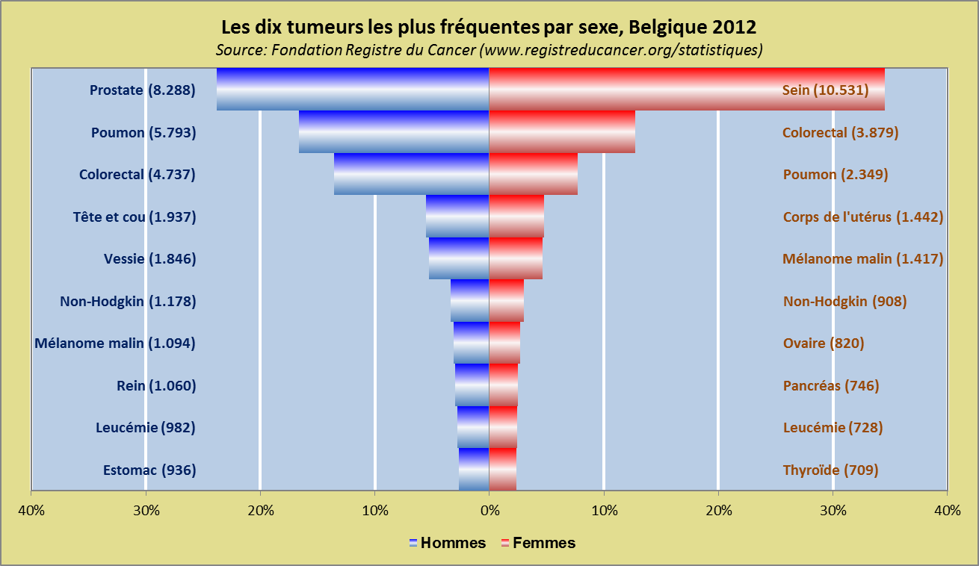
Les cancers les plus courants

Slide 11
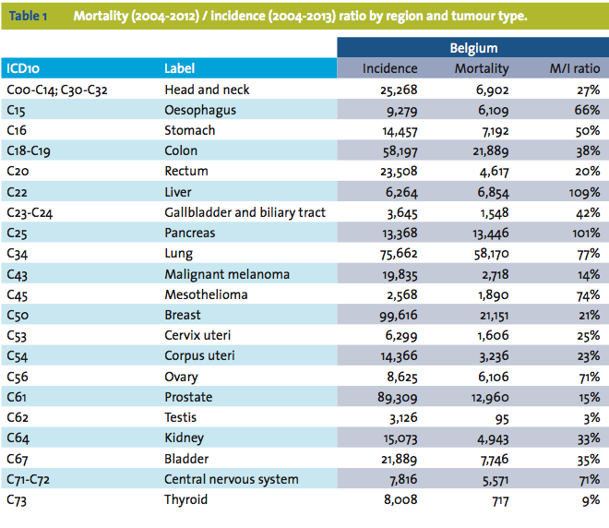
Incidence et mortalité par cancer

Slide 12
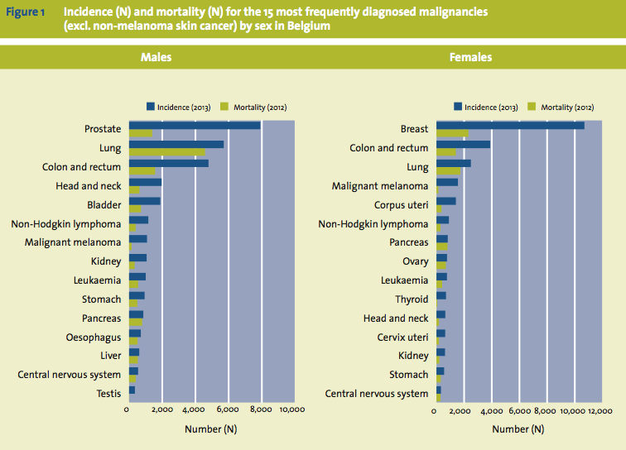
Rapport incidence – mortalité dans les 15 cancers les plus courants

Slide 13
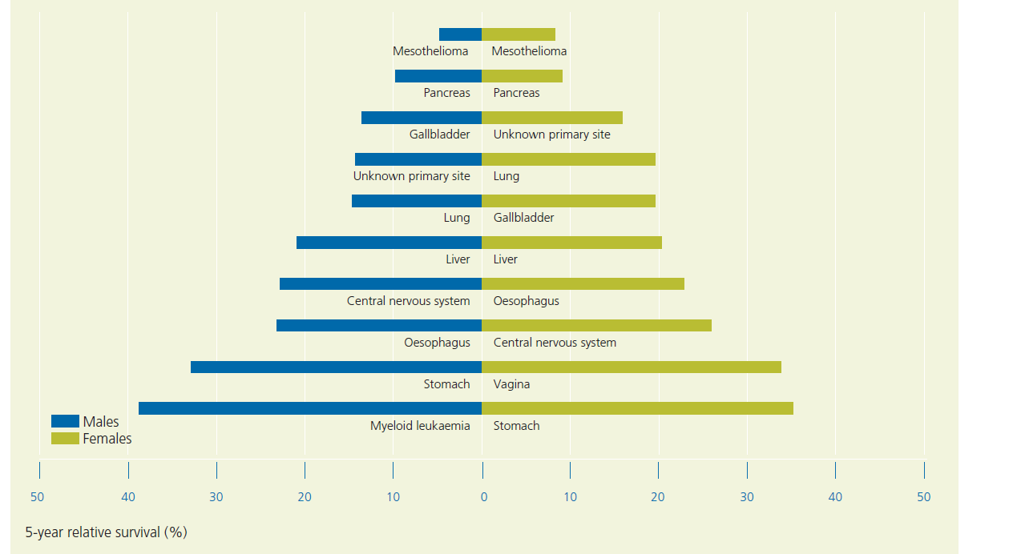
Les cancers avec la plus faible survie relative à 5ans

Slide 14
Conséquences les plus redoutées
Les conséquences les plus redoutées du cancer
Les effets secondaires du traitement
Décès
Douleur
Difficultés relationnelles
Conséquences sur la famille/les enfants
Impacts sur la vie professionnelle
Dégradation de la qualité de vie
Choc psychologique
Perte d’autonomie
Top 4 des conséquences les plus redoutées: naturellement le décès, directement après les conséquences sur la famille/enfants, douleur, dégradation de la qualité de vie

Slide 15
Les chances de vaincre le cancer
La recherche permettra-elle un jour de guérir le cancer?
Oui, à très court terme(<5 ans)
Oui, à moyen terme (10-20 ans)
Oiu, à plus long terme (>20 ans)
Non, on ne guérira jamais tous les cancers
Pas d’opinion
64%
1 Belge sur 4 pense que la recherche ne permettra jamais de vaincre le cancer
Plus 60% pensent qu’elle le permettra sur le long terme

Slide 16
Une nouvelle arme révolutionnaire contre le cancer arrive en Belgique: l’immunothérapie

Slide 17
Le rôle du système immunitaire
Système immunitaire détecte toute substance ‘étrangère’ et attaque pour protéger le corps de infections
Substances capables de déclencher une réponse immunitaire = antigènes
Certains cancers ne sont pas détectés et détruits car ne sont pas reconnus comme antigènes

Slide 18
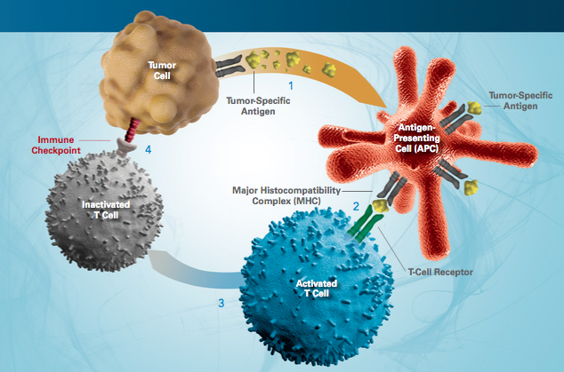
Les bases de l’immunothérapie
Certaines tumeurs arrivent à échapper au contrôle du système en activant ce qu’on appelle des checkpoints immunitaires

Slide 19
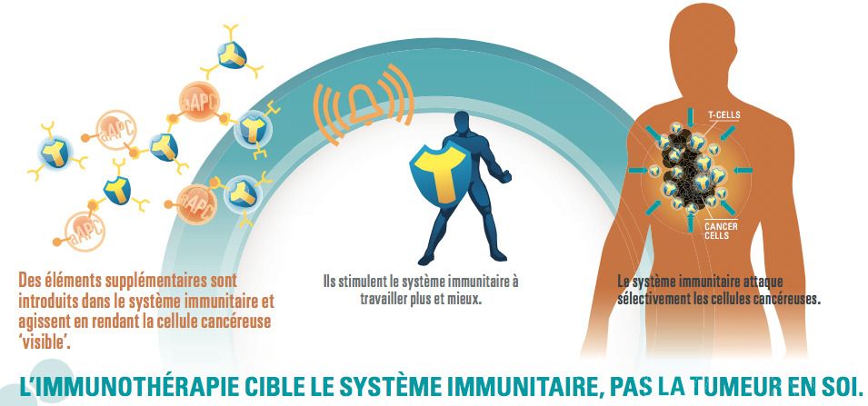
Comment fonctionne l’immunothérapie dans le cancer?
L’immunothérapie dans le cancer consiste à ‘réveiller’ le système immunitaire

Slide 20
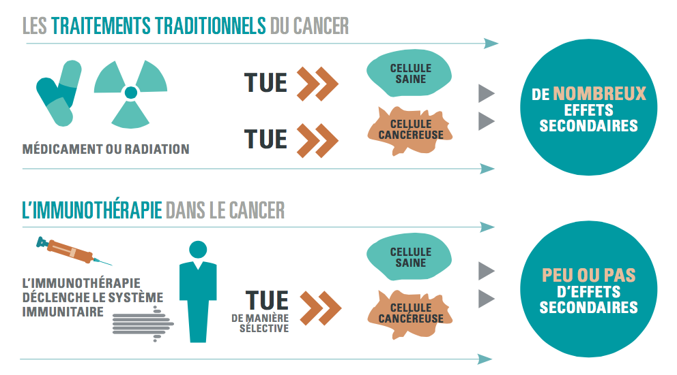
Spécificité extraordinaire → grande tolérance

Slide 21
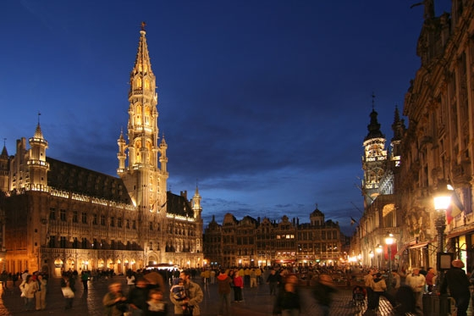


UZ Brussel experience with
pembrolizumab in patients
with pretreated advanced melanoma
Professor Bart Neyns
Medische Oncologie
Universitair Ziekenhuis Brussel
Brussels, Belgium
Bart.Neyns@uzbrussel.be

Slide 22
Diclosures
Personal financial compensation from Roche, Bristol-Myers Squibb, Merck Sharp & Dohme, Novartis, CryoStorage for public speaking, consultancy and participation in advisory board meetings
UZ Brussel received research funding from Pfizer, Novartis, Roche, Merck-Serono

Slide 23
Melanoma: Incidence and Epidemiology
Global incidence: ~232,000 cases per year in 2012¹
  Equivalent to ~5% increase per year
Global mortality: ~55,500 deaths in 2012¹
  Incidence/mortality (1:4 to 5 ratio)²
Belgium (11,000,000 inhabitants)⁴
  ± 2166 new cases/year (1249M/917F) in 2011
  ± 350 deaths/year
  1st cause of cancer death women 20–30 years
  2nd cause of cancer death men 30–40 years
Risk factors: exposure to UV light, constitution (phototype I), inherited predisposition syndromes [e.g. germline CDKN2A or CDK4 mutation]²
1. GLOBOCAN 2012. Available at http://globocan.iarc.fr. Accessed Apr 2014;
2. Cancer Research UK. Available at http://www.cancerresearchuk.org/about-cancer/type/melanoma/. Accessed Nov 2014;
3. Thirlwell C and Nathan P. BMJ 2008;337:a2488;
4. Belgian Cancer Registry, Incidence 2005; Tsao et al. NEJM 2004.

Slide 24

Prognosis of Melanoma following Surgery
Early disease¹
  High proportion cured by surgery
Advanced disease¹
  No systemic treatment (cytotoxic chemotherapy, IFNa2b, IL2) improved median survival for non-resectable stage IIIC–IV melanoma in a randomized trial before 2010
  AJCC Stage IV
    1y OS <50%
    3y OS <20%
1.0
Stage I
0.5
Stage II
Probability of survival
Stage III
Stage IV
0.0
0
1
5
10
15
Years after diagnosis
Relationship between the stage of melanoma and survival²
Kaplan–Meier survival curves are adapted from the American Joint Committee on Cancer.
1. Cancer Research UK. Available at http://www.cancerresearchuk.org/about-cancer/type/melanoma/. Accessed Nov 2014; 2. Adapted from Tsao H et al. N Engl J Med 2004; 351:998–1012.

Slide 25
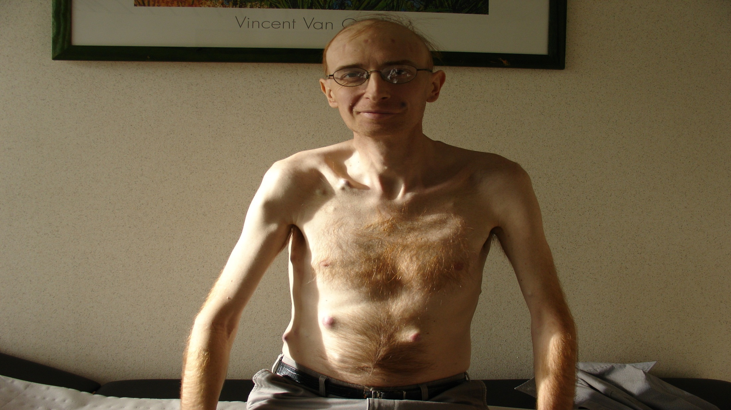
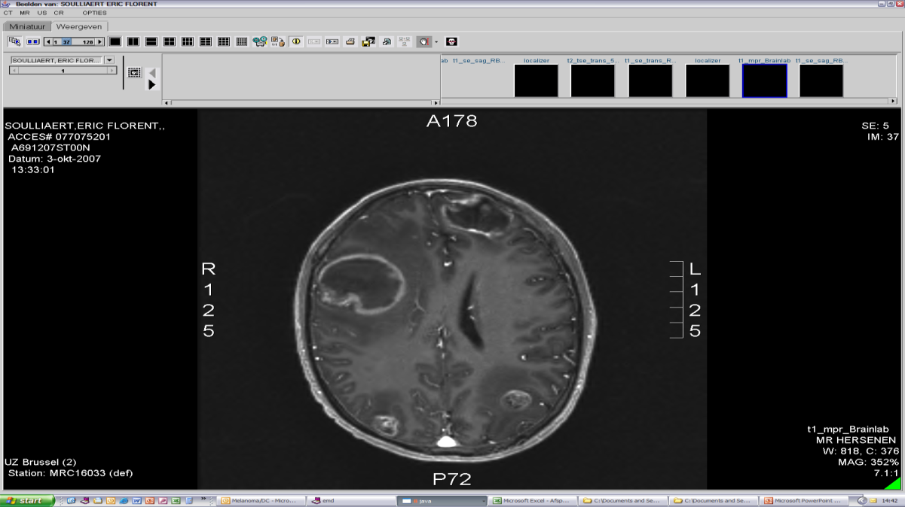
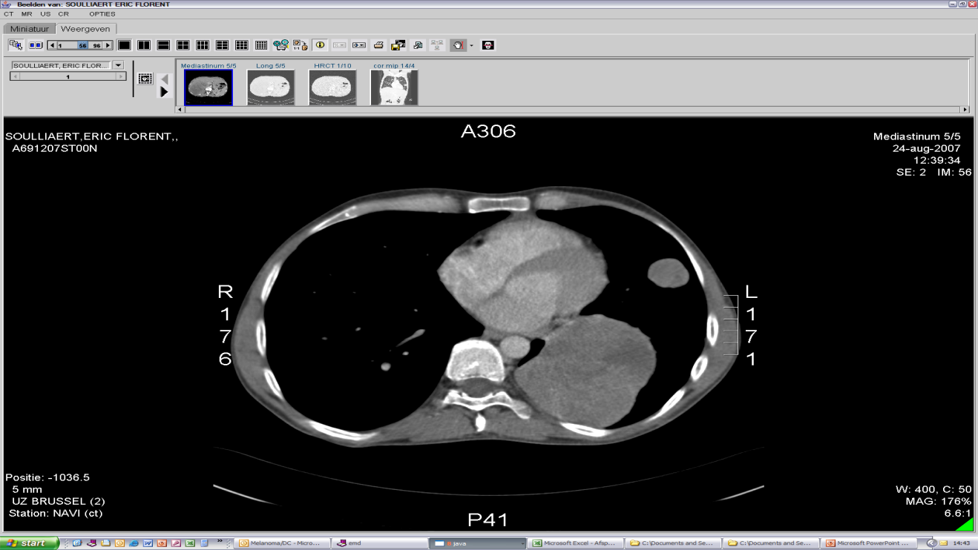
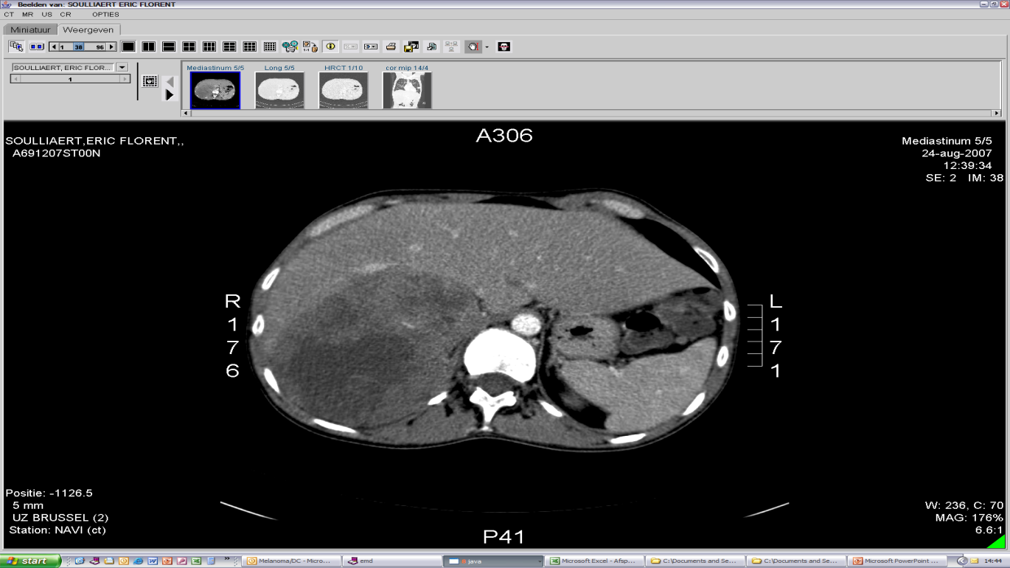
36-year-old male
Engineer, married
  Plans to have children
No health problems
  Runs marathons
Jun 2004: stage II melanoma
Sep 2006: recurrence lnn/lung
  Oct–Nov 2006: DTIC
  Feb 2007: WBRT
Nov 2007: death

Slide 26




CTA
Neo Ag
Stromal Cells
MSC
Differentiation Ag
CTL
CD8+ Tcell
CD28
Melanoma
TCR
CxCL1
CTL precursor
MHC-I
Immusuppressroenvironmention
COX2
Immature
DC
PGE2
IL-1b
IL-6
T_{h}1
CD4+ Tcell
M2
Macrophage
MHC-II
MHC-II
Endothelial Cells
T_{h}2
CD4+ Tcell
CD4+ Helper
T Cell
CRP
FAS-L
VEGF

Slide 27
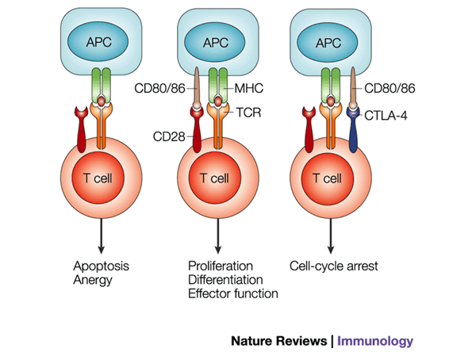
Cancer Testis Ag
Immusuppressive microenvironment
Neo Ag
FAS-L
Endothelial Cells
Differentiation Ag
MDSC
CTL
CD8+ Tcell
CTLA-4
PD-1
CD28
B7.1/B7.2
Melanoma
Cell
TCR
IFNγ
Granzyme
Perforin
CTL
CD8+ Tcell
IL-12 secretion
MHC I
Mature
DC
TGFβ
IL-10
PD-L1
PD-1
T_{h}1
CD4+ Tcell
IFN-γ
TNF-α
IL-2
MCP-1
IL-12
CD4+ Treg
M2
Macrophage
Stop
T_{h}2
CD4+ Tcell
IL-4
IL-5
IL-10
IL-13
IDO
Arginase

Slide 28

Cancer Testis Ag
Peptide/protein Vaccines
Private Ag
FAS-L
Immusuppressive microenvironment
Endothelial Cells
Differentiation Ag
MDSC
CTL
CD8+ Tcell
CTLA-4
Adoptive TIL Therapy
PD-1
Anti-CTLA-4 (Ipilimumab)
Intralesional therapy (e.g. T-VEC)
CD28
IL-2
IFNa2b
B7.1/B7.2
Melanoma
Cell
IFNγ
Granzyme
Perforin
TCR
CTL
CD8+ Tcell
IL-12 secretion
MHC I
Mature
DC
TGFβ
IL-10
DC
PD-L1
PD-1
T_{h}1
CD4+ Tcell
BRAF V600mut
Anti-PD1 (nivolumab, pembrolizumab)
anti PD-L1 (atezolizumab, avelumab, durvalumab )
Stop
IFN-γ
TNF-α
IL-2
MCP-1
IL-12
CD4+ Treg
M2
Macrophage
T_{h}2
CD4+ Tcell
Cyclofosfamide
Daclizumab (anti-CD25 mAb)
Denileukin diftitox (IL-2/diphtheria toxin fusion protein
IL-4
IL-5
IL-10
IL-13
IDO
Arginase
Inhibitors (IDO, galectin-3).

Slide 29
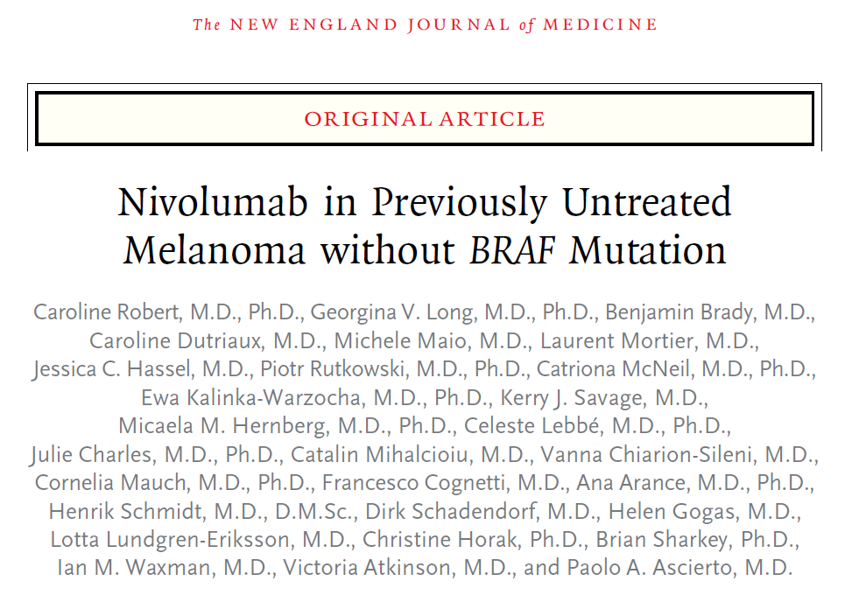
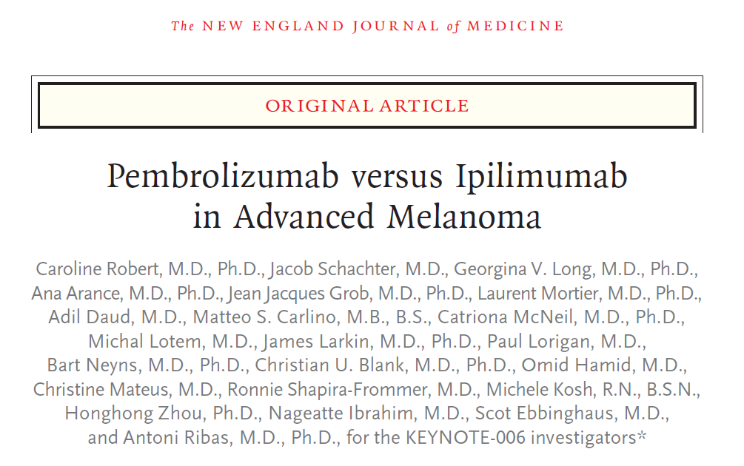
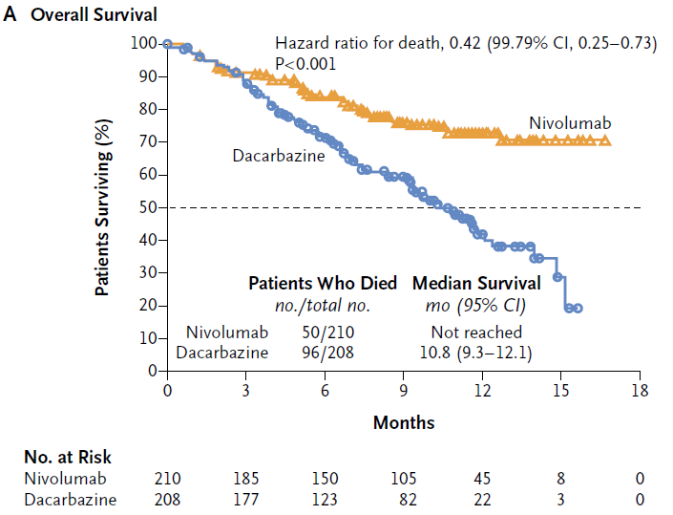
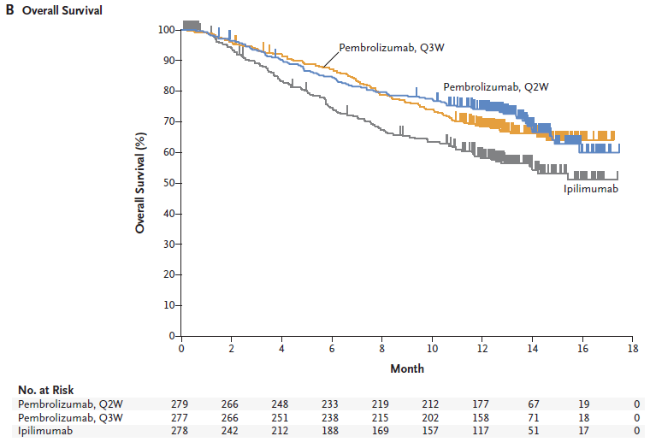


Immunotherapy with anti-PD-1 monocloncal antiodies (pembrolizumab, nivolumab) improves the overall survival of patients with advanced melanoma
Arm | Median (95% CI), mo | Rate at 12 mo | HR (95% CI) | P
Pembro Q2W | NR (NR-NR) | 84.8% | 0.63 (0.47-0.83) | 0.00052
Pembro Q3W | NR (NR-NR) | 87.8% | 0.69 (0.52-0.90) | 0.00358
Ipilimumab | NR (12.7-NR) | 74.5% | — | —

Slide 30
Pembrolizumab Expanded Access Program (EAP) for
Ipilimumab Pretreated Patients with Advanced Melanoma
Academic investigator sponsored observational clinical trial
  Aim = prospective collection of outcome data on pembrolizumab treated advanced melanoma patients at the University Hospital Brussel (Brussels, Belgium)
Pembrolizumab (Keytruda®, Merck Sharp & Dohme) 2 mg/kg Q3W
Key eligibility criteria:
  Unresectable AJCC stage III/IV melanoma
  Progressive disease following anti-CTLA-4 therapy (ipilimumab) and BRAF inhibitors (if BRAF V600-mutated)
  No active CNS metastases
Treatment continuation until
  Disease progression, unacceptable toxicity, withdrawal of consent
Yanina Jansen et al ECC 2015 and SMR 2015

Slide 31
Study status January 2016
Recruitment period: 1 September 2014 to 10 January 2016
Safety population: 108 patients who received >1 administration of pembrolizumab
Follow-up: median 33 weeks (range 1-71)
# Patients still on treatment: 54
# Patients off-pembrolizumab-treatment: 54
  Stopped pembrolizumab in complete remission: 4
  Progressive disease on pembrolizumab: 50
    Alive: 12
    Dead (all with PD): 38
Yanina Jansen et al ECC 2015 and SMR 2015

Slide 32
Baseline Patient Characteristics
 |  | Number | (%)
Patients (safety population)* |  | 107
Median age | (year, range) | 58 (26-93)
Gender | Male/Female | 39/68 | 36/64
Primary | Skin/mucosal/unknown/uveal | 84/3/13/7 | 79/3/12/7
ECOG PS | 0/1/2 | 69/26/12 | 64/24/141
AJCC M-stage | IIIC/M1a/M1b/M1c | 8/5/7/86 | 7/5/7/80
Brain metastases | Yes/No | 33/74 | 31/69
BRAF mutation | mutant/WT/unknown | 45/48/2 | 42/45/2
*Safety population: defined as all patients who received at least one dose of pembrolizumab
Yanina Jansen et al ECC 2015 and SMR 2015

Slide 33
Prior melanoma therapies
Type of therapy (other than ipilimumab) | No. | (%)
Combo BRAF/MEK inhibitor | 33 | (37)
BRAF inhibitor | 27 | (30)
MEK inhibitor | 1 | (1)
Cytotoxic chemotherapy | 36 | (40)
Autologous dendritic cell therapy | 12 | (13)
IFN alpha 2b (adjuvant) | 10 | (11)
Yanina Jansen et al ECC 2015 and SMR 2015

Slide 34
Adverse events of special interest
 | All grades |  | Grade 3-4
 | No. | (%) | No. | (%)
Any AE | 73 | (83) | 9 | (10)
Fatigue | 26 | (29) | 3 | (3)
Thyroid disorders | 11 | (12) | 1 | (1)
Pruritus | 8 | (9) | 0 | (0)
Vitiligo | 7 | (8) | 0 | (1)
Skin rash | 7 | (8) | 0 | (0)
Fever | 6 | (7) | 0 | (0)
Diarrhea/Colitis | 6 | (7) | 1 | (1)
Hepatitis | 3 | (3) | 3 | (3)
Pleuritis | 3 | (3) | 0 | (1)
Uveitis | 2 | (2) | 0 | (1)
Lymphocytic meningitis/hypofysitis | 1 | (1) | 1 | (1)
Orchititis | 1 | (1) | 0 | (0)
Yanina Jansen et al ECC 2015 and SMR 2015

Slide 35
Tumor response by irRC
N = 66 patients evaluable for response
N = 6 patients no measurable disease at baseline
N = 16 patients insufficient follow-up (<12weeks of treatment)
N = 7 clinically progressive before first CT-based response assessment
 | No. | (%)
irCR | 7 | (11) | 23% ORR | 38% DCR
irPR | 8 | (12)
irSD | 10 | (15)
irPD | 41 | (62)
ORR: objective response rate by immune-related response criteria (irRC); DCR: disease control rate by irRC
Yanina Jansen et al ECC 2015 and SMR 2015
Notes:
Unknown
Mucosal
Uveaal
Apart

Slide 36
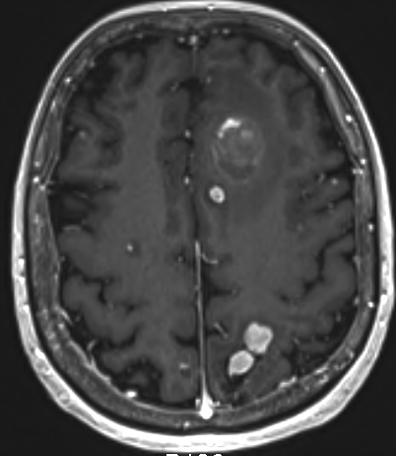
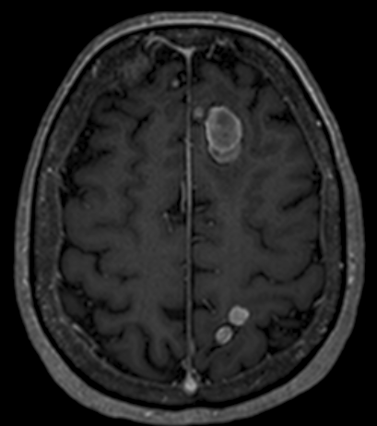
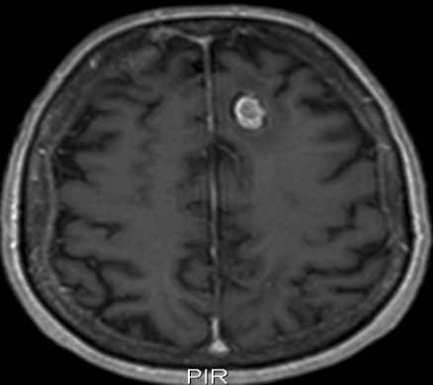
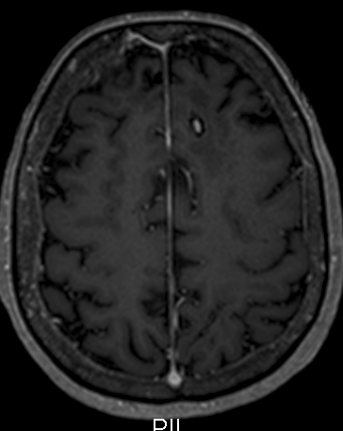
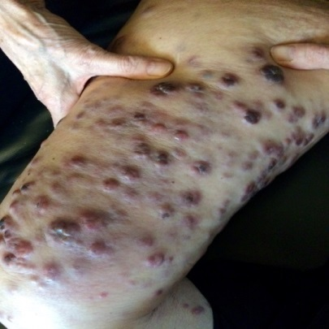
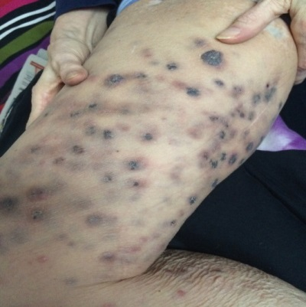
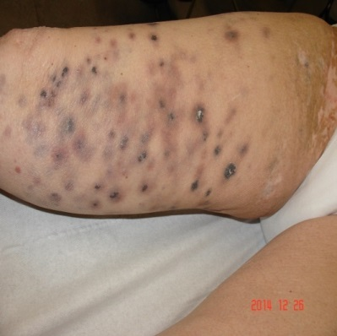
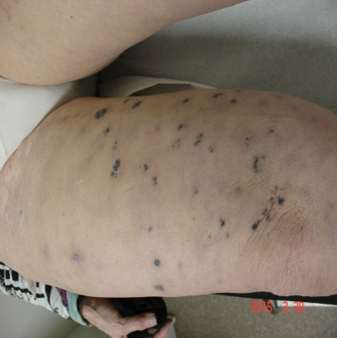
Response to pemrolizumab (MNP) in a patient with melanoma brain metastases and high tumor burden
72y F, stage IV-M1c
BRAF V600E, failed Vemurafenib, WBRT
Baseline CRP 6 mg/dl, LDH 836 mg/dl
17NOV2015
15JAN2015
30MAR2015
26JUN2015
2 administrations of pembrolizumab
17NOV2014
9DEC2014
26DEC2014
30MAR2015

Slide 37
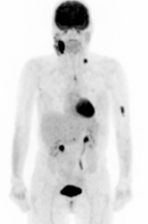
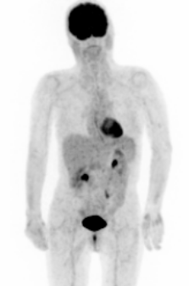
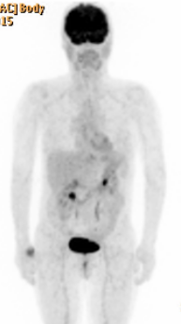
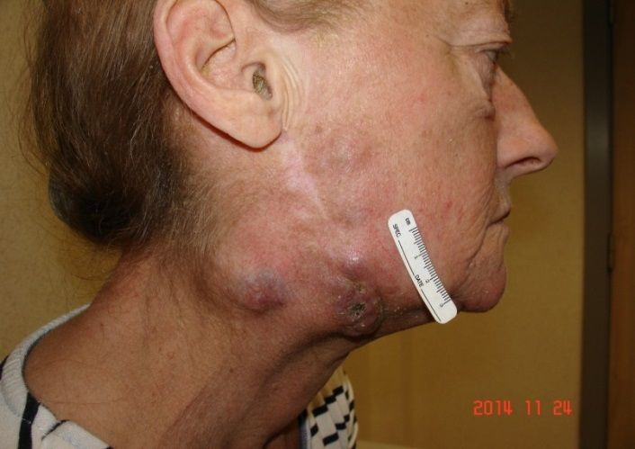
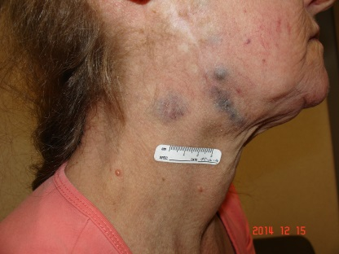
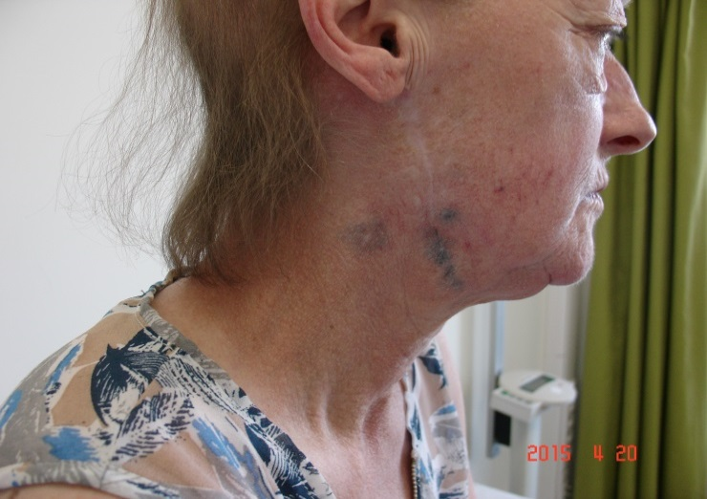
Case illustration
57y F, stage IV-M1c BRAF V600E
26NOV2014
20JAN2015
14APR2015
1 administration of PEM
24NOV2014
15DEC2014
11MAY2015

Slide 38
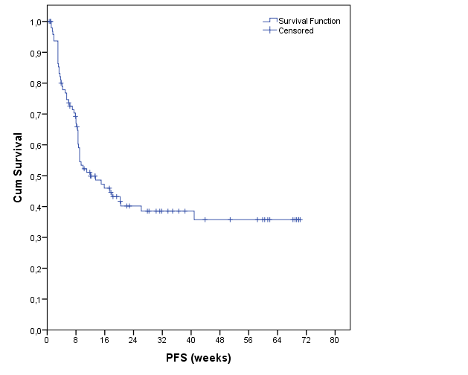
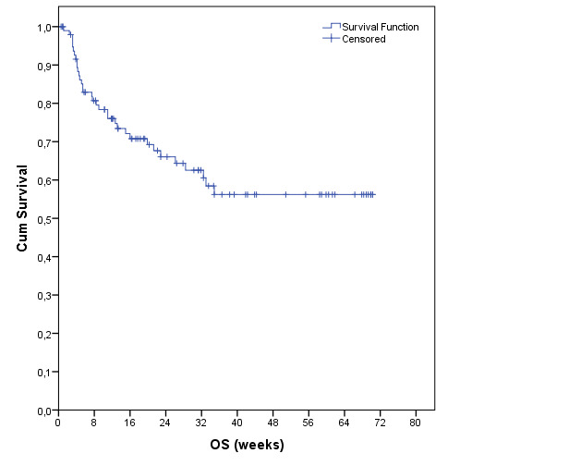
Progression-free and overall survival
Median 12 wks (5-18)
1y PFS: 35% (95% CI 46-24)
Median: not reached
1y OS: 56% (95% CI 68-44)
Pembrolizumab EAP experience UZ Brussel – Update 10 January 2016

Slide 39
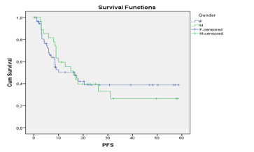
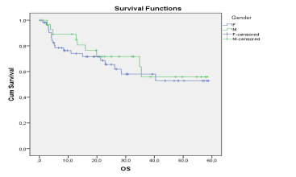
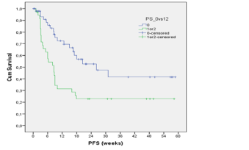
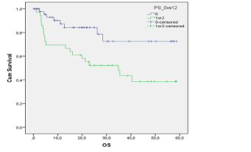
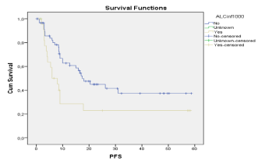
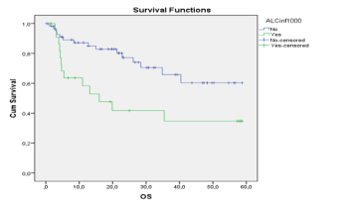
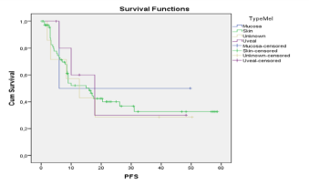
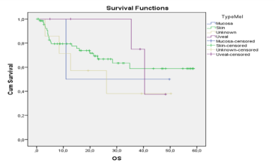
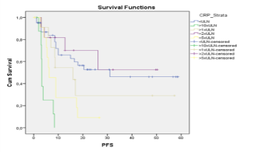
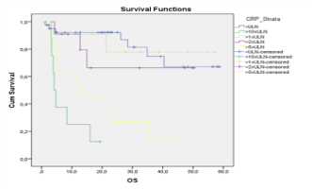
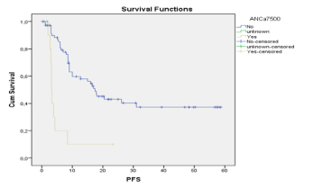
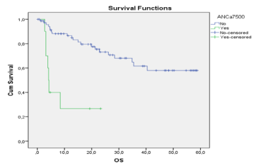
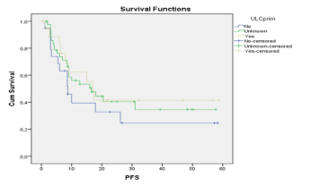
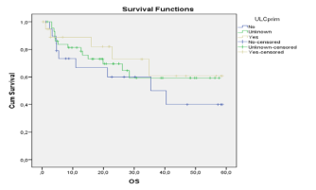
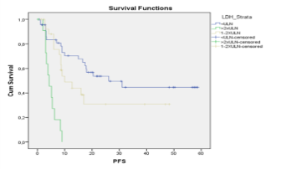
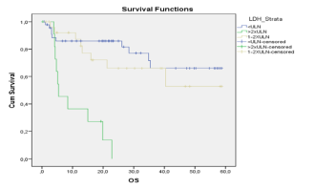
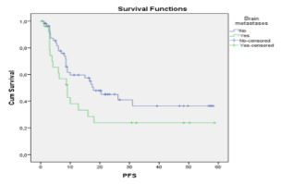

Correlation of survival with baseline co-variables
Gender
Asymptomatic vs Symptomatic
Absolute Lymphocyte Count (ALC)
Type of melanoma
C-reactive protein (CRP)
Absolute Neutrophil Count (ANC)
Ulceration of primary
Lactate dehydrogenase (LDH)
Brain Metastases
Yanina Jansen et al ECC 2015 and SMR 2015

Slide 40


Symptomatic vs asymptomatic patients
P ,003
P ,007
P .007
Yanina Jansen et al ECC 2015 and SMR 2015

Slide 41


Brain metastases
P ,079
P ,038
Yanina Jansen et al ECC 2015 and SMR 2015

Slide 42



C-reactive protein (CRP)
CRP (mg/dl)
10x ULN
5x ULN
ULN
Patients
Yanina Jansen et al ECC 2015 and SMR 2015

Slide 43


CRP: Background
Yanina Jansen et al ECC 2015 and SMR 2015

Slide 44


Lactate Dehydrogenase (LDH)
<ULN
>2xULN
LDH (mg/dl)
1-2xULN
1-2xULN
>2xULN
>2xULN
Patients
Yanina Jansen et al ECC 2015 and SMR 2015

Slide 45


Absolute Lymphocyte Count (ALC)
Yanina Jansen et al ECC 2015 and SMR 2015

Slide 46



Poor Prognosis Population
CRP >10xULN and/or LDH >2xULN and/or ALC <500/mm³
No. = 18 patients (20% of the study population)
P <0,001
P <0,001
Yanina Jansen et al ECC 2015 and SMR 2015

Slide 47




Baseline prognostic factors excluding patients with a poor prognosis [N: 68]
CRP >5xULN
Brain Metastases
P 0,047
P 0,037
4
3
18
CRP
>5xULN
Brain Metastases
P 0,002
P 0,007
Yanina Jansen et al ECC 2015 and SMR 2015

Slide 48
Conclusion
“Real life data” obtained with pembrolizumab in pretreated melanoma patients confirm the safety and activity profile as established in prospective studies (incl. clinically meaningful activity in patients with brain metastases and rare subtypes)
An encouraging “plateau” observed in the survival probability curves 6 to 9 months after intitiating therapy
  Identification of a “poor prognosis” subgroup (LDH >2x ULN and/or CRP >10x ULN and/or ALC < 500 mm²) that is in need of alternative treatment options or should be considered for pembrolizumab treatment at an earlier stage of their disease
  The future availability of anti-PD-1 monoclonal antibodies (e.g. pembrolizumab) as a first-line treatment option will allow achieving unprecedented results in the treatment of advanced melanoma

Slide 49

Acknowledgements
The patients who consented to participate in these clinical trials, their families and HCPs
Medical Oncology, UZ Brussel
  Dr Yanina Jansen, Dr Max Schreuer
  Katrien van den Bossche, Kathleen Mooren

