Slide 1
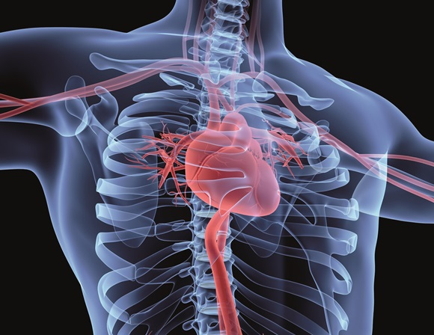
DIASTOLE
4D imaging and cardiac modelling
for in-silico trials of cardiovascular devices

Slide 2
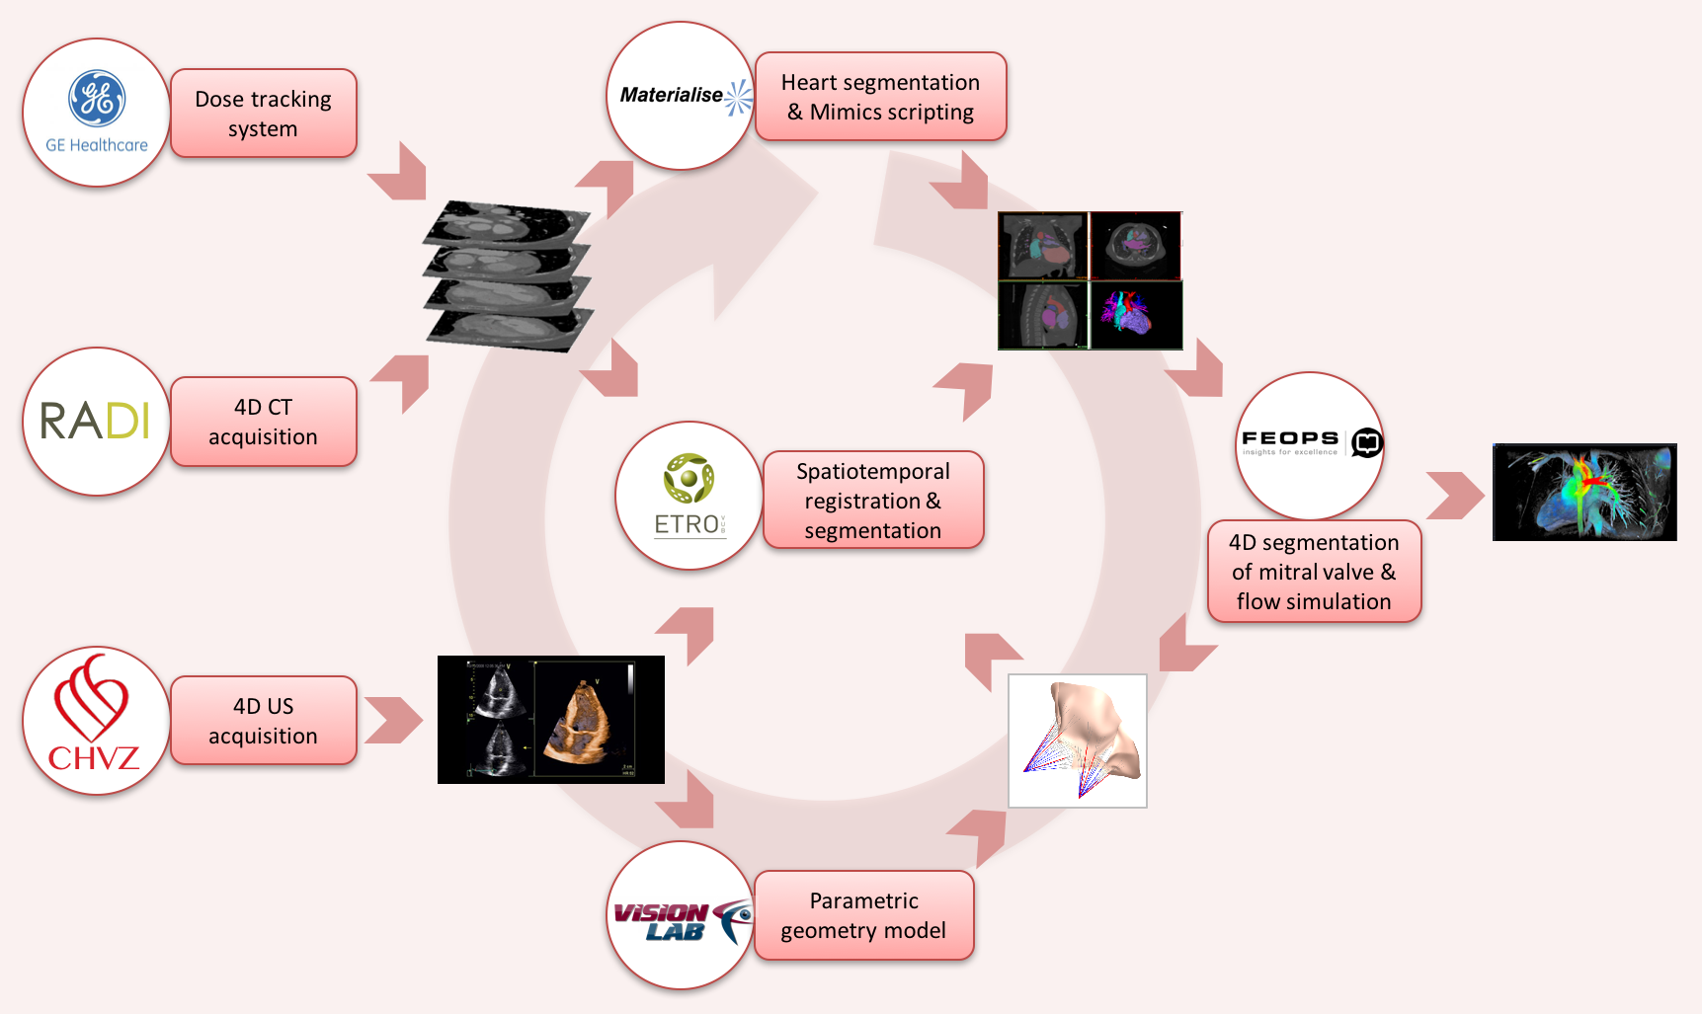

Slide 3
Clarification of the process
A pipeline from acquisition to flow simulation
4D CT Image acquisition
3D segmentation of the heart
4D registration to estimate the motion
4D statistical modelling
4D simulations
UZ Brussel developed novel dose metrics for this type of acquisition
GE integrated them in a software called dosewatch
ETRO developed 4D segmentation
Amongst other allowing to map 3D segmentation to the 4D sequence
By making a 4D model, we can describe the shape (3D) and motion (4th D is time) characteristics of the heart for a population
These can be patient-specific (to plan an intervention)
Or based on a statistical model, to design or evaluate and medical implant
Novelty
Materialise can reliably segment the heart in 3D (Mimics software)
Novelty
Materialise integrated registration their mimics software
They can repeat this on every frame of a 4D, but this has some downsides
Combined with their 3D segmentation this gives an alternative to 4D segmentation
Novelty
Novelty
4D simulations by FEOPS
4D models by Vision lab
Such statistical models may be more relevant for medical device makers

Slide 4
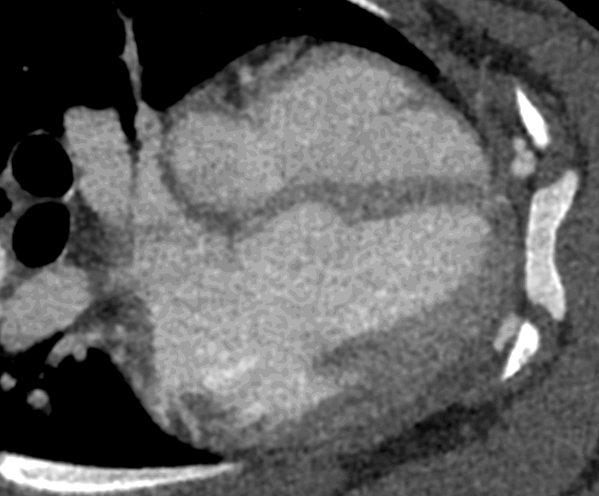
4D CT images
Contrast-enhanced images

Slide 5
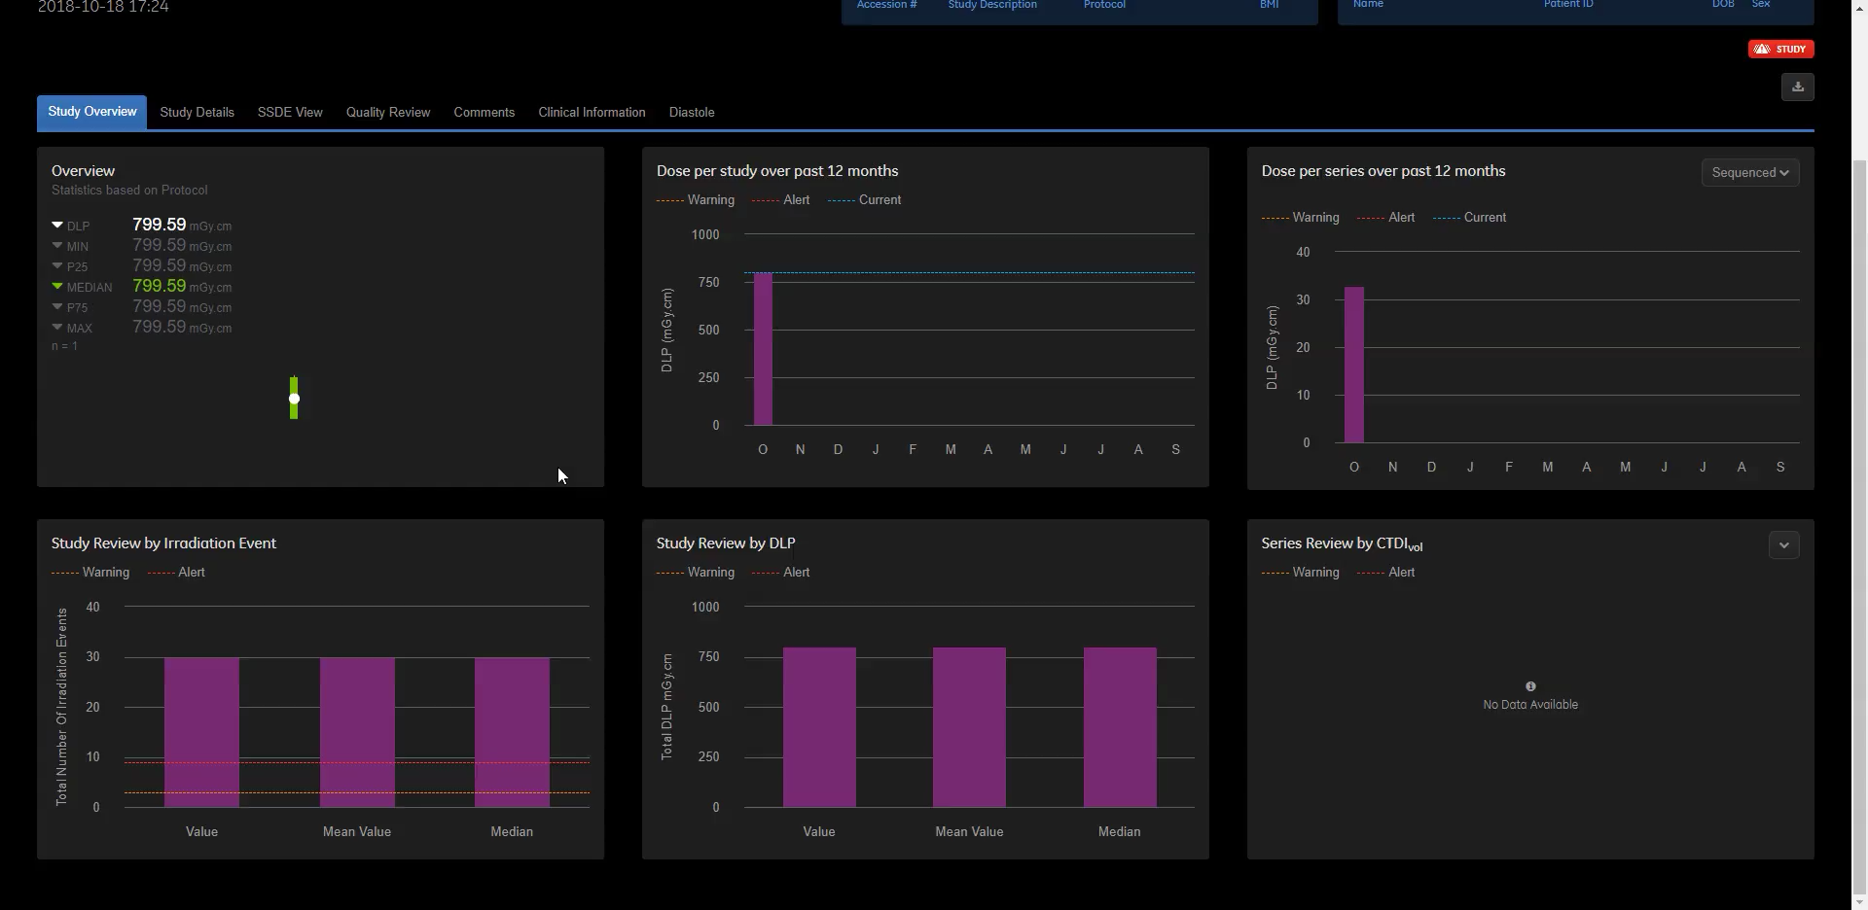
dose prediction and tracking for 4D acquisitions
This involves novel skin dose metrics

Slide 6

3D segmentation
First part shows 3D segmentation, then registration is launched

Slide 7
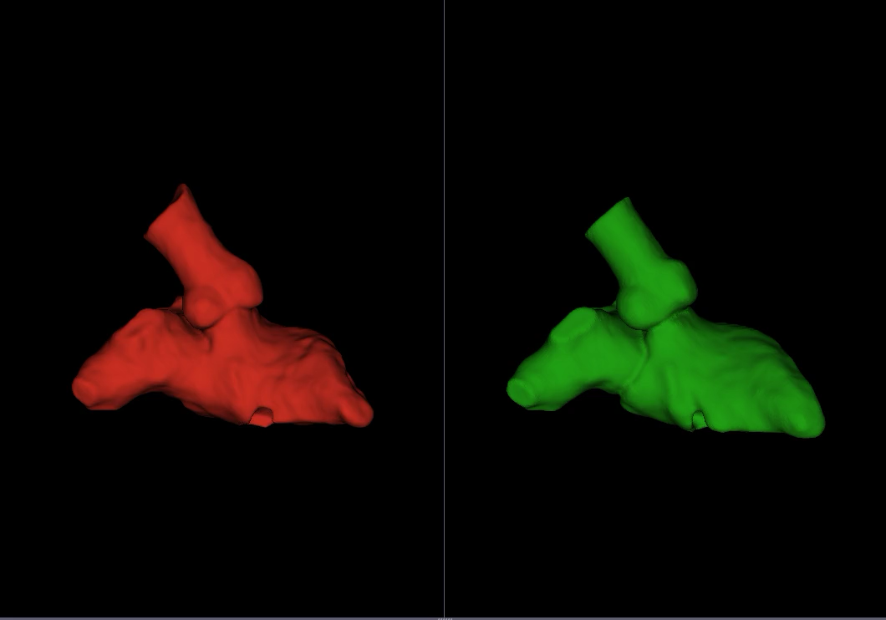
4D registration
This images shows the blood pool (inner heart wall motion)
Estimation through registration
Ground truth

Slide 8
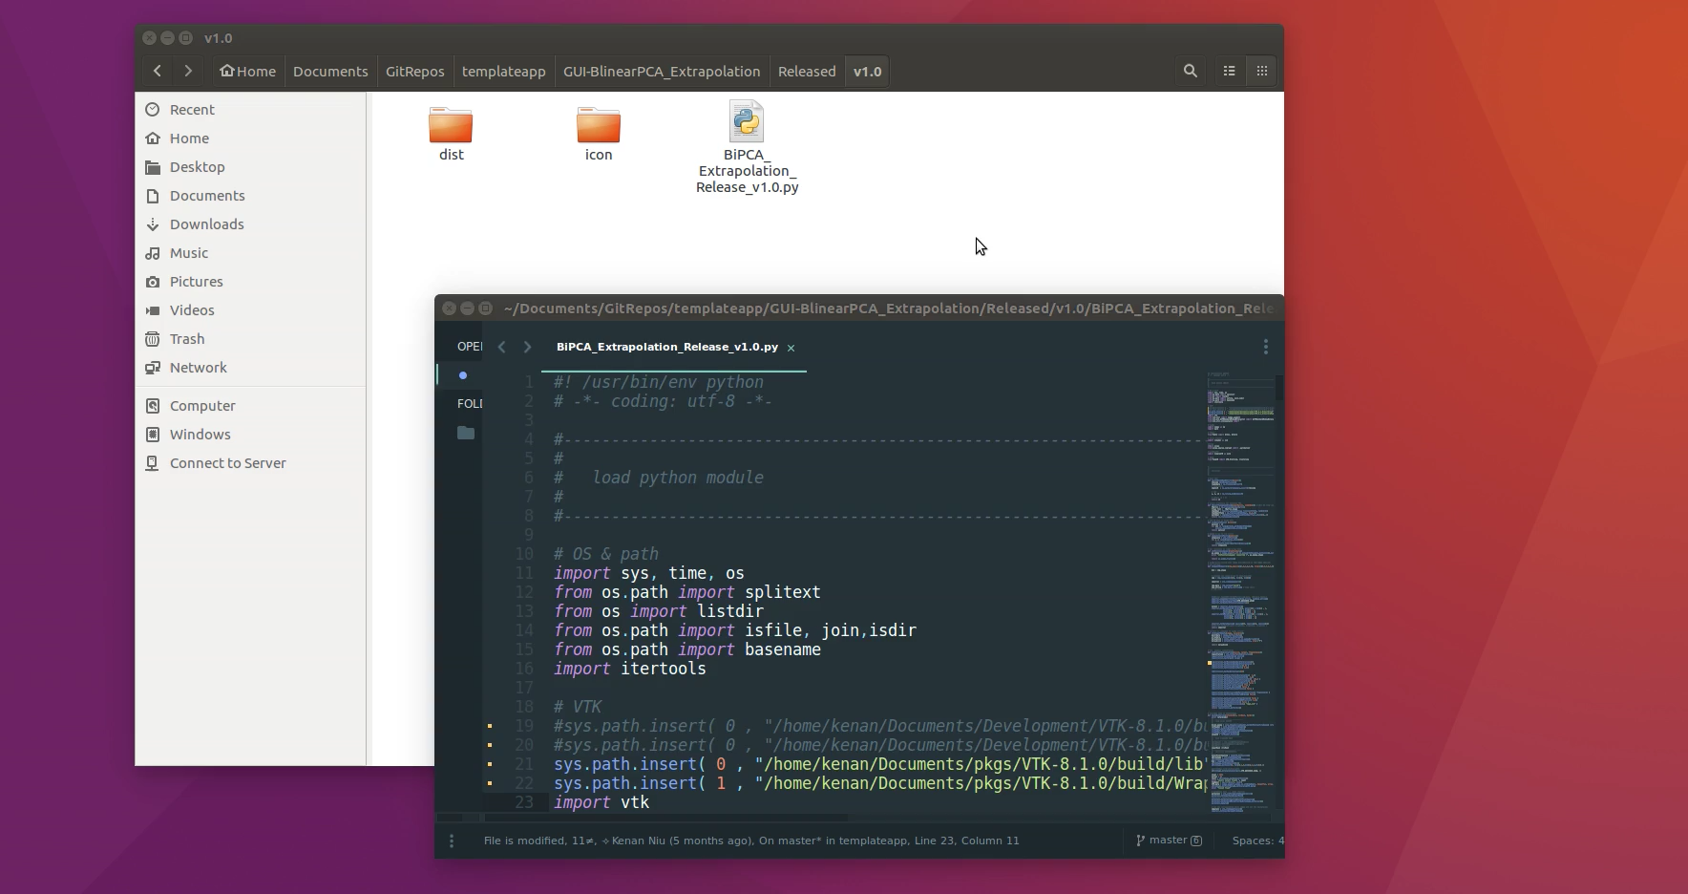
4D Statistical Modelling

Slide 9
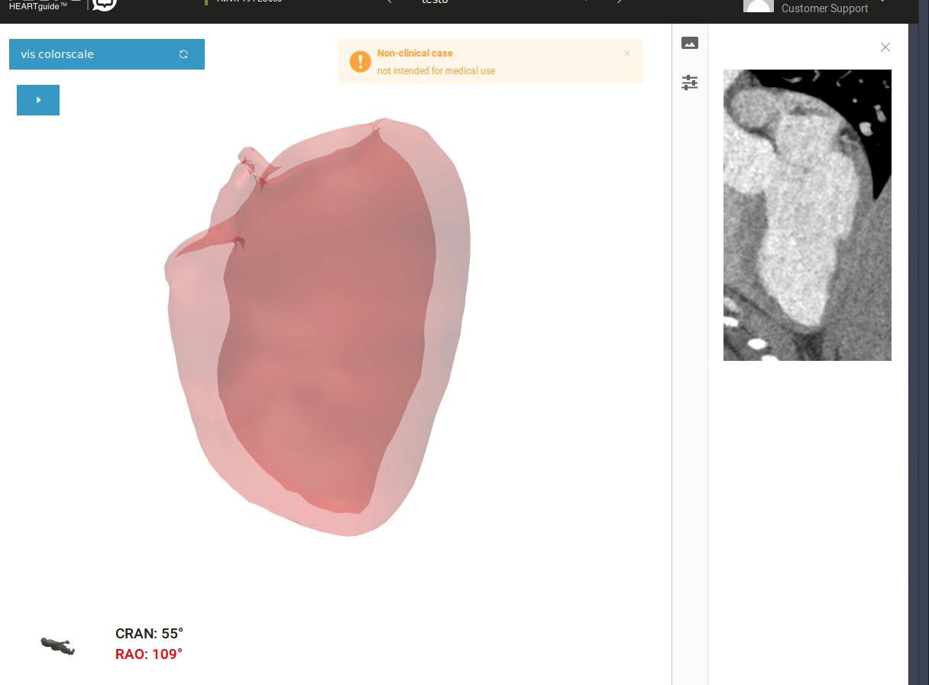
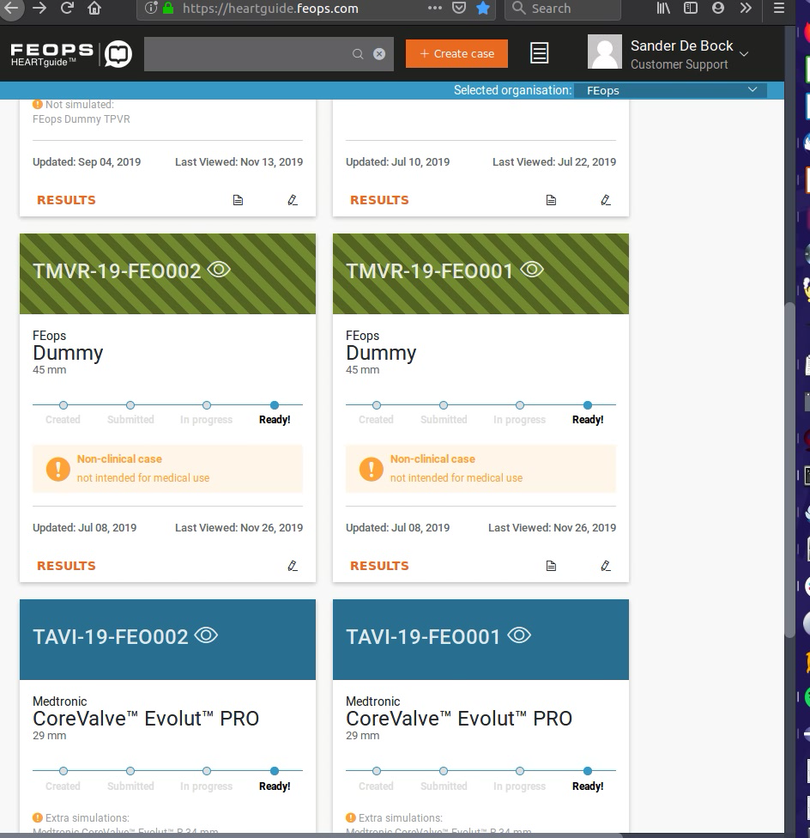
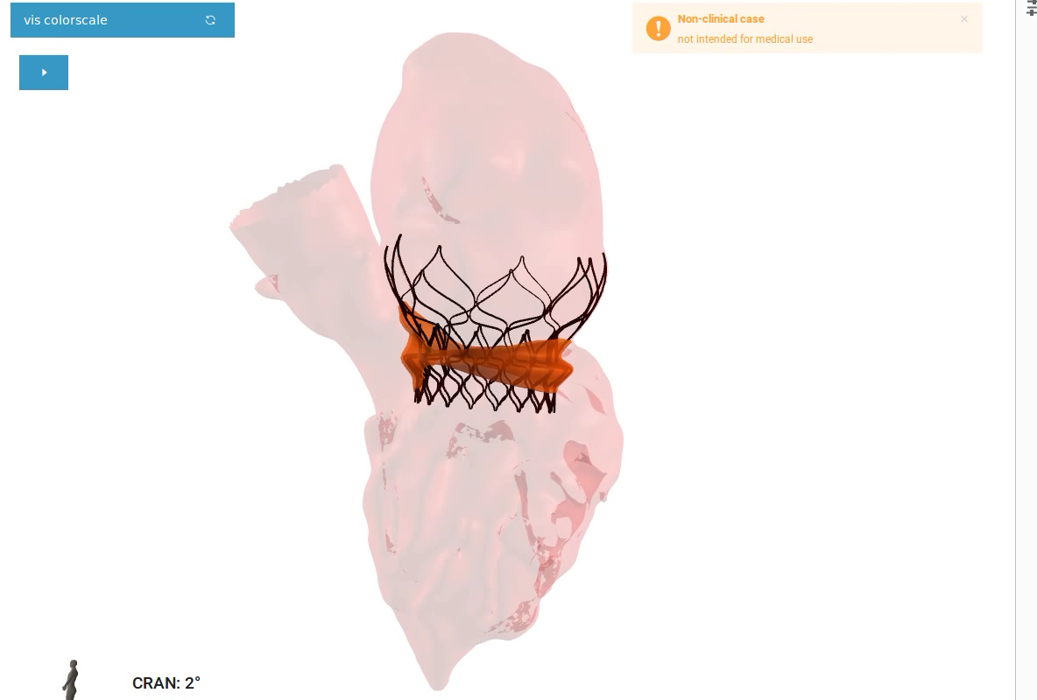
4D simulations

