Slide 1

ING Economic Focus
Impact of AI on the Belgian economy
Charlotte de Montpellier
Senior Economist, ING Economic Research

Slide 2
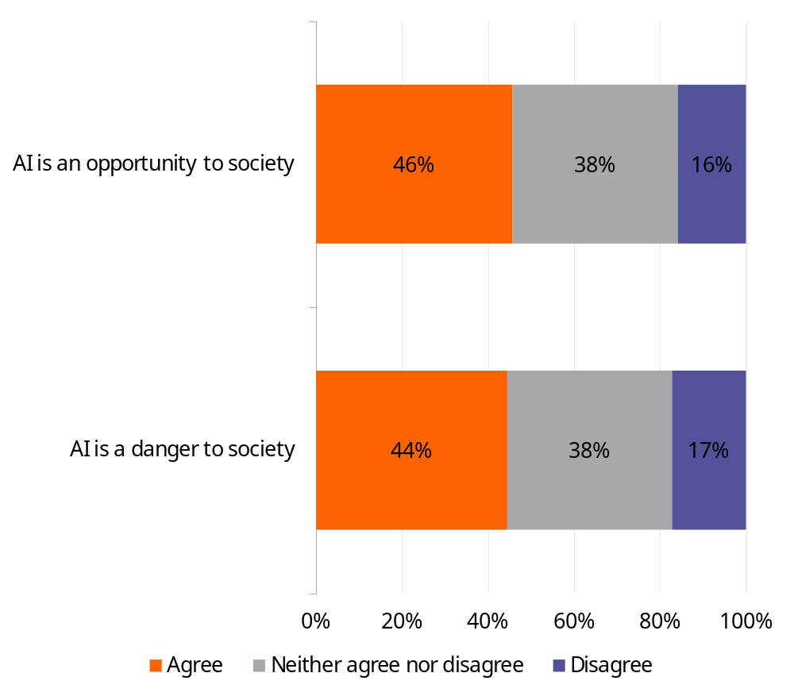
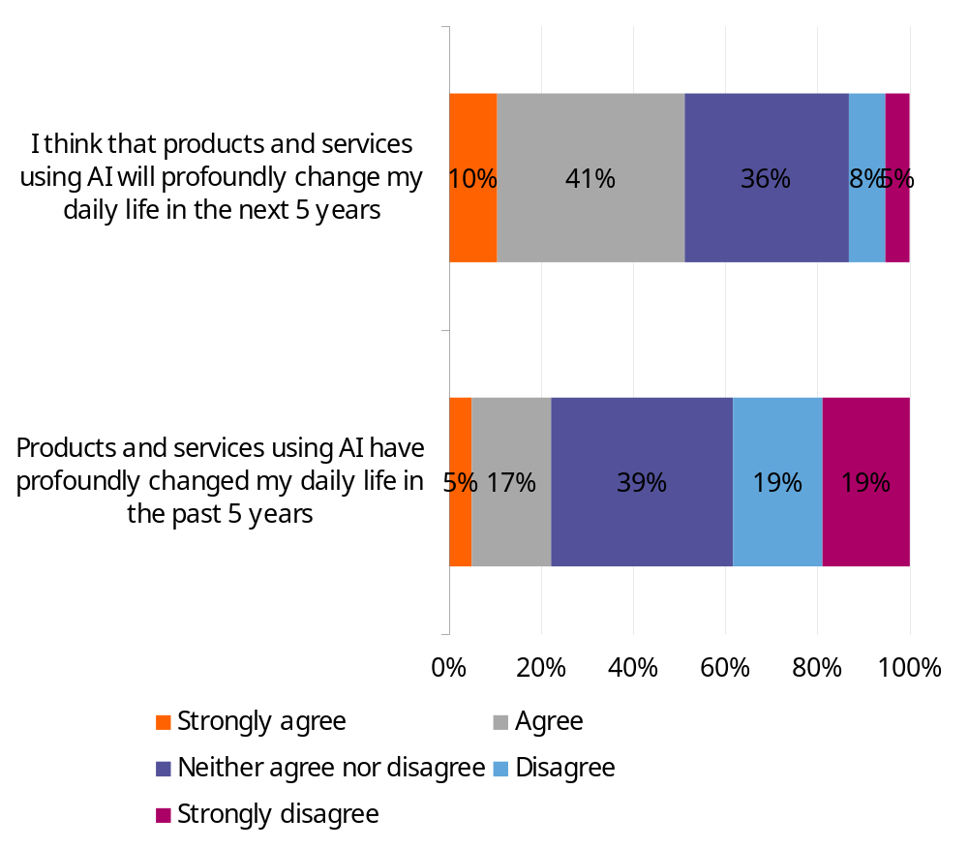
Belgians remain ambivalent about artificial intelligence
Belgians see AI as a potential threat, but also an opportunity
Half of Belgians expect AI to profoundly change their daily lives
Source: ING Consumer Survey, conducted by Ipsos on a representative panel of 1002 Belgians

Slide 3
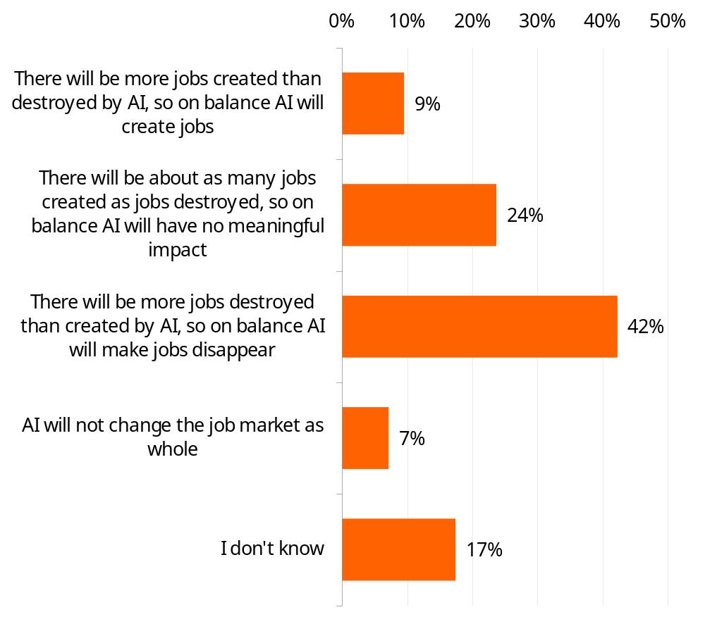
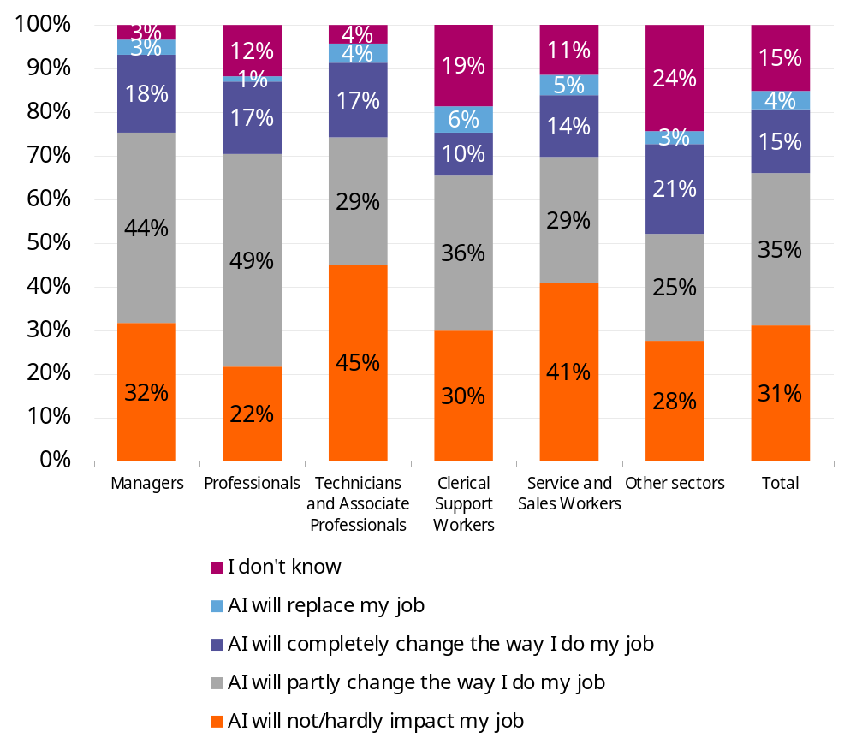
Belgians believe AI will have a negative impact on the job market, but not on their own job
“What impact do you think the use of artificial intelligence (AI) in general will have on the overall job market in your country in the next 5 years?”
“What impact do you think the use of artificial intelligence (AI) in general will have on your own current job in the next 5 years?” (Question asked of people who say they have a job)
Source: ING Consumer Survey, conducted by Ipsos on a representative panel of 1002 Belgians

Slide 4
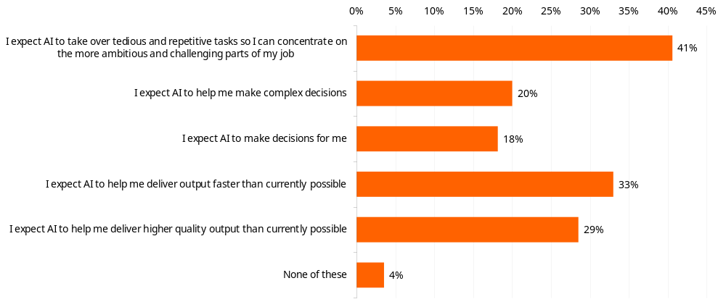
AI should help mainly with repetitive tasks and improving efficiency, according to Belgians
‘How do you think the use of artificial intelligence (AI) in general will affect your own current job in the next five years?’ (Question asked of those who say they have a job)
Source: ING Consumer Survey, conducted by Ipsos on a representative panel of 1002 Belgians

Slide 5
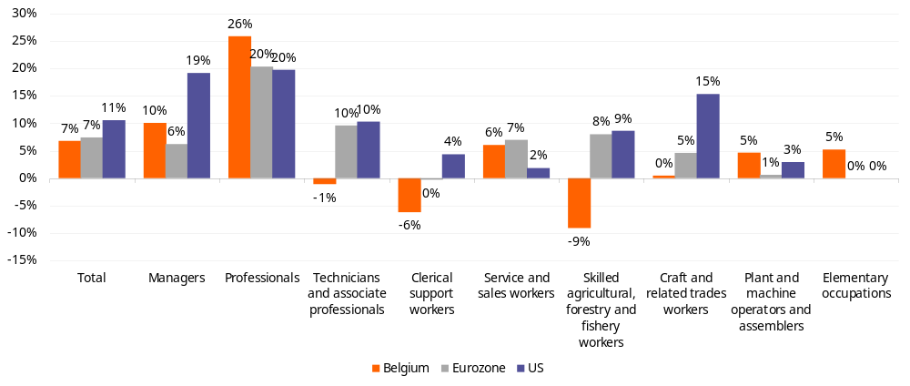
The fear that automation would lead to higher unemployment did not materialize over the last decade, on the contrary
% change of number of employed persons between 2012 and 2019, by occupation
Frey and Osborne in 2013 :
“47% of jobs at substantial risk of being automated”
➔ 10 years, robots have clearly not replaced half of all jobs
Source: Eurostat, Ilostat; ING Research Calculations.

Slide 6
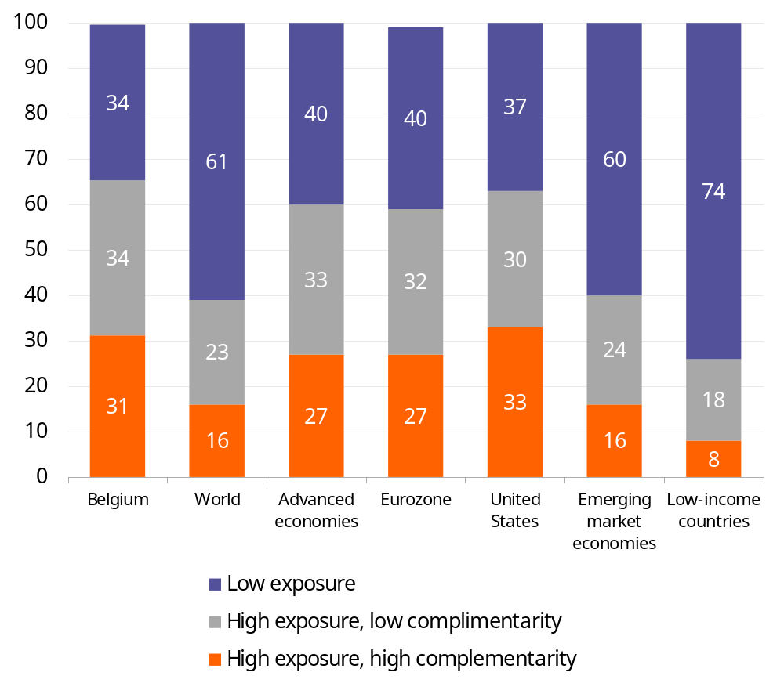
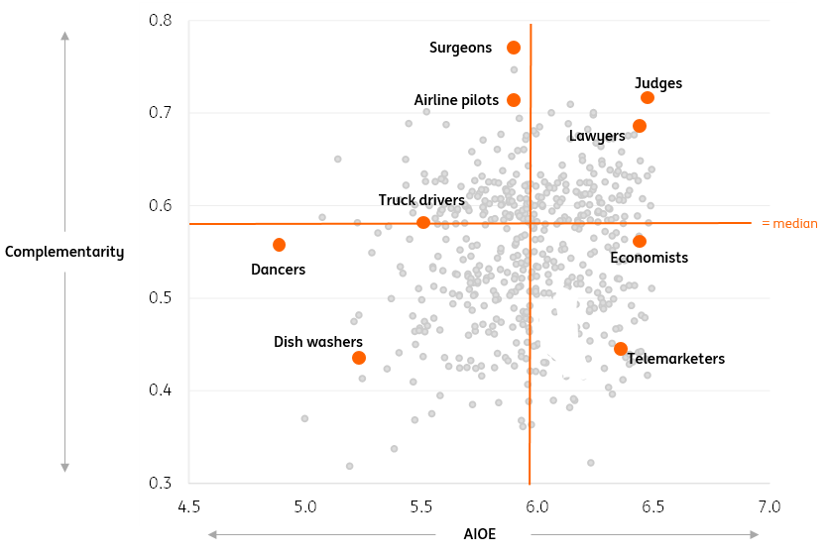
We believe AI will fundamentally transform most of the jobs that exist today
Share of employment by AI exposure, in percent
Conceptual diagram of AI Occupational Exposure (AIOE) and Complementarity θ
1.7 millions Belgians
1.6 millions Belgians
Source: Felten, Raj, and Seamans (2021); Pizzinelli and others (2023); IMF; ING Research Calculations.

Slide 7
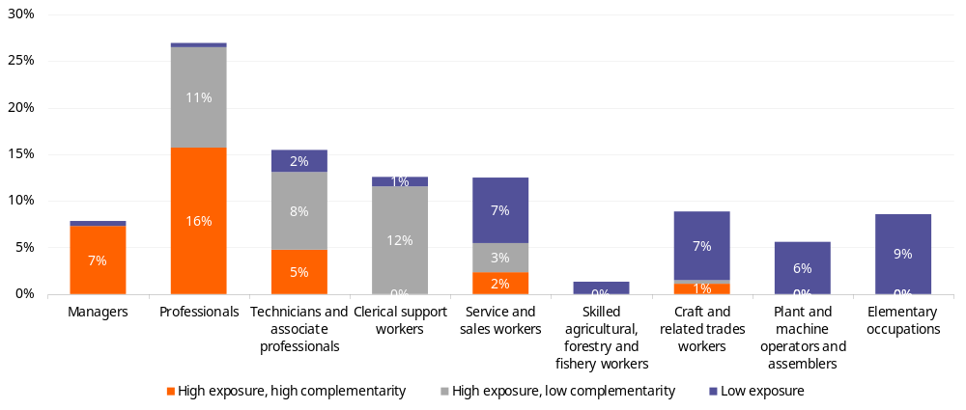
Certain types of occupation are much more likely to be impacted by AI
Detailed employment share by exposure and complementarity in Belgium
(% of total employment)
Source: Eurostat, IMF, ING calculations

Slide 8
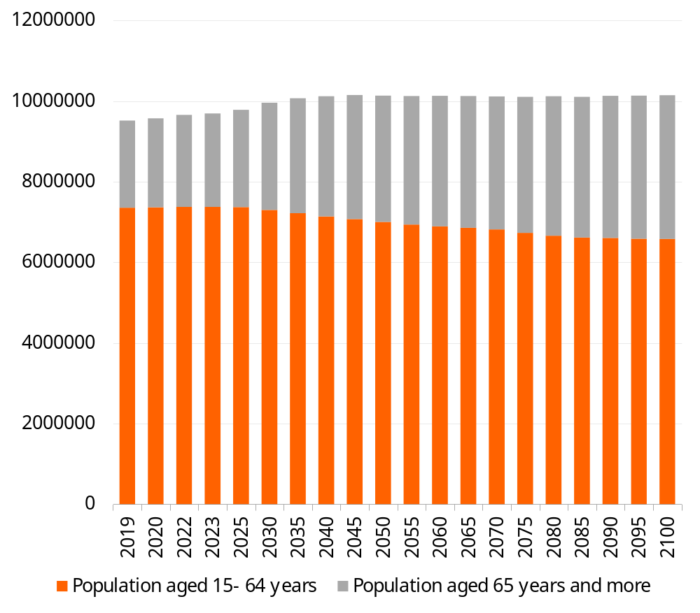
AI is unlikely to lead to mass unemployment
AI have the potential to fundamentally transform a significant part of the jobs that exist today
    This transformation will be gradual
Jobs is not the same as workers.
AI will
    Destroy some jobs
    Create new types of jobs
    Enhance some existing jobs
  ➔ Effects on employment will depend on the characteristics and adaptability of the workers
Ageing: the supply of labor is set to fall
    ➔ Unlikely that AI will have a significant impact on unemployment
Population projections for Belgium, Eurostat
65 years +
+54% in 2100 vs 2023
15 – 64 years
-11% in 2100 vs 2023
Source: Eurostat, ING calculations

Slide 9
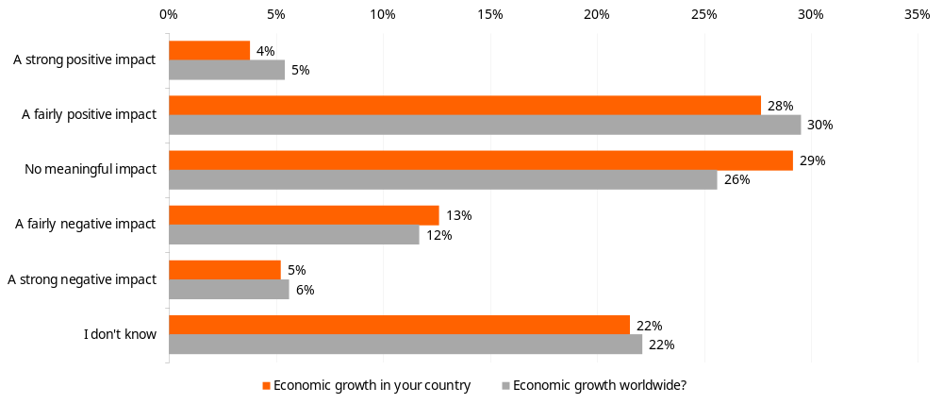
AI will have a positive impact on economic growth, say Belgians
“Over the next 5 years , what impact do you think the use of artificial intelligence (AI) in general will have on…”
Source: ING Consumer Survey, conducted by Ipsos on a representative panel of 1002 Belgians

Slide 10
No productivity boom yet
Average annual growth of labour productivity (real GDP per hour worked)
It takes time for a productivity boom to happen
    In the past, ~20 years after the emergence of the new technology
Productivity growth tend to follow a J-curve :
    ➔ productivity growth first declines during the first phases of the diffusion of the new technology before increasing in a second phase
A productivity boom is usually preceded for 2 to 3 years by a rise in investment in equipment enabling the new technology to be used.
    But no sign of a boom in investment yet
Source: OECD, ING calculations

Slide 11
A productivity boom is likely, but not immediately and not on a massive scale
IMF, Goldman Sachs: ↑ of productivity at country level ≥ 1.5 pp increase in workers’ average annual productivity growth rate over a 10-year period after the start of the productivity boom
    Based on firm-level studies
    Do not take into account productivity “leakages”
Our view: we believe that this will take longer, be more gradual and that the total impact is likely to be lower, though still significant
    Maximum 1 pp of increase in workers’ average annual productivity growth rate
    Other factors, such as the ageing of the population and the decline in productivity gains from previous innovations, will work in the other direction and weigh on productivity growth
    ➔ We expect annual productivity growth, and therefore the economy's potential growth rate, to increase over the next few years, but by around 0.1 to 0.5 percentage points.

Slide 12
During previous productivity shocks, the ICT sector was the main driver of productivity gains
Total factor productivity contributions to output growth by sectors in private business in the US
1st stage: 60% of productivity gains due to the ICT sector
2nd stage: productivity gains spread to the economy as a whole, but ICT sector still accounted for 1/3 of total productivity gains
Source: US Bureau of Labour Statistics, ING calculations

Slide 13
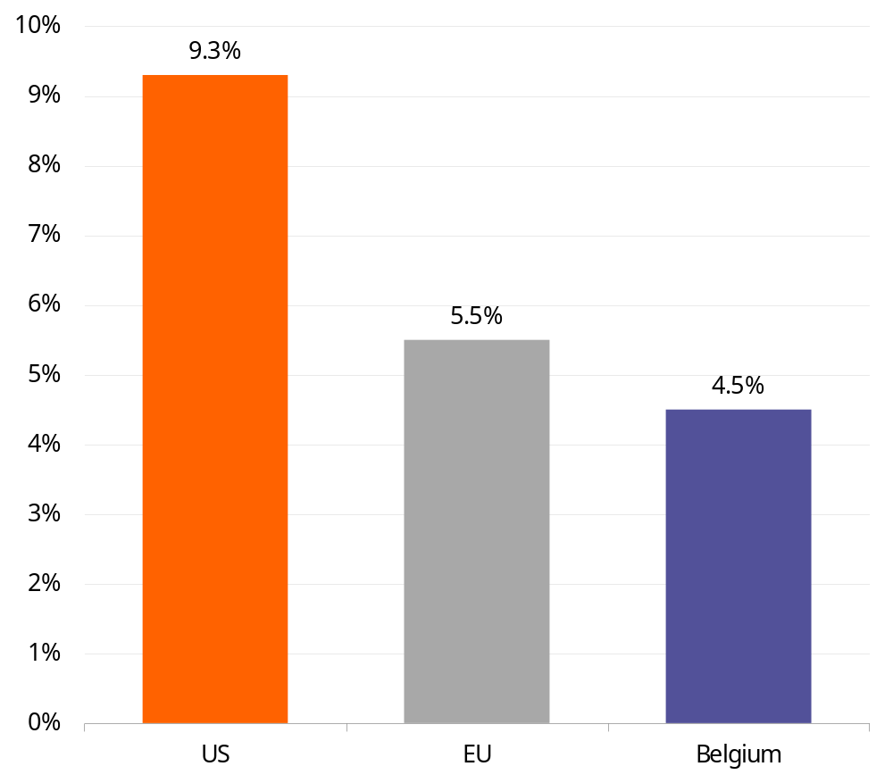
The United States is set to outperform Europe
Size of IT sector (as % of GDP)
Europe is likely to benefit much less from the productivity shock than the United States because
    Less developed ICT sector
    Less investment in AI
    Stricter data protection regulations
    Greater regulatory pressure
Source: Eurostat, Statista

Slide 14
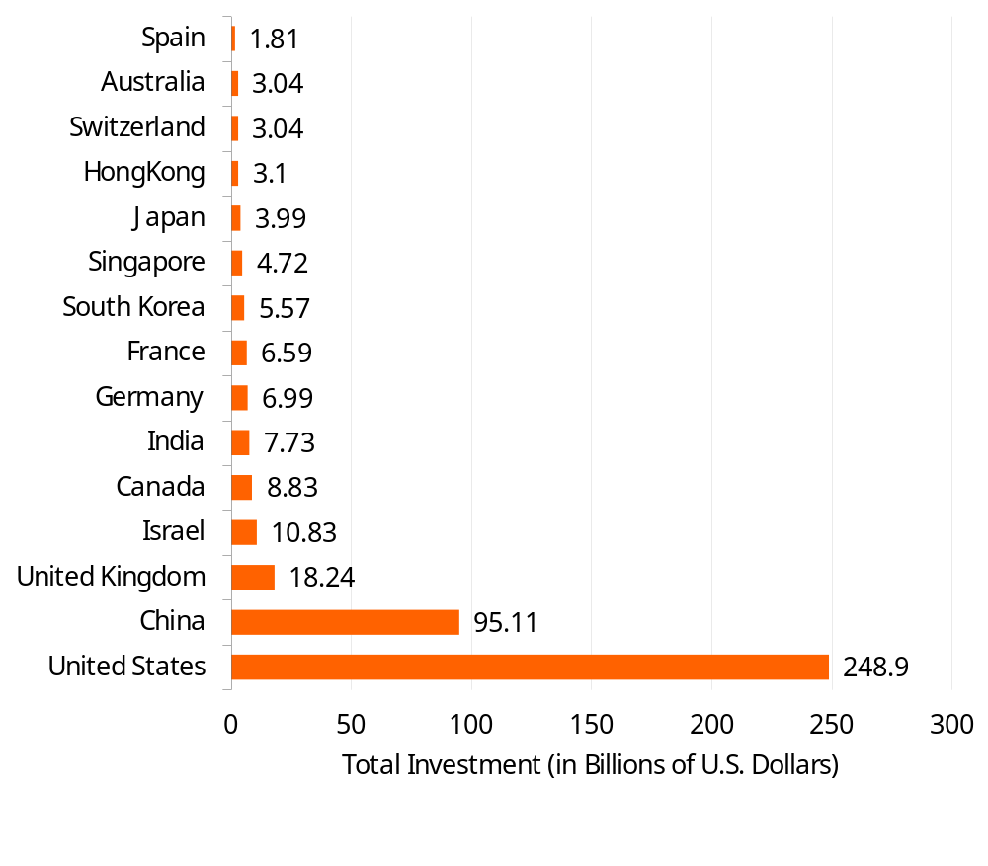
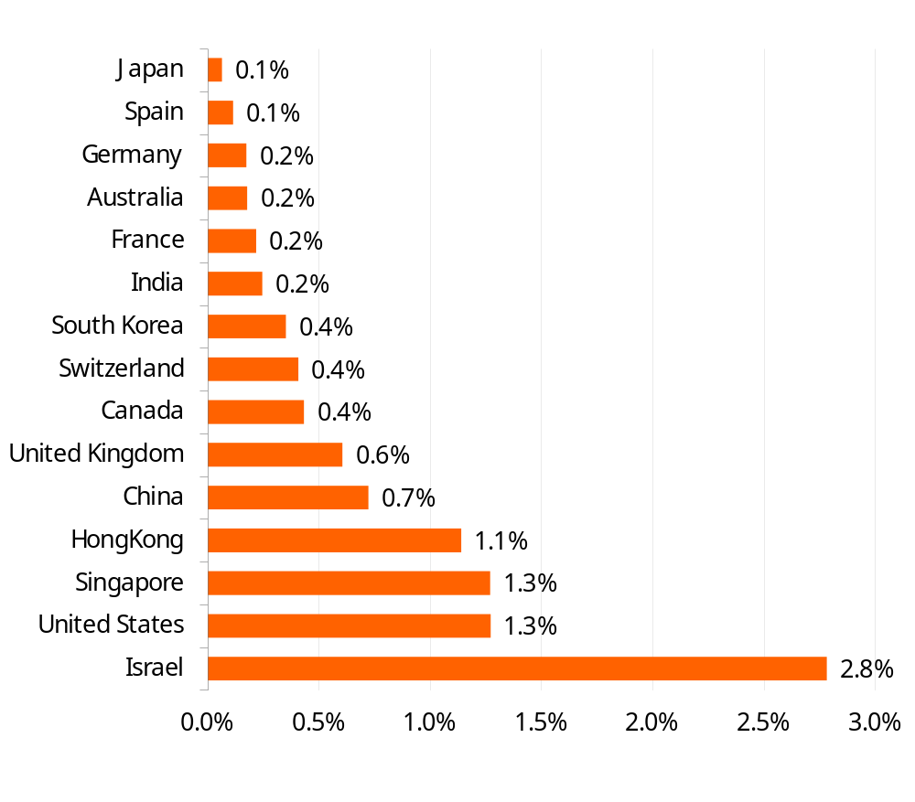
The US invested much more in AI than European countries
Private Investment in AI by geographic area (2013–22, Sum)
Sum of private investment in AI between 2013 and 2022 by geographic area as a percentage of 2022 GDP
Source: HAI AI Index Report 2023, LSEG Datastream, ING Calculations

Slide 15
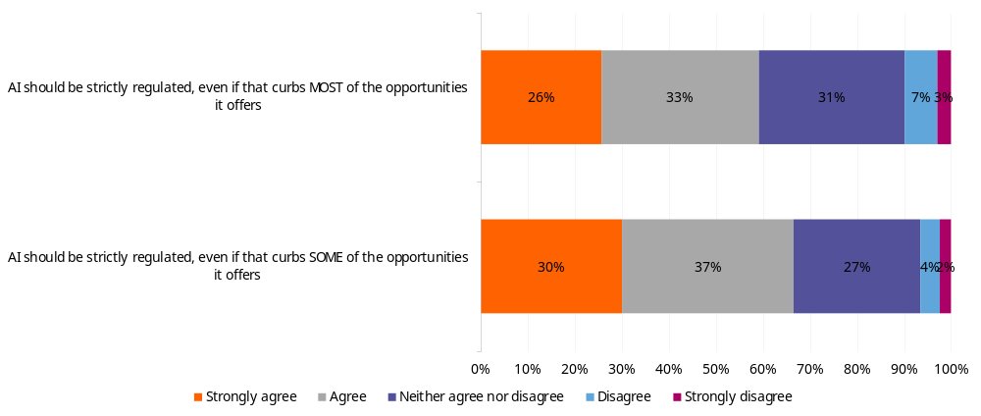
Large majority of Belgians in favour of strict regulation of AI
59%
67%
Source: ING Consumer Survey, conducted by Ipsos on a representative panel of 1002 Belgians

Slide 16
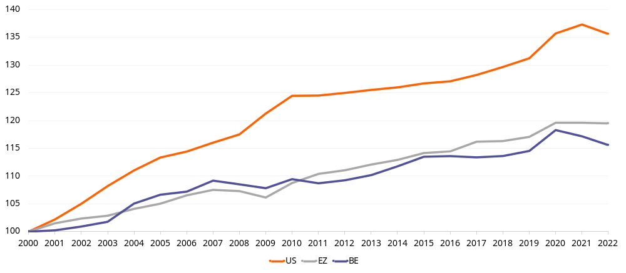
The productivity gap between Europe and the US is already wide and is likely to widen
Labour productivity (real GDP per hour worked)
2000 = 100
US
Belgium
Eurozone

