Slide 1





Slide 2

Introduction
Dr. Bart Vandersmissen
Headache consultant, Department of Neurology
Erasme Hospital, Brussels

Slide 3
Program Overview
Introduction
10:00 | Reception
10:30 | Introduction by Dr. Bart Vandersmissen, Department of Neurology at the Erasme Hospital in Brussels
Migraine is a taboo
10:35 | Kevin Thomas, Senior Research Expert at GfK: “Revelation of research results: “The social impact of migraine in Belgium”.
10:55 11:15 | Dr. Bart Vandersmissen, Department of Neurology at the Erasme Hospital in Brussels: The social impact of migraine. Christian Gérard, testimonial - living with migraine
11:20 | Pharmacist Alain Chaspierre, Secretary-General of APB: ‘‘Week of migraine, help breaking the taboo”
11:35 | Q&A
Interviews and lunch
11:45 | Interview possibilities
 | Light lunch
13:30 | End

Slide 4

Kevin Thomas
Senior Research Expert
GfK
Migraine is a taboo
Research results

Slide 5
Incidence of migraine in past 12 months
18%
65%
35%
18% migraine sufferers in past 12 months
2 out of 3 migraine sufferers are female
At least 1 attack per week /
At least 1 attack per month

Slide 6
Intensity & discomfort of pain
Severe pain intensity: headache
Severe pain intensity:
migraine
4%
63%
Discomfort of pain
Migraine sufferers: 7,4
Headache sufferers: 5,3
0
1
2
3
4
5
6
7
8
9
10

Slide 7
Duration

Slide 8
Migraine is a taboo in the job environment
37% of migraine sufferers goes to work at least once a month despite having had a migraine attack that morning
37%
Top2
48%
43%
32%
26%
24%

Slide 9
Migraine is a taboo in the job environment
34% of migraine sufferers believes that migraine is not talked enough about at work
34%
20% of migraine sufferers agrees it’s hard for migraine sufferers to make a career
20%
52%
52% of migraine sufferers believes that migraine has
a negative impact on professional life

Slide 10
Migraine is a taboo in the family life
Top2
67%
44%
45%
43%
35%
26%

Slide 11
Migraine is a taboo in the family life
27% of migraine sufferers finds it hard to manage
a family as migraine sufferer
27%
49% of migraine sufferers concludes that migraine has a negative impact on family life
49%

Slide 12
Migraine is a taboo among friends
Top2
44%
35%
22%
55% of migraine sufferers believes migraine
has a negative impact on social life
55%

Slide 13


Information channels
26% of migraine sufferers has looked up
info on migraine on the internet last year
26%
55%
55% of migraine sufferers indicates the pharmacy
is the ideal channel to receive information

Slide 14
Dr. Bart Vandersmissen
Headache consultant, Department of Neurology
Erasme Hospital, Brussels
The social impact of migraine

Slide 15
Overview
migraine definition
migraine impact
  why
  where
  how much
  measure
  treatment

Slide 16
Definition
DEFINITION MIGRAINE
> criteria IHS:
At least 5 attacks fulfilling criteria B-D
Headache attacks lasting 4-72 hours (untreated or unsuccessfully treated)
Headache has at least two of the following characteristics:
      Unilateral location
      Pulsating quality
      Moderate or severe pain intensity
      Aggravation by or causing avoidance of routine physical activity
      (e.g. walking or climbing stairs)
D. During headache at least one of the following characteristics:
    Nausea and/or vomiting
    Photophobia and phonophobia
E. Not attributed to another disorder

Slide 17
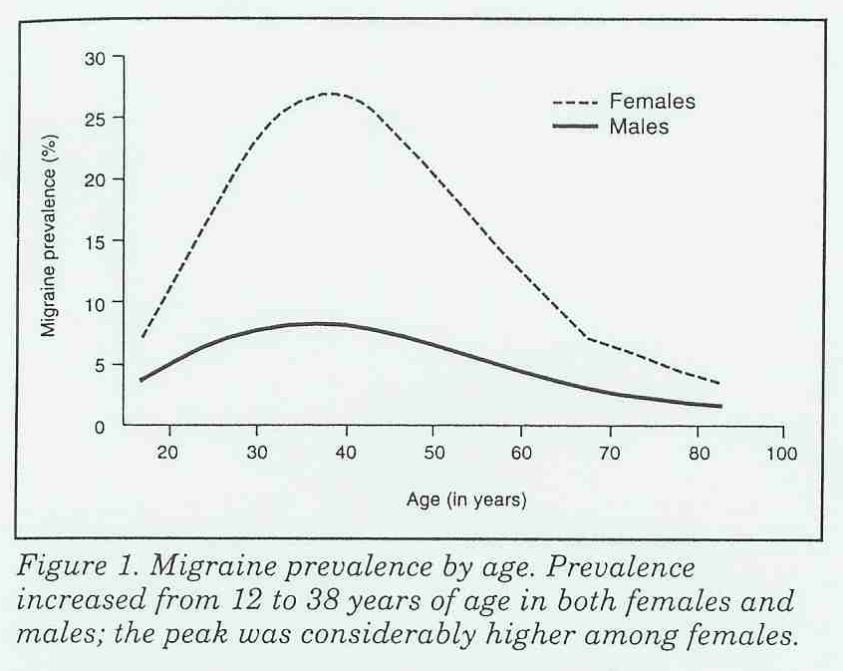
Definition
PREVALENCE
Lifetime +/- 20%
  30% of females
  10% of males
1 year +/- 12%
  18% of females
  6% of males
Source:
Neurology 1993; 43(suppl 3):S6-S10
1. Very frequent pathology
2. Females > males
3. Mostly during productive years

Slide 18
Impact of migraine: why
high prevalence
mainly young productive population
underdiagnosed
undertreated
more then a headache
highly disabling

Slide 19
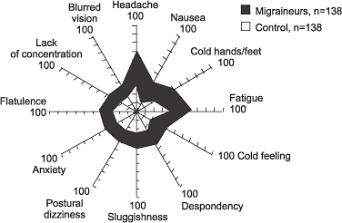
Impact of migraine: why
Source:
Drugs Today (Barc). 2003;39 Suppl D:17-23. Measuring disability and quality of life in migraine.

Slide 20

Impact of migraine: why
Direct: Pain, nausea, FF/SF
Indirect: Emotional stress, anticipation, anxiety, depression, medication dependency, …
> WHO disability/handicap degree ranking:
19th (females 12th) amongst psychosis, dementia, quadriplegia, …

Slide 21
Impact of migraine: why
high prevalence
mainly young productive population
underdiagnosed
undertreated
more then headache
highly disabling

Slide 22
impact of migraine: where
Different levels:
- Patient
- Direct environment (family/work)
- Society
Impairs normal tasks at home
Obstructs family obligations
Obstructs social plans
Absenteeism from work/school

Slide 23
impact of migraine: how much
Depends on frequency and intensity
Important variability in attack frequency:
    60% < 8 days/year
    25% 8-14 days/year
    15% > 14 days/year
Important variability in intensity:
slight ←-----------------------------------------------→ very severe
= completely incapacitated
Direct symptoms: Pain, nausea, FF/SF
Indirect symptoms : Emotional stress, anticipation, anxiety, depression

Slide 24
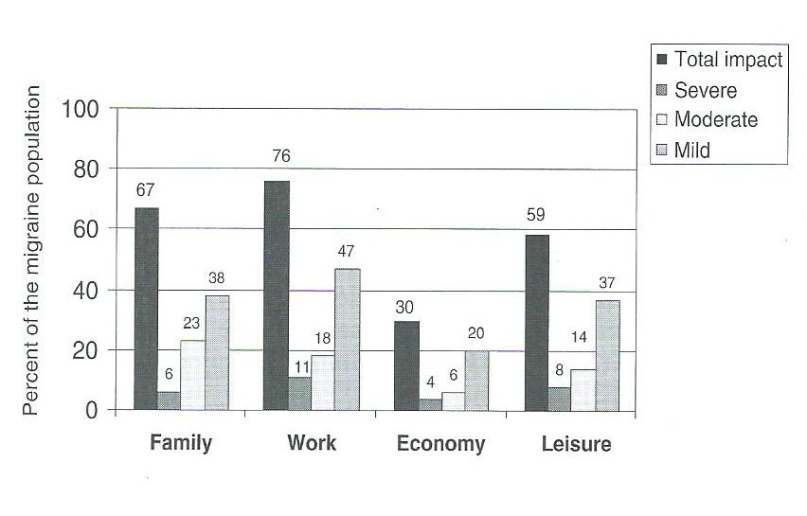
impact of migraine: how much
Linde M, Dahlöf C.
Cephalalgia. 2004 Jun;24(6):455-65.

Slide 25
impact of migraine: how much
Society
25 % direct healthcare costs
  Emergency and office room visit, hospitalisation, drugs, …
  Healthcare costs migraine family +/- 70% higher in US study
75% indirect socioeconomic costs (loss of productivity)
  Absenteeism
  Reduced functional status at work (presenteeism)
Different studies > mean days and productivity loss:
- Absenteeism: 2,5 days/year
- Presenteeism: 3,5 days/year (< productivity level 45%)
6 days/year lost for every migraine patient
- 85% by 10% most disabled > 7w/year
- 15% by other 90%
Steiner TJ, et al.
Cephalalgia. 2003 Sep;23(7):519-27.

Slide 26
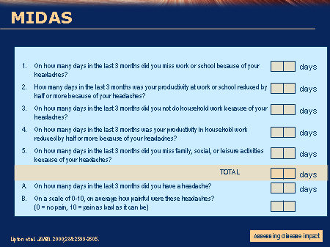
impact of migraine: measure
MIDAS (Migraine Disability Assessment Test )
0 to 5 MIDAS Grade I : Little or no disability
6 to 10 MIDAS Grade II: Mild disability
11 to 20 MIDAS Grade III: Moderate disability
21+ MIDAS Grade IV: Severe disability

Slide 27
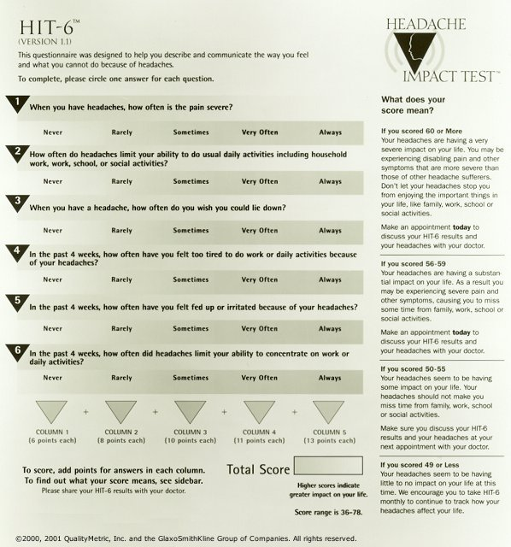
impact of migraine: measure
HIT-6

Slide 28
impact of migraine: treatment
Identify migraine triggers and aggravating factors
Attack treatment :
- light: simple/combined analgesics or NSAID
- moderate/severe: triptans
Preventive treatment
Treatment associated psychopathology (anxiety, sleep disorder, depression,…)
Goal treatment = reduction of
1/ headache intensity
2/ headache frequency
-> also reduction impact social and professional functioning

Slide 29
Christian Gérard
La ligue belge contre les céphalées
Testomonial

Slide 30
Alain Chaspierre
Secretary-General of APB
General Pharmacist Association
The Week of Migraine

Slide 31
Facts
Almost 1/5 of all Belgians suffered from migraine during the past 12 months (18%)
Migraine ≠ Headache
Migraine is a taboo among friends, within the family and job environment.
Pharmacists can play a key role
Specific health campaign for pharmacists, migraine sufferers and the general public:
“Semaine de la MIGRAINE” / “Week van de MIGRAINE”

Slide 32
Objectives
Help breaking the migraine taboo in the job environment, family and among friends and help migraine patients break out of their social isolation by
  Uniting them with peers
  Evoking them to talk about migraine with family, friends and colleagues
Inform the general public, migraine sufferers and pharmacists about migraine and support the pharmacist in his role as first contact point.

Slide 33
CAMPAIGN MATERIALS

Slide 34
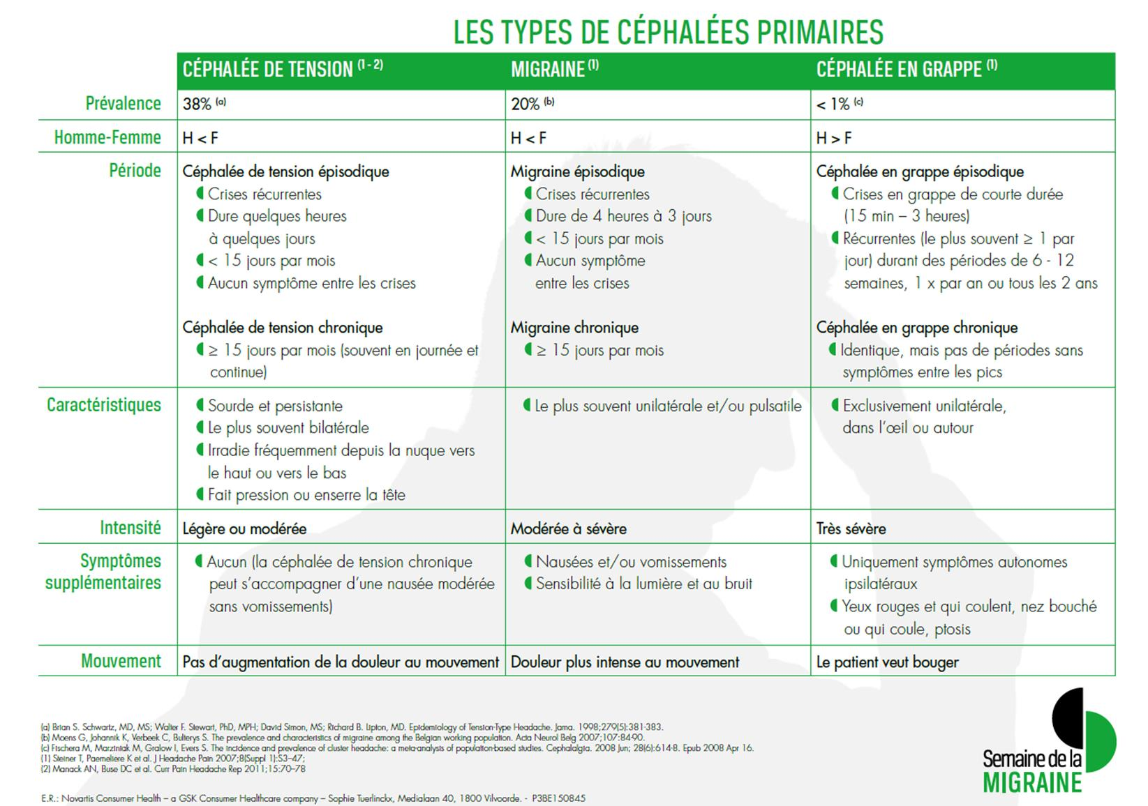
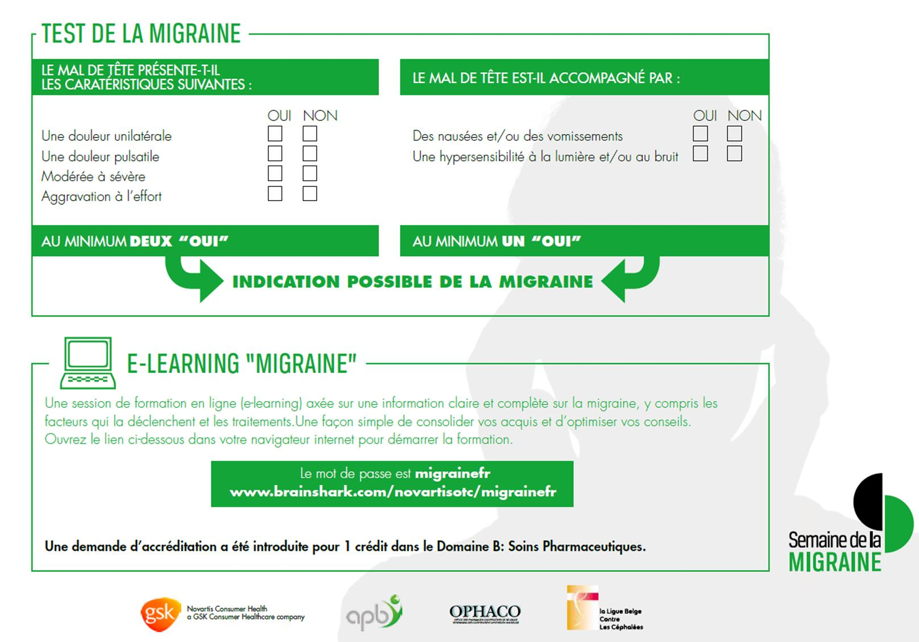
Campaign Materials
Informative leaflet with migraine test
Notes:
Liste des caractéristiques des différents types de céphalée primaire
Test de migraine : le pharmacien peut effectuer le test avec le patient et lui donner une premère indication s’il souffre de migraine ou d’un autre type de céphalée.

Slide 35
Campaign Materials
E-learning
Notes:
L’outil d’e-learning permet au pharmacien d’affiner ses connaissances sur la migraine, ses déclencheurs et ses traitements.

Slide 36


Campaign Materials
Poster
Notes:
Brochure destinée au patient

Slide 37
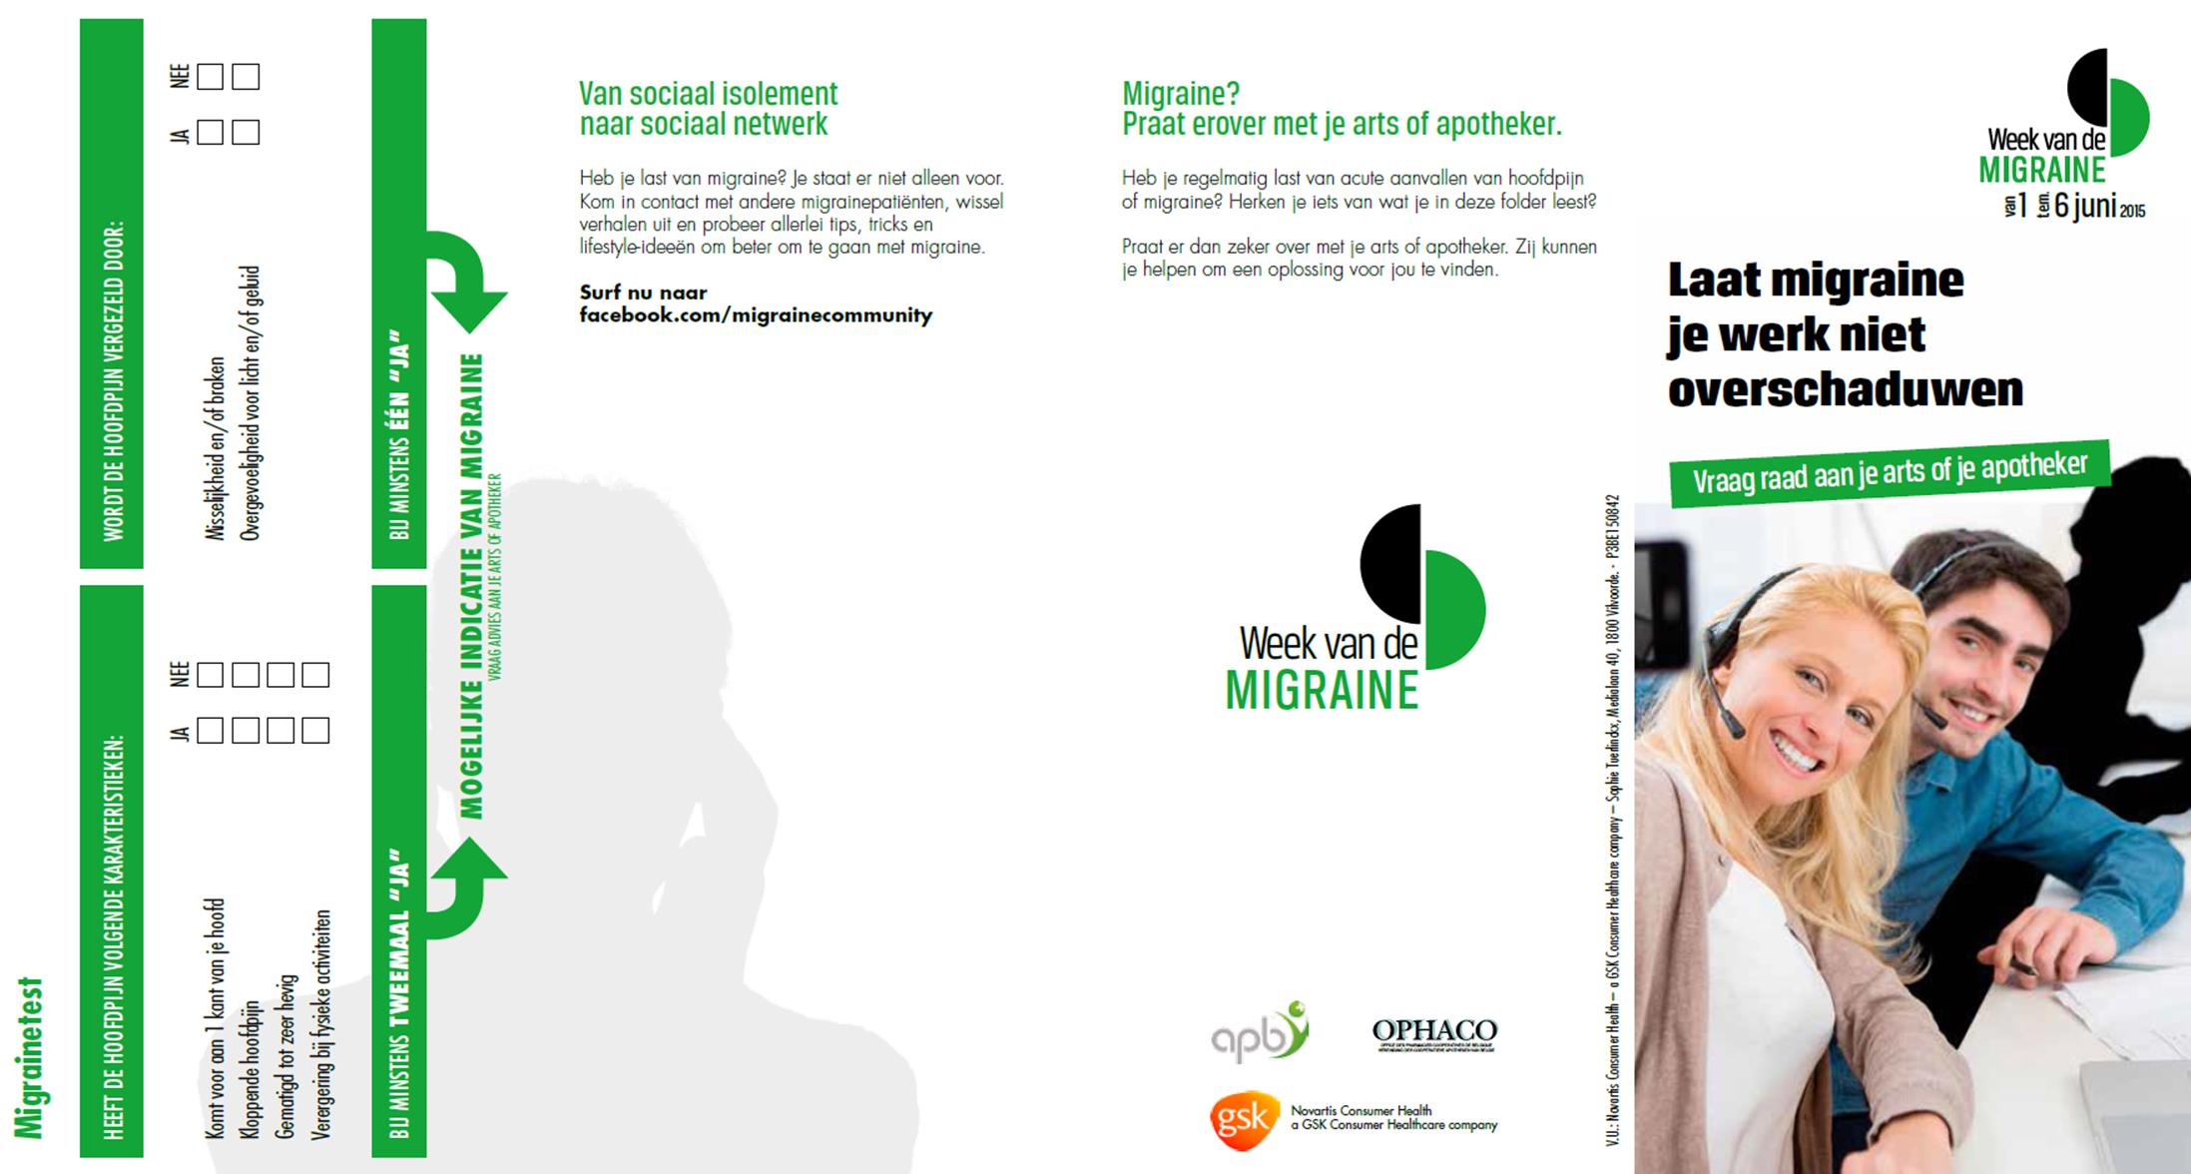

Campaign Materials
Brochure
Notes:
Brochure destinée au patient

Slide 38
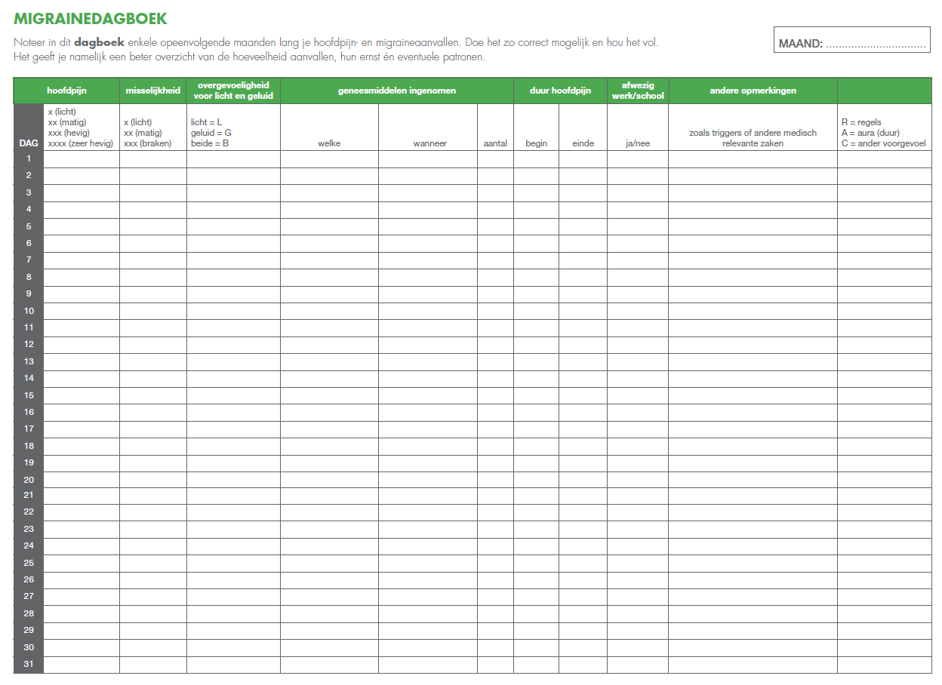
Campaign Materials
Migraine diary
Notes:
Le pharmacien peut remettre au patient un journal de la migraine où consigner, pendant plusieurs mois successifs, le déroulement des crises de migraine et de céphalée.
Le journal de la migraine donne au patient un aperçu plus clair de la fréquence et de la sévérité des crises. Des schémas peuvent alors être établis.
Le patient peut présenter son journal lors de sa prochaine visite chez le pharmacien, le médecin ou le spécialiste.
Les professionnels de la santé disposent ainsi d’un document clair qui peut les aider à poser un diagnostic, à identifier les déclencheurs et à choisir un traitement.

Slide 39

Migraine Community
http://facebook.com/migrainecommunity
Notes:
Le pharmacien peut renvoyer ses patients vers cette communauté pour qu’ils y partagent leurs expériences avec d’autres personnes concernées.

Slide 40
Take home message
When a patient turns to his pharmacist with headache-related questions, the pharmacist can and should counsel the patient and/or refer to a medical doctor.
On the occasion of the Migraine Week, pharmacists are offered all the appropriate tools in support of this counselling role

Slide 41
Q&A

